Slide 1
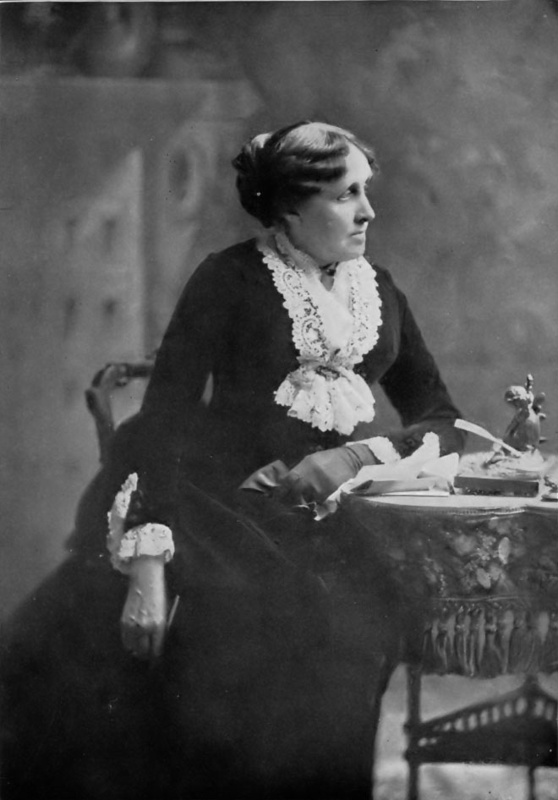
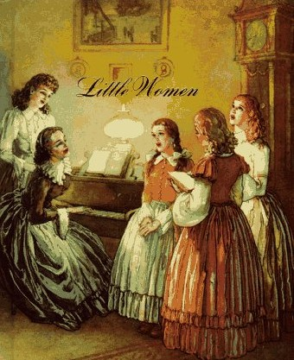
Louisa May Alcott

Slide 2
Read ex.1 p. 16 Remember as much as you can about the author!

Slide 3
Find a mistake and say correctly
…was born in 1888.
…grew up in a rich family in London, England.
…was one of four brothers.
…is best known for her books for adults mostly, especially “Old Men”.
This novel reflects her father’s life and experiences.
The book is about loves and lives of 4 young brothers during American Civil War.
Meg, Jo, Beth and Amy live with their Dad while their Mom is away at war.

Slide 4
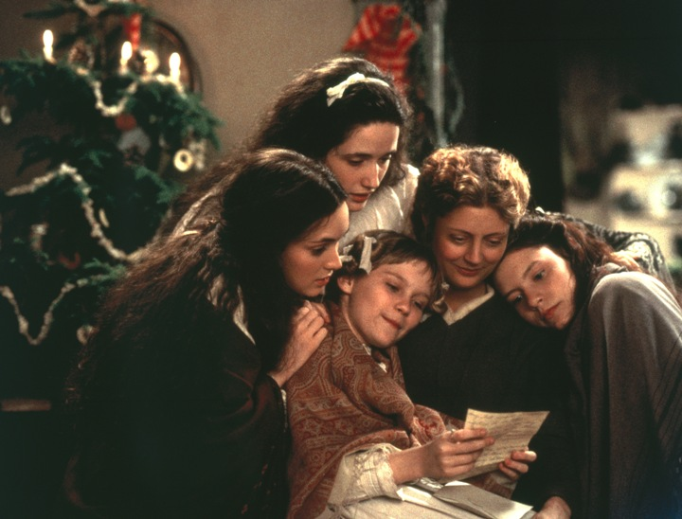
Listen to the story and be ready to answer the questions from ex.3 p. 16.

Slide 5
Find the synonyms (highlighted words)
interrupted
loose/flowing
strong
moving her body
old and useless
growing fast
arms and legs
not thin
cheered up
talking
cut in
fly away
decisive
carrying herself
worn out
rapidly shooting up
limbs
plump
brightened
lecturing

Slide 6
Translate using new words:
Он прервал меня гневными словами.
«Сумерки» – известное стихотворение Байрона.
Снегурочка – внучка Деда Мороза.
Мои тапочки очень изношены.
Приятная атмосфера домашнего уюта наполнила дом перед Рождеством.

Slide 7
Match the underlined parts with the explanation below:
Who is very polite
Leaving it
She rarely lost
A typical pale beauty
Bothered her/made her feel awkward
Quite a few paintings
Mindful of her manners
Venturing out
Which were very much in her way
A regular snow-maiden
Was seldom disturbed
A good picture or two

Slide 8
Form compound adjectives:
Baby face
Blue eyes
Short legs
Stiff neck
Broad shoulders
Kind heart
Sharp tongue
Wide eyes
Cold heart
Dark hair – dark-haired

Slide 9
What /who was it said about?
Shy manner
Timid
Peaceful expression
Miss Tranquility
Sharp & Comical
Fierce, Funny And Thoughtful
Bundled In A Net
The youngest
Pale and slender
Curling hair
Knitting in twilight
Crackled within
Faded
Bloomed
Plain
Home-peace
The eldest
Plump
Vain
Soft brown

