Slide 1
What is hot with young generation?
Tsatsina Ksenia, 9 «V» class
Sergach, Russia 2017

Slide 2
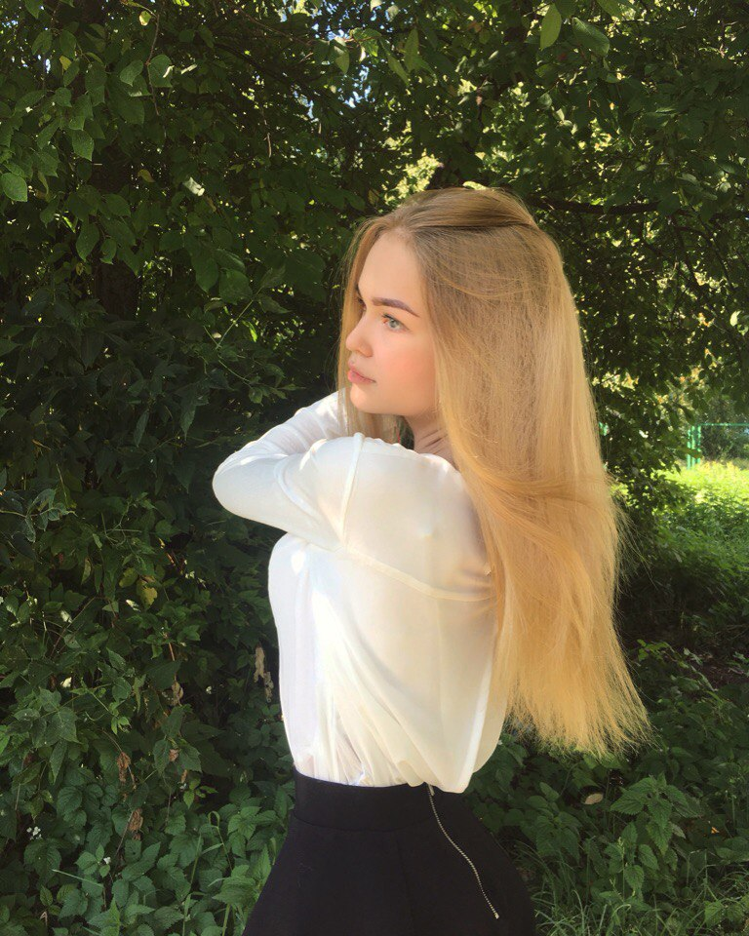
Personal information
My name is Ksenia
I am 14 years old
I live and study in the small town Sergach, Russia
I like to learn English and to practice journalism
I have a best friend, a loving family and beloved cat

Slide 3
Family and friends
Family
My parents always support me and give me advice. From an early age I was taught not to mess with the wrong people and make friends only with trusted people.
Friends
As parents, I listen to my friends. We love spending time together. In the summer we often walk in the street. In the winter we go skating, or watch movies at home.

Slide 4
My opinion
. The current young generation is very diverse. The tastes of young people differ from the tastes of young people of 80-90 years. Remember the teenage years of our parents. They studied a lot in school, talked with friends and parents without internet. Currently, the preference of teenagers is very poor. Dependence on bad habits from video games, from the Internet . Teenagers are pretty rough, cruel. Their reputation and health play a small role in life.
Only a small number of teenagers think about their health and future. Many do sports. They have skills in different areas (music, art, sports) They are Not impacted by the "coolness" of peers that do not depend on bad habits.

Slide 5
Hobbies
Every teenager has a hobby. Entertainment adolescents are very diverse. Someone that likes to spend time with benefits, and someone with harm. Their entertainment is divided into positive and negative. My hobby is walking with my friends, study English, read books about self-improvement and travel with parents.

Slide 6
Teenagers interests
Positive interests
Music
Communication
Sport
Negative interests
Bad habbits
Internet dependence
Bad entertainment

Slide 7
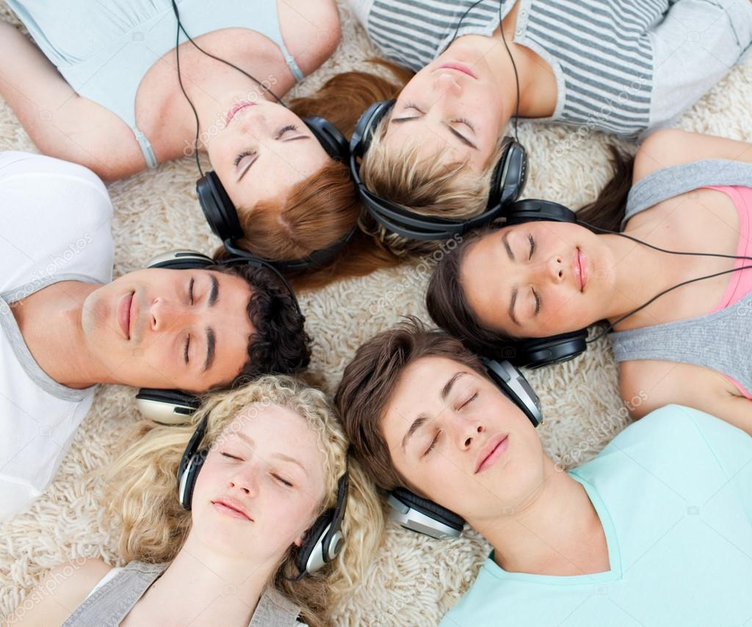
Music
Teenagers like to listen to music. Someone is a music lover, and someone like a certain genre of music.
The types of music
Folk music
Rock music
Pop music
Hip-hop/rap music
Jazz

Slide 8
Communication
Teenagers love to communicate in real life and online. Many communicate only in the Internet because of his shyness and uncommunicative. Someone who likes to chat and spend time in real life. I choose the communication without the Internet.

Slide 9
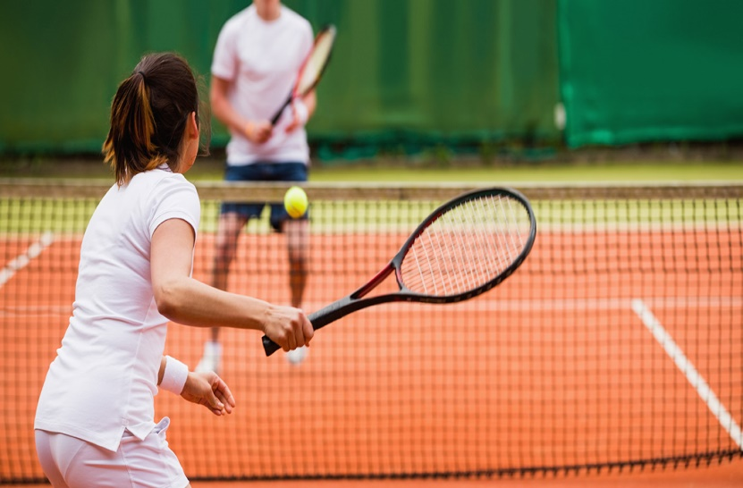
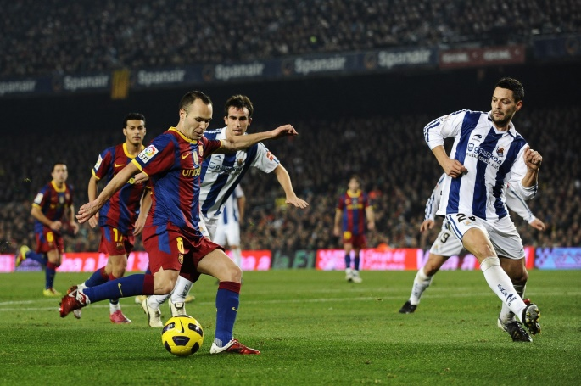
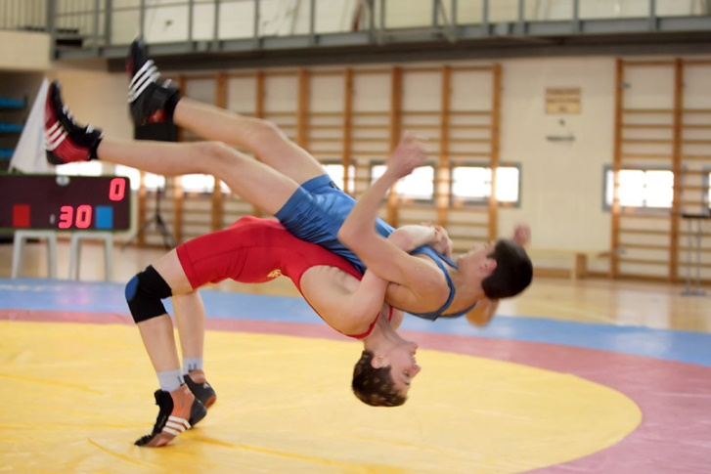
Sport
Many Teens play sports. Someone involved in sports for many years , for some it's a hobby.
Types of sport
Hockey
Football
Fights
Pastime in gym
Tennis

Slide 10
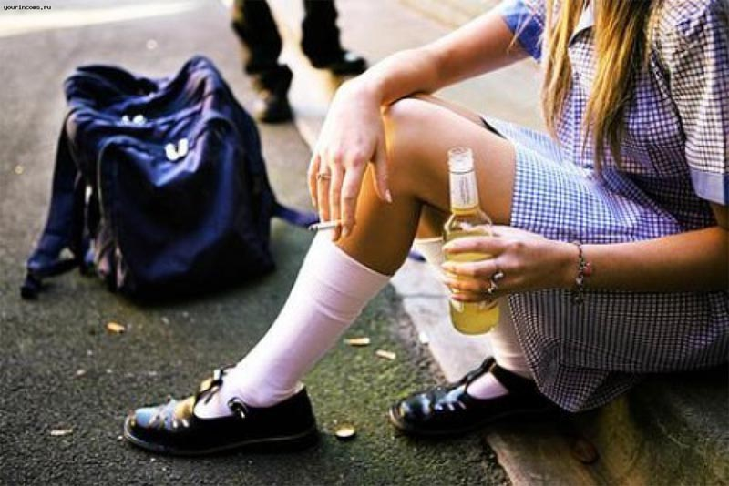
Bad habbits
Attachment to bad habits is very bad. These habits have many teenagers.
- Smoking
- Alcohol
- Drugs

Slide 11
Internet dependence
Internet addiction has many teenagers. Computer games is the same addiction.
negative influence on teenagers
- Deterioration of health - Aggression
- The drop in the level of education
- Unsociable
- Bad grades in school

Slide 12
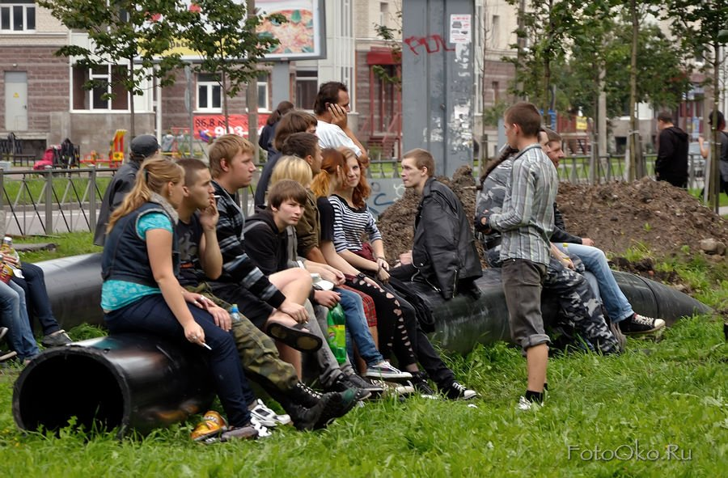
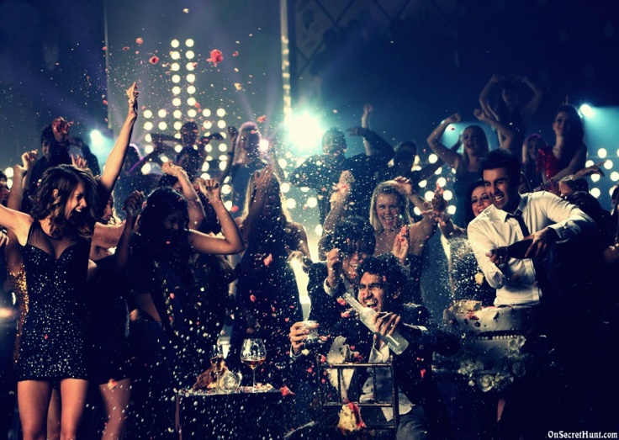
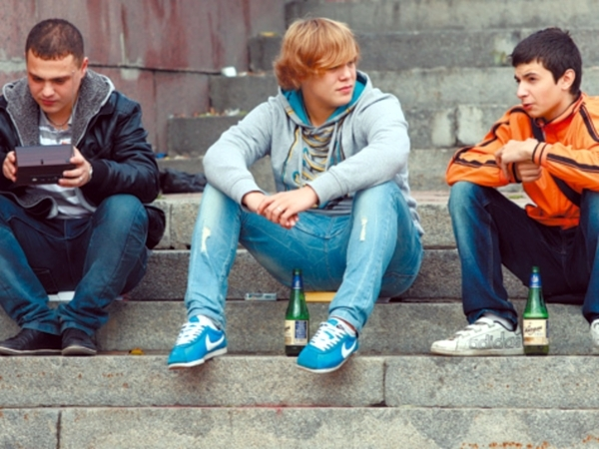
Bad entertaiment
Bad entertainment is spending time with bad company , walk in abandoned and old places, attend parties with drugs and alcohol. A teenager can communicate with bad company, which is very bad for him.

Slide 13
Conclusion and my goals in life
I believe that the current generation of Teens need to listen to parents 'and friends' opinions. Teenage time is the most important in life, and his need to live well and sensibly.
My goals in life is to achieve maximum success in linguistic and journalistic activities. To devote more time to the sport. Appreciate and love my friends and parents.

