Slide 1
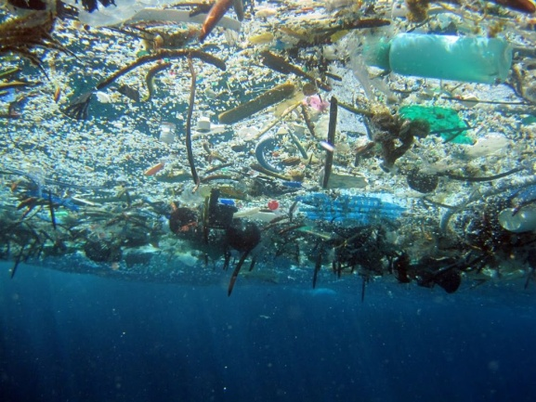
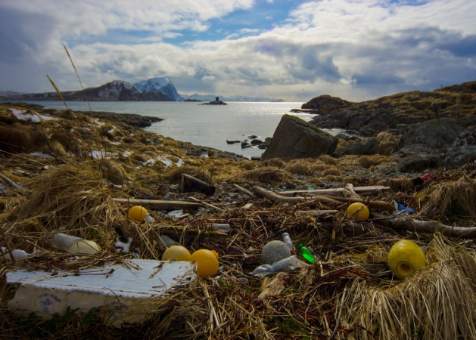
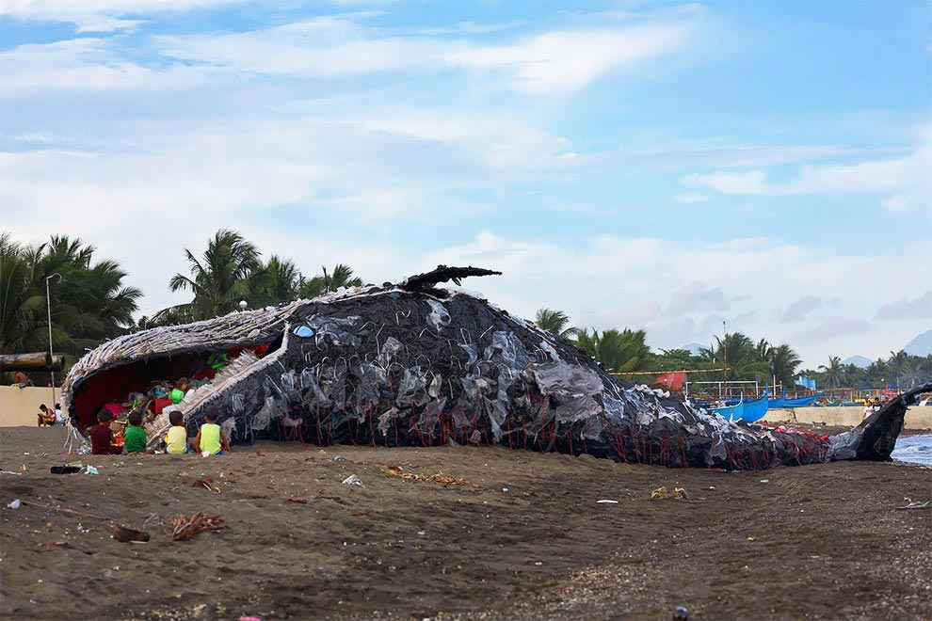
Marine debris
Completed: Anastasia Markina
Class: 10Б

Slide 2
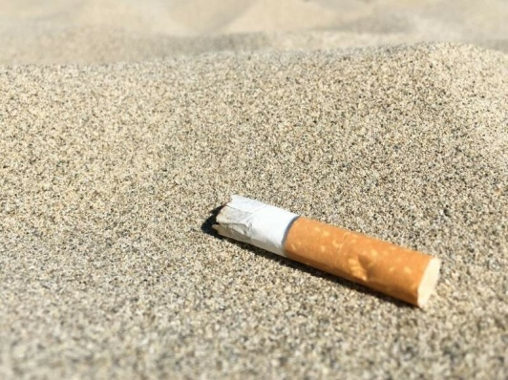
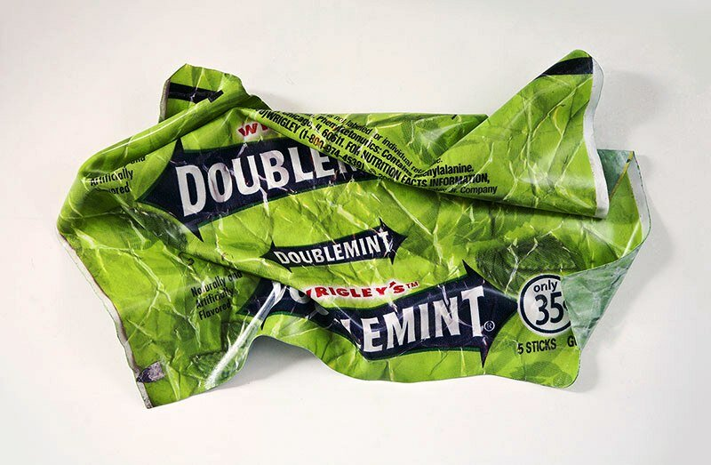
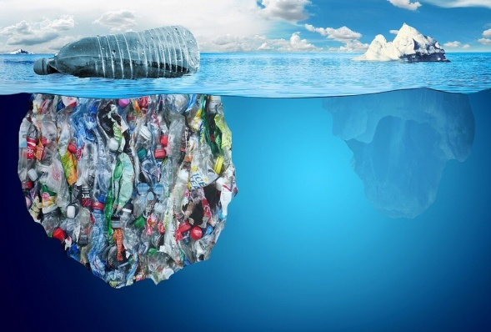
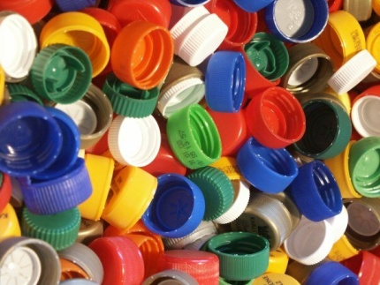
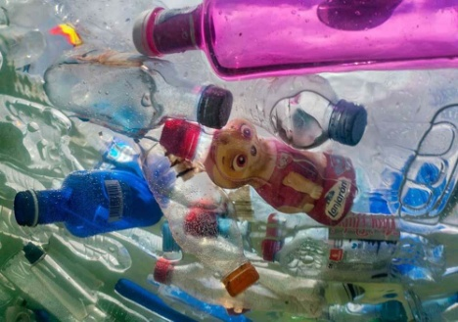
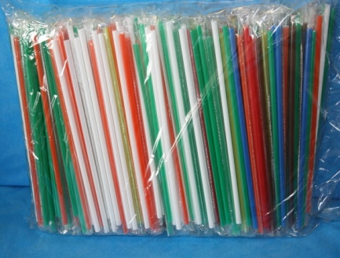
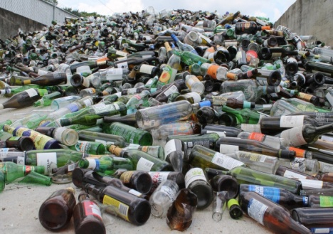
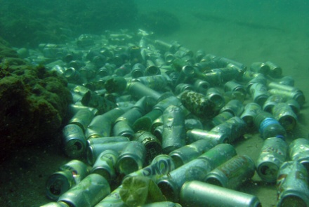
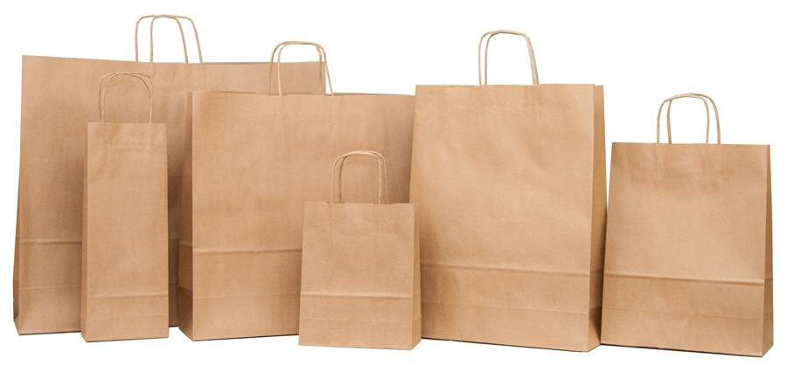
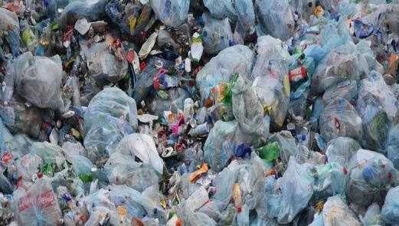
Marine debris varieties:
1) Сigarettes 2) Food wrapper 3) Plastic bottles
4) Plastic plugs 5) Plastic utensils 6) Straw tubes 7) Glass bottles
8) Cans 9) Paper packets 10) Plastic bags

Slide 3
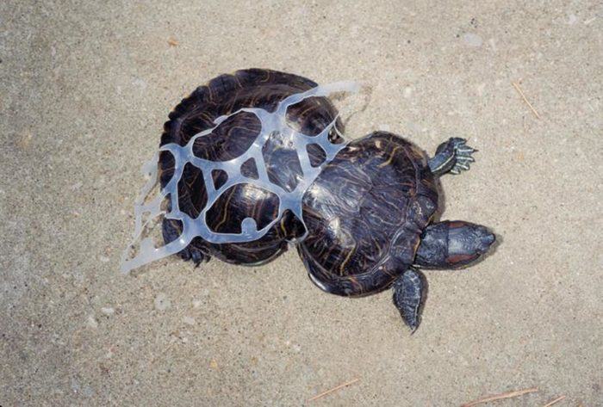
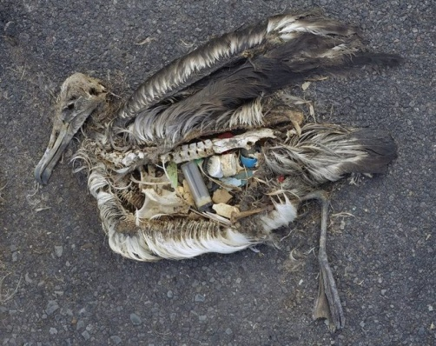
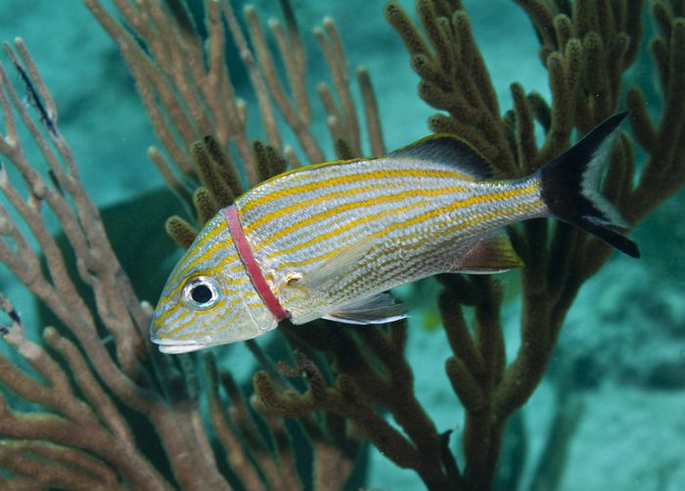
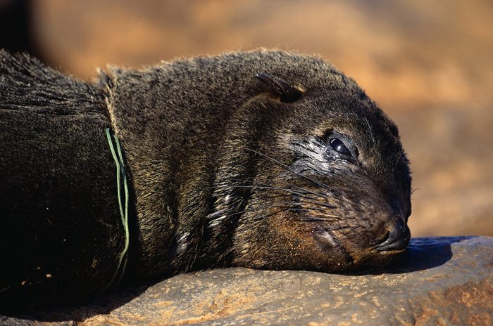
The shocking effects of ocean pollution
The amount of debris that already covers the surface and is in the thin water of the ocean cannot even be calculated. Everything that we throw into the landfill - from bottle caps, plastic utensils to various tools - sooner or later ends up in the water and kills fish and animals inhabiting the oceans and seas.
Tortoise with distorted shell due to plastic garbage. A dead albatross with a stomach full of plastic debris.
A fish stuck in a plastic ring. A SEAL who died of strangulation with a plastic rope.

Slide 4
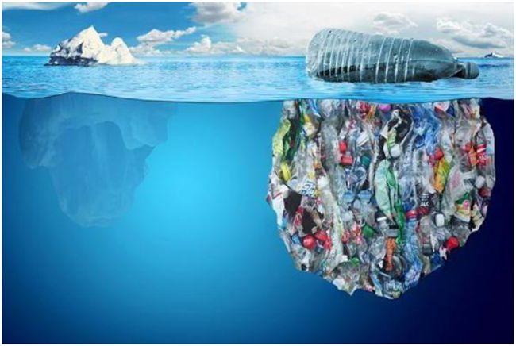
How to deal with the problem?
1) Reduce the amount of plastic and polyethylene used, giving preference to containers and packages made of natural materials: fabric and paper bags and bags, wooden and cardboard boxes, etc.
2) In no case throw objects from any kind of plastic into water, on the ground or even into the total mass of garbage, but store them in special containers marked "for plastic" or hand them over to recycling points for subsequent processing and recycling.

Slide 5
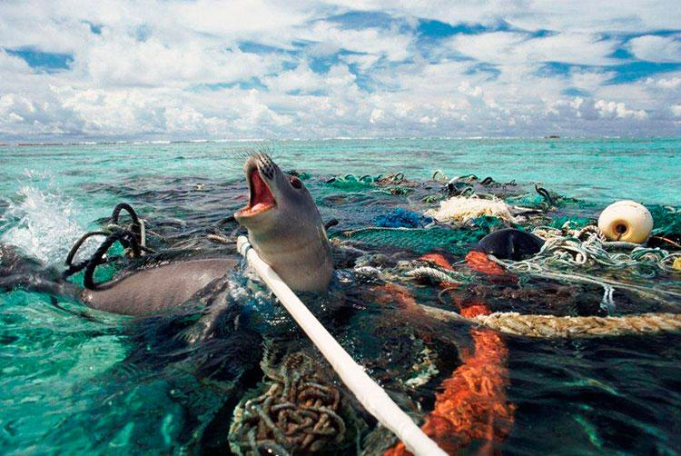
Thank you for your attention!
! Take care of nature, friends !

