Slide 1
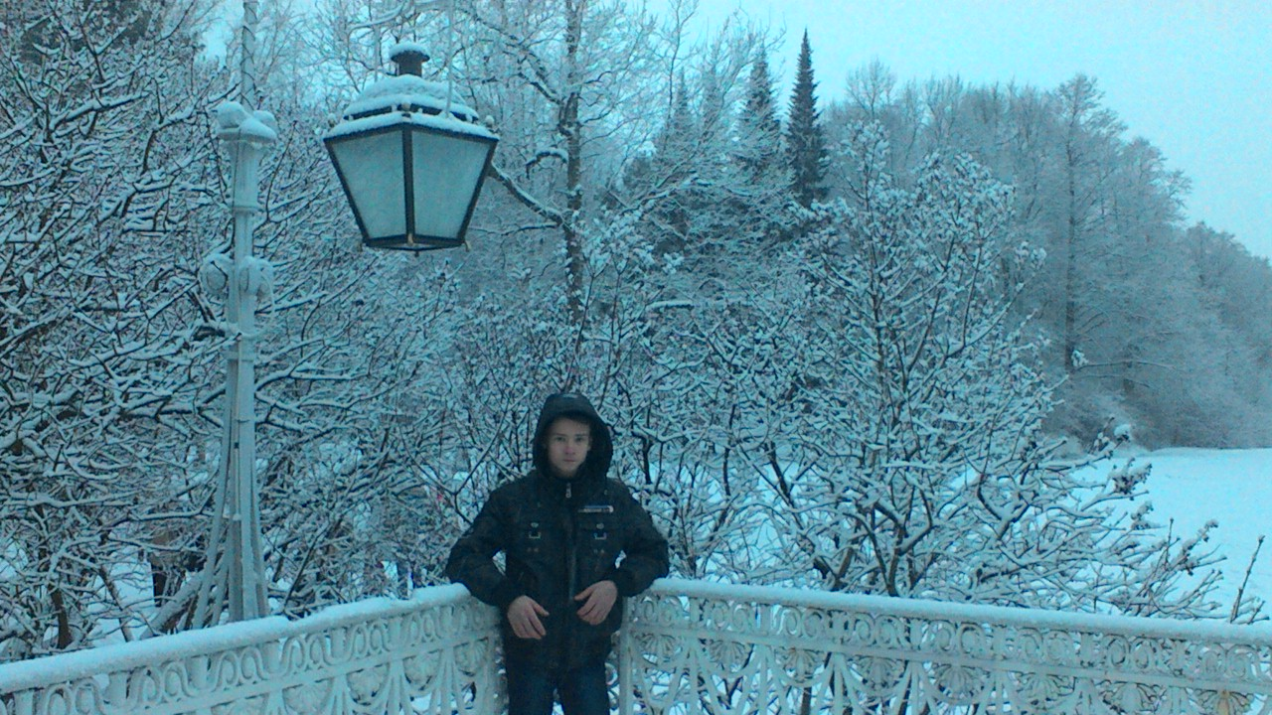
My Winter Holidays
Saint-Petersburg
2015

Slide 2
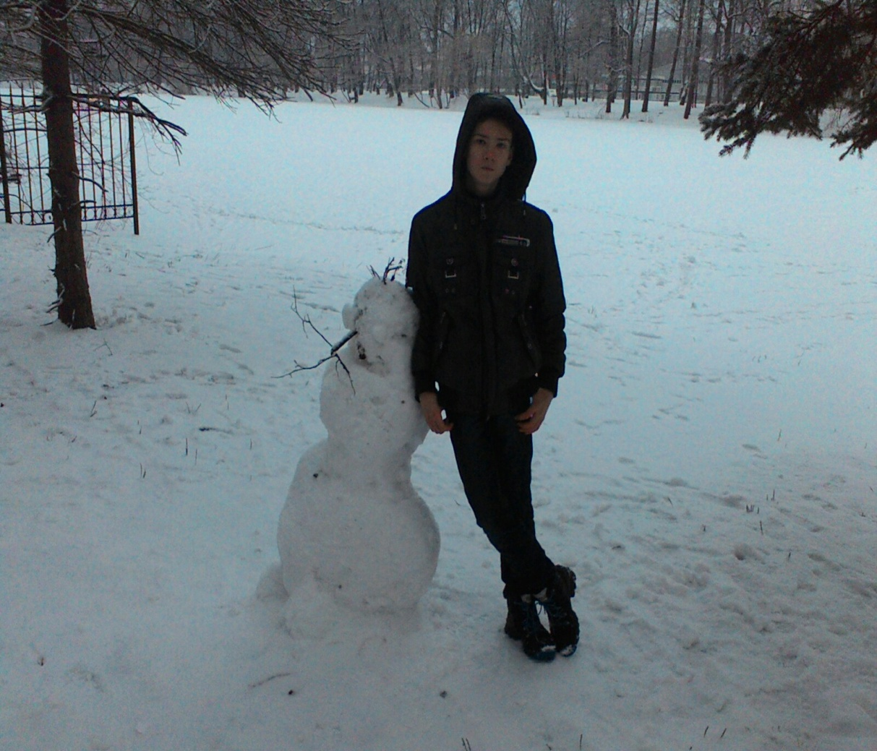
During my winter holidays I went for a walk a lot.
On Sunday I visited the Central Park on Elagin Island

Slide 3
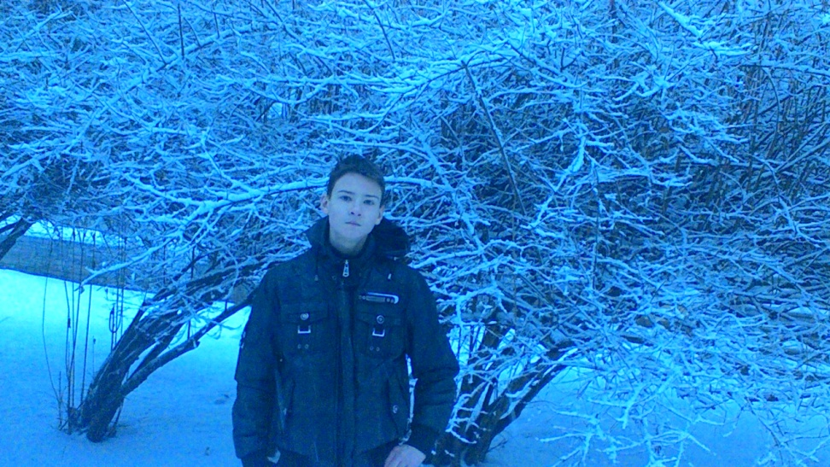
The weather was cold and snowing.
The trees were covered by snow.

Slide 4
The Park was beautiful,
decorated by fir-trees and colourful lights.

Slide 5
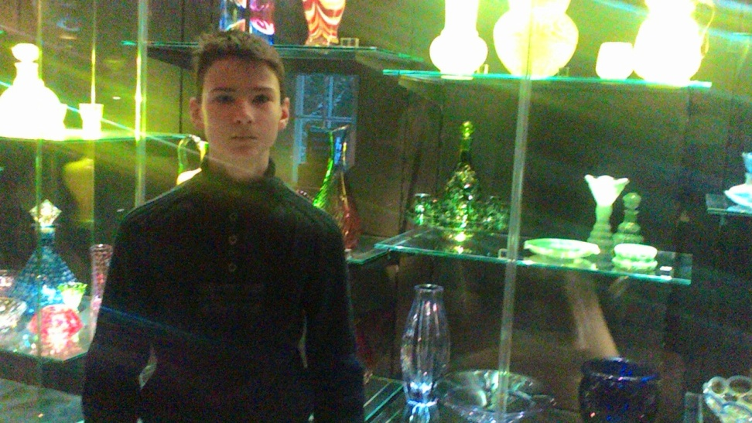
I visited the Art Glass Museum.
There were a lot of wonderful glass articles:
vases, dishes, glasses and others.

Slide 6
I enjoyed the pictures by the artist Vitalii Ermolaev.
They are called INNER LIGHT because
the pictures are glowing in the dark.

Slide 7
I visited the Elagin palace as well.
The assembly halls were beautiful.

Slide 8
I think my winter holidays were cool!

Slide 9
Thank you for your attention!

