Slide 1
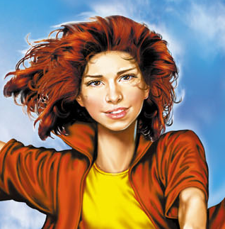
Dmitry Emts
«Tanya Grotter»
(The Plot)
Morozova Alexandra
School #106
7 “D” class
Saint-Petersburg
Учитель ангийского языка
Шайдурова Валентина Федоровна
ГБОУ «Школа №106»
Санкт-Петербург
2015

Slide 2
“Tanya Grotter” by Dmitry Emts
is a fantasy story about adventures of a little girl.
This is her picture.

Slide 3
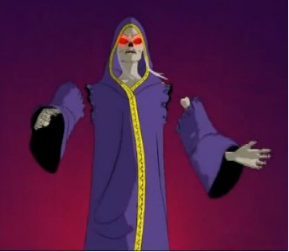
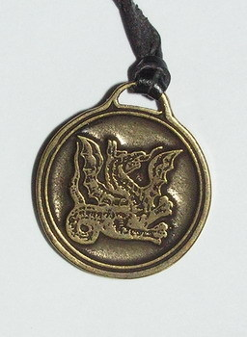
Tanya’s parents were killed by the cunning witch.
Tanya was saved and alive
because she had a magic amulet.

Slide 4
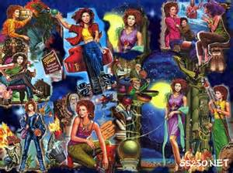
She was brought up in her uncle’s family.
Her childhood was extremely difficult:
troubles, love, choice, death, deceit and secrets.

Slide 5
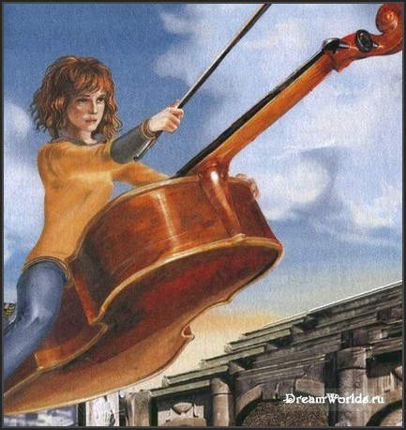
At the end of the story
Tanya became a great magician.

Slide 6
Sources
https://www.bing.com/images/search?q=%d1%82%d0%b0%d0%bd%d1%8f+%

