Slide 1
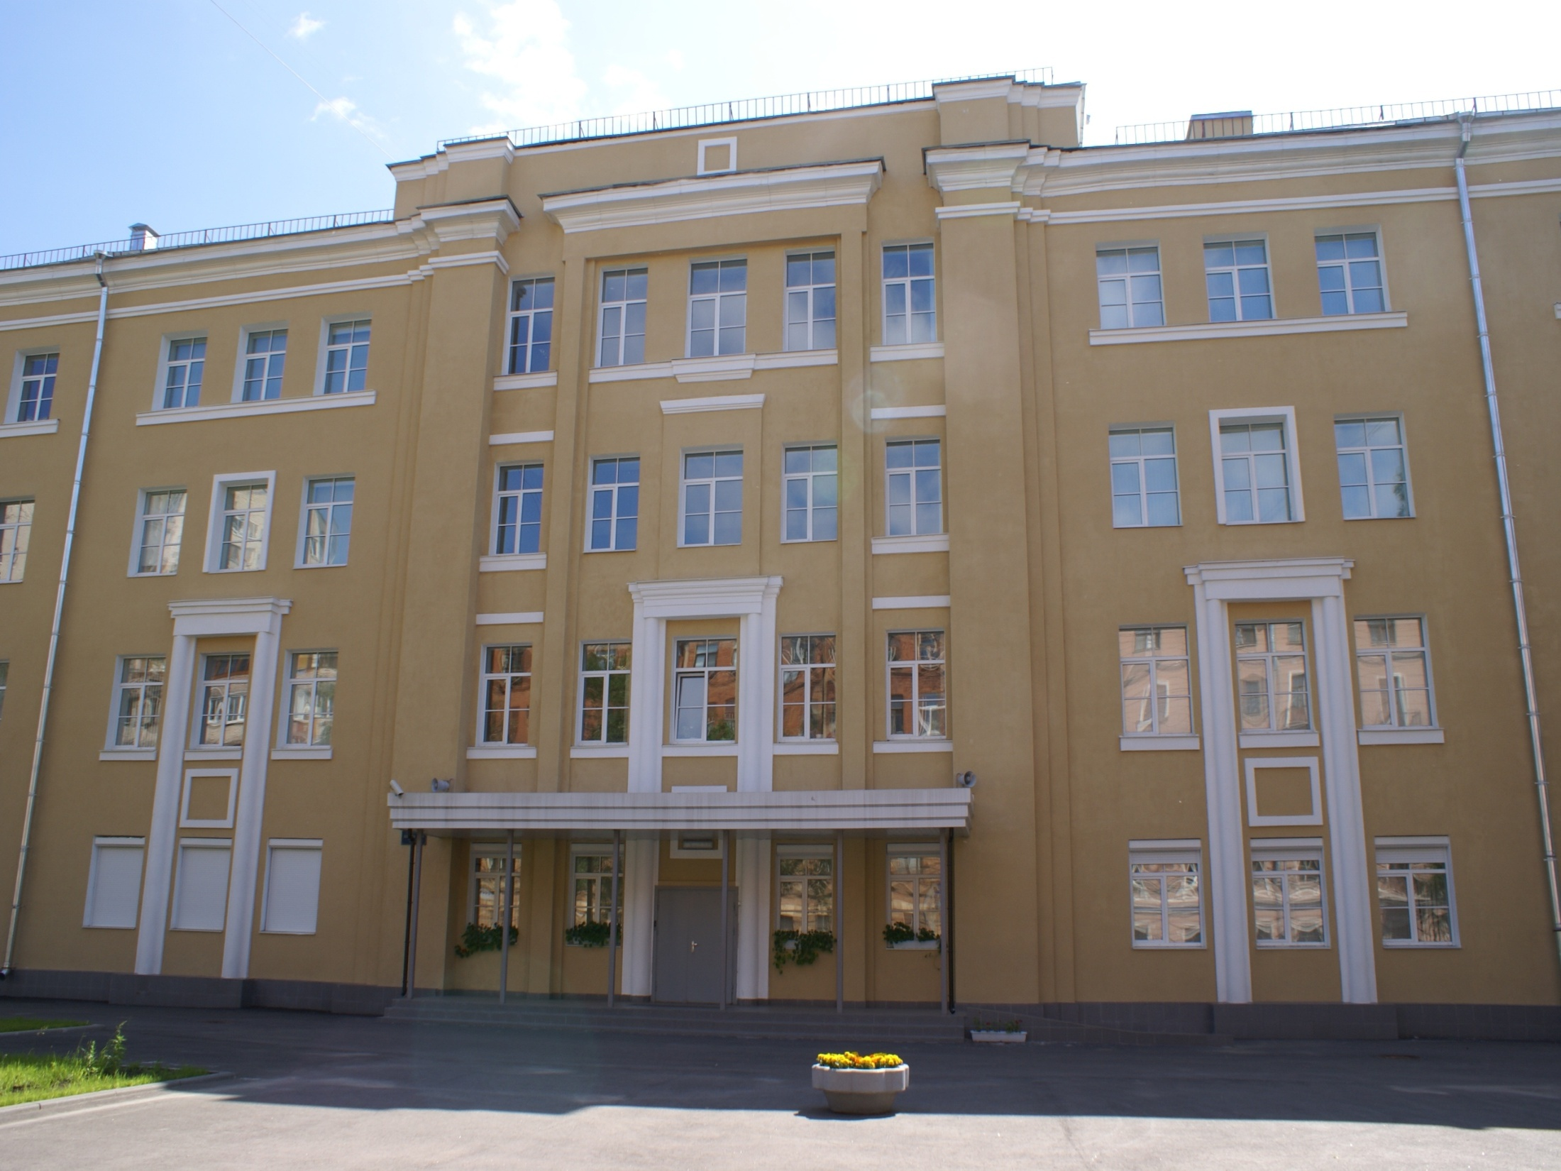
State School № 106

Slide 2
Our school is over 100 years old.
It’is an old school in a modern building.

Slide 3
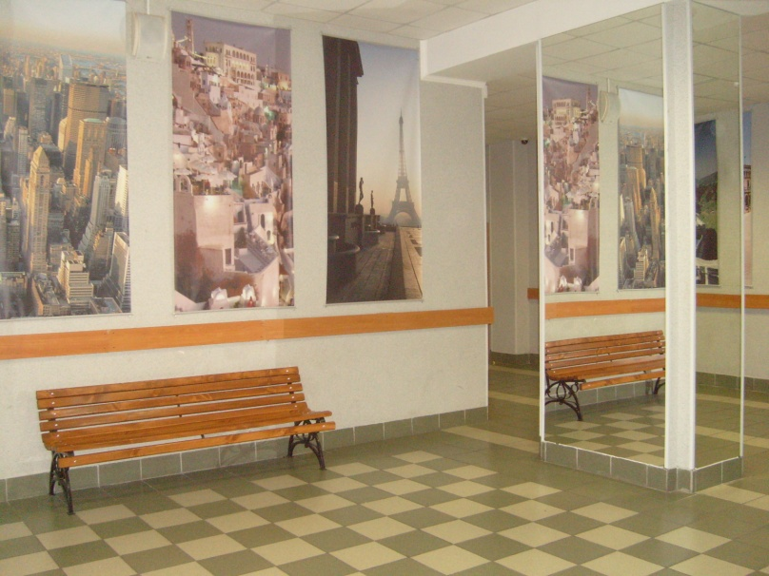
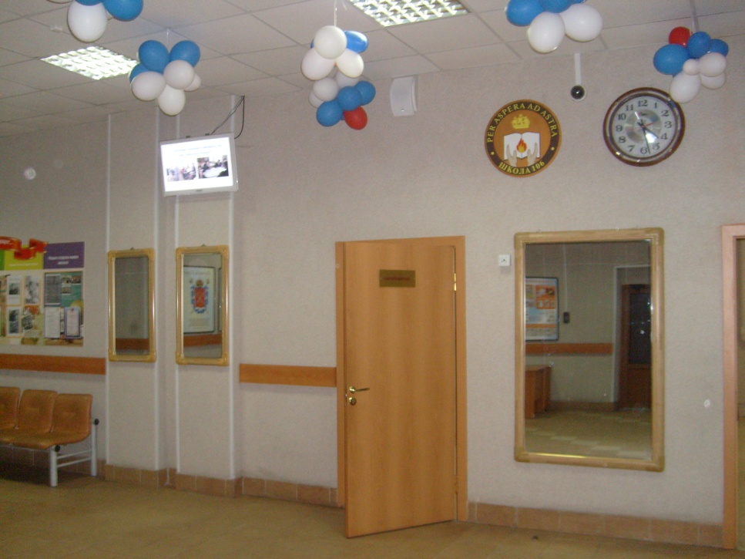
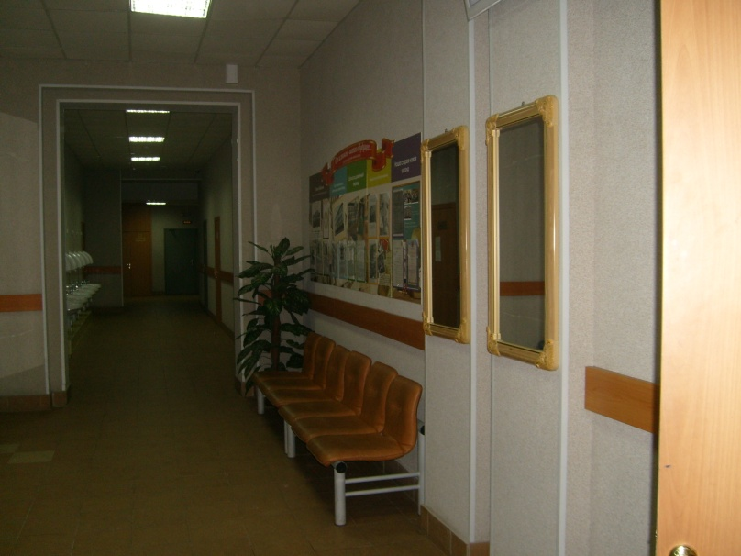
Beautiful interior creates a friendly atmosphere and invites to the world of knowledge.

Slide 4
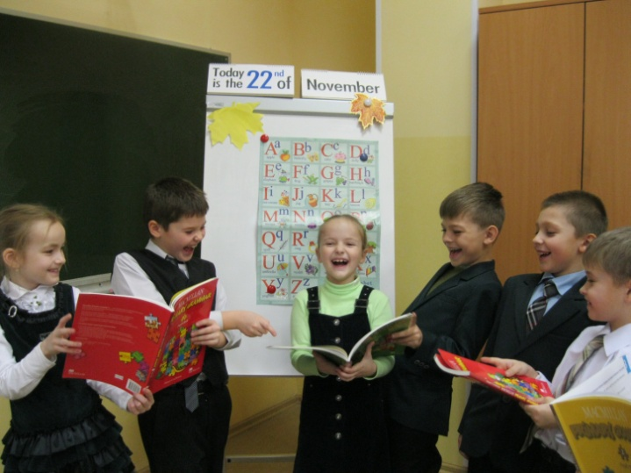
Students start learning English in the second form. They play funny games, sing songs and really enjoy their lessons.

Slide 5
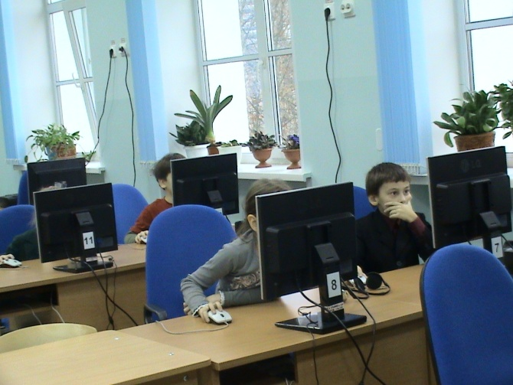
Nowadays it’s impossible to imagine our life without IT-technologies. At the IT-lessons students discover a new world. The future success starts here.

Slide 6
The exhibition of our school museum is dedicated to the Siege of Leningrad.
It has got a lot of interesting exhibits which can tell about children’s life in the city under the siege.

Slide 7
Our library is a world of wisdom. Students’ tastes differ but each student can find an interesting book here. A nice and kind librarian is always ready to give some good advice.

Slide 8
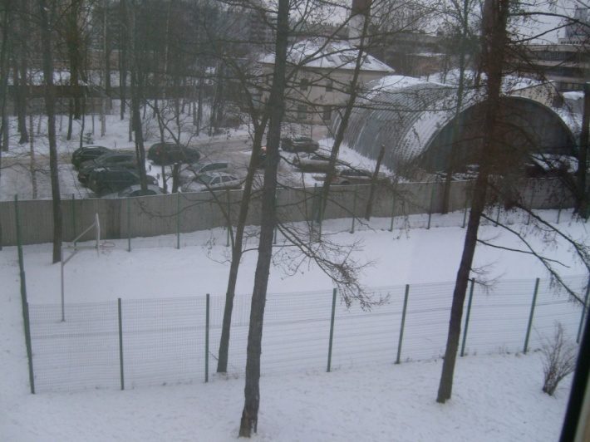
Students like playing sports. They want to be healthy and strong.
If the weather is fine, we do sports in the open air.

Slide 9
At Handicraft and Woodwork lessons students get necessary practical skills for their future life. Girls are taught to sew and cook. Boys make different things from wood.

Slide 10
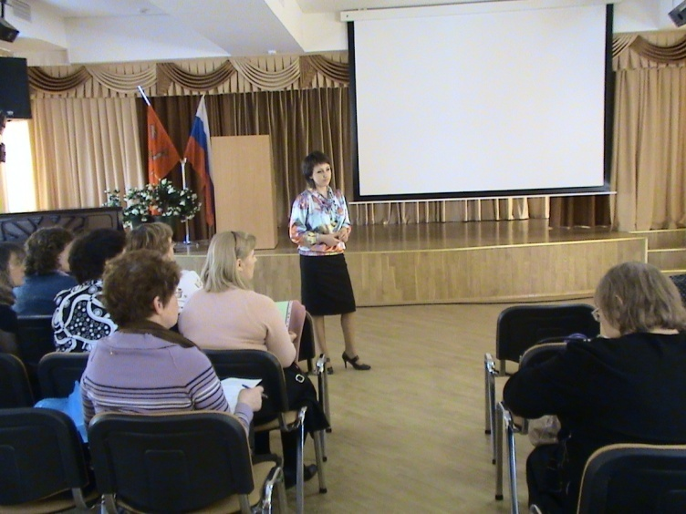
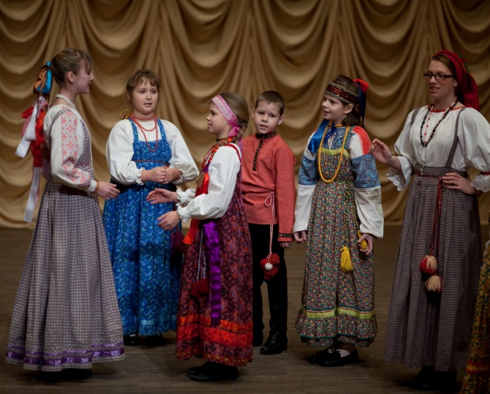
The Assembly hall is the heart of the school. All important events of the school life are connected with this place.

Slide 11
Our school is proud of our school leavers. Most of them are students of the best universities.

Slide 12
Thank you for your attention!
We’ll be very happy to see you again.

