Slide 1
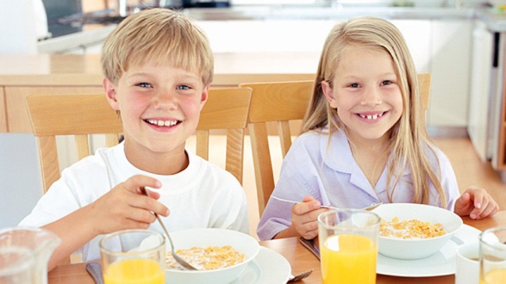
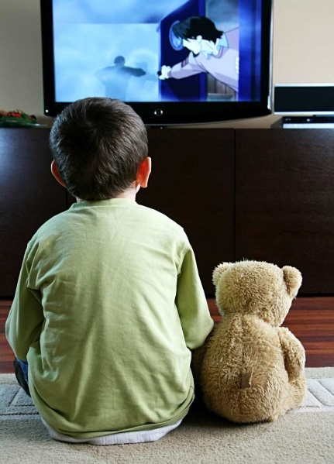
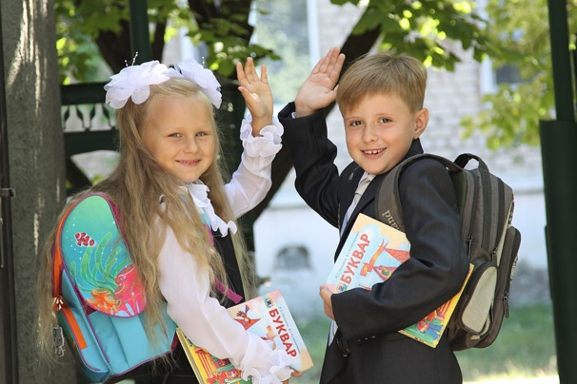

Slide 2
Daily activities

Slide 3
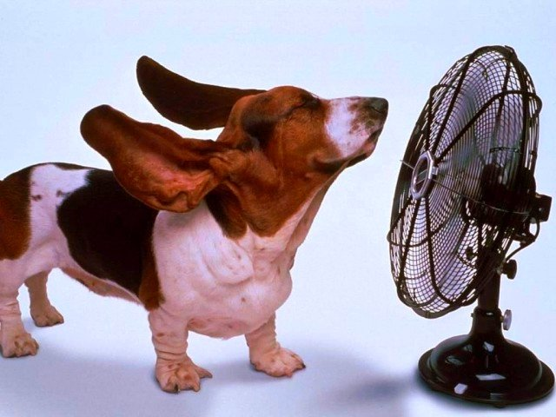
In the morning
In the evening
In the afternoon

Slide 4
In the morning | In the afternoon | In the evening
Work on computer | Get up | Go to school
Do homework | Have dinner | Have lunch
Go to bed | Have breakfast | Do the shopping

Slide 5
In the morning | In the afternoon | In the evening
Get up | Work on computer | Go to bed
Have breakfast | Do homework | Have dinner
Go to school | Have lunch | Do the shopping

Slide 6
I get up at 7 every morning.
I have lunch at 12 every afternoon.
I watch a DVD at 8 every evening.

Slide 7
He gets up at 7 every morning.
He has lunch at 12 every afternoon.
He watches a DVD at 8 every evening.

Slide 9
What’s the time?
It’s _____ o’clock.
It’s half past _____ .
It’s a quarter past (to) _____ .
At 8 o’clock. (В 8:00)
At half past 8. (В 7:30)
At a quarter past 8. (В 8:15)
At a quarter to 8. (В 7:45)

Slide 10
7:00 –
5:15 –
9:30 –
6:45 –

Slide 11
7:00 – It’s 7 seven o’clock.
5:15 – It’s a quarter past five.
9:30 – It’s half past nine.
6:45 – It’s a quarter to seven.

