Slide 1
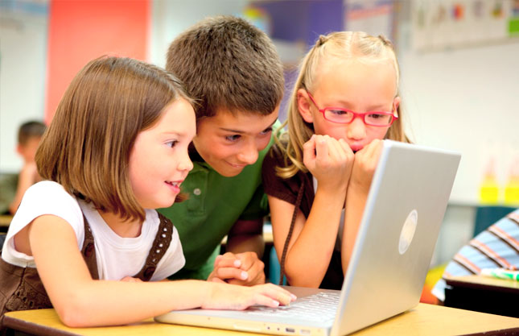
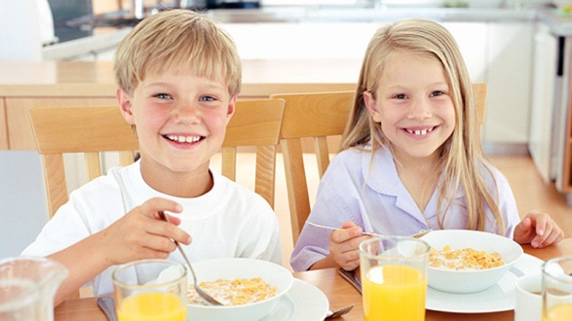
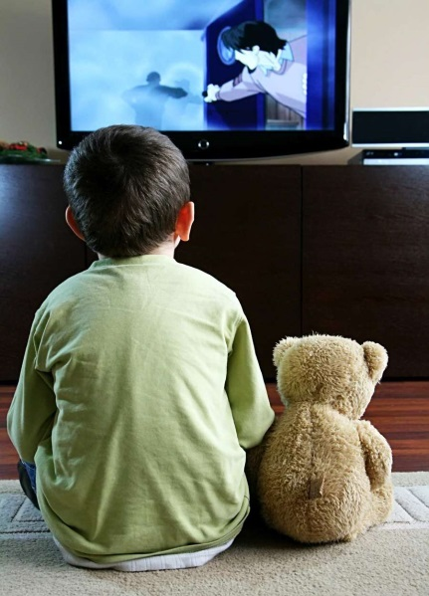
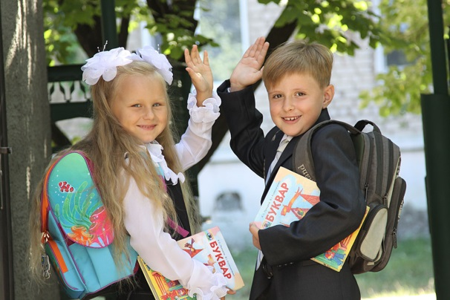

Slide 2
Lifestyle

Slide 3
Present Continuous
Действие происходит сейчас
be (am, is, are) + V ing
Now
At the moment
I am reading a book now.
You are reading a book now.
He is reading a book now.
We are reading a book now.
You are reading a book now.
They are reading a book now.

Slide 4
Present Simple
Настоящее простое время (действие происходит постоянно, регулярно, обычно)
V1/Vs (3 лицо ед.числа he, she, it)
Окончание es
brush – brushes
go – goes, do – does
carry - carries
We brush teeth in the morning.
She brushes teeth in the morning.
Do, does – вспомогательные глаголы
Только для отрицаний и вопросов

Slide 5
Usually:
go camping in summer (I)
eat lunch at school (he)
wear warm clothes in winter (they)
Now:
listen to music (I)
wear a uniform (she)
talk to a friend (you)

Slide 6
My plane starts at 7 o’clock.
Present Simple (действие происходит по расписанию)
We are going to watch a film tonight.
Present Continuous (действие запланировано на ближайшее будущее)

