Slide 1
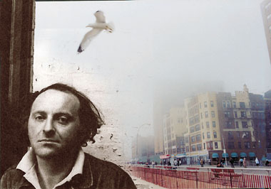
May I introduce myself: Brodsky!

Slide 2
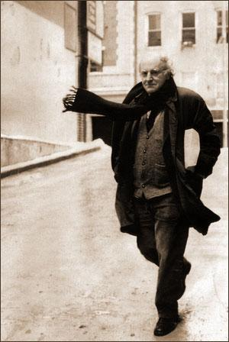
«Не в том суть жизни, что в ней есть, но в вере в то, что в ней должно быть.»
«Сияние русского ямба
упорней и жгучей огня,
как самая лучшая лампа,
в ночи освещает меня…»
И.Бродский.

Slide 3
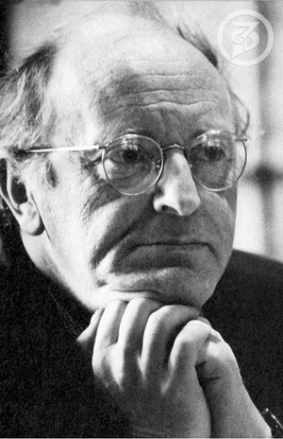
Iosif Aleksandrovich Brodsky
Date of birth:
On May 24 1940(1940-05-24)
Birthplace:
Leningrad, USSR
Death date:
On January 28 1996(1996-01-28) (55 years)
Death place:
New York, USA

Slide 4
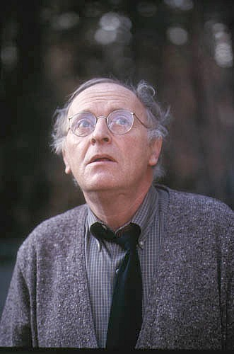
Nationality:
USSR USA
Kind of activity:
poet, essayist, playwright
Years of creativity:
1956 — 1996
Awards:
Nobel Prize on literature Makartur's (1987) Grant (1981) Poet winner of the USA (1991)
Awards: Award of the Honourable legion

Slide 5
Young years of Iosif Brodsky
Iosif Brodsky was born in an ordinary intelligent family. His father, Alexander Ivanovich Brodsky, graduated from geographical faculty of the Leningrad university and School of red journalists. As the press photographer I passed all war (from 1940 in Finland to 1948 in China). In 1950 within "cleaning" of the officer case from Jews it was invalided out, it was interrupted by small notes and I photographed for departmental factory newspapers. Mother, Maria Moiseevna Volpert, worked all life the accountant.

Slide 6
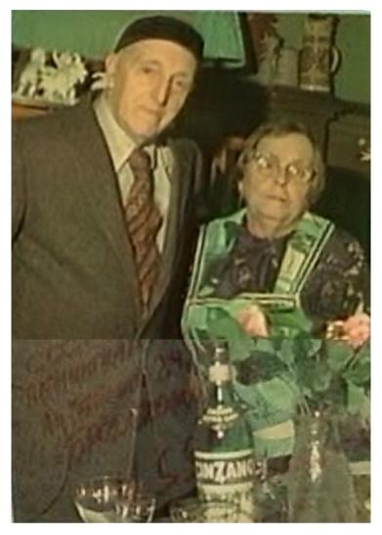
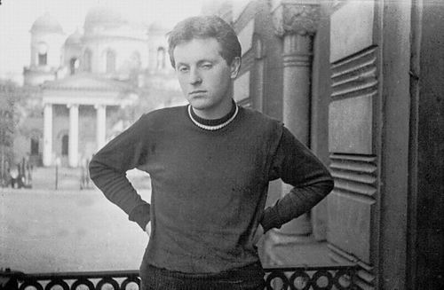
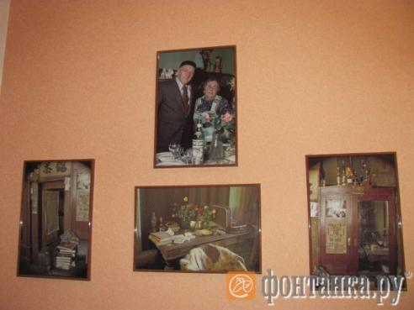

Slide 7
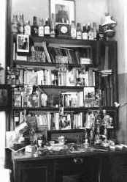
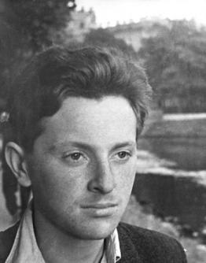
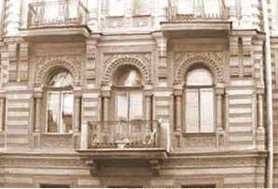
In 1955 Brodsky' family moved to a big communal flat in the House Muruzi on Liteyny Avenue 24/27, and young Iosif gradually fenced off cases in it the personal space, these well-known "one and a half rooms", become its office, a bedroom, a place of reception of the guests, meaning so many in formation of its character and development of independence and freedom of thinking... Brodsky remembered the childhood reluctantly: "Russians don't attach to the childhood great value. I, at least, don't give. Usual childhood. I don't think that children's impressions play an important role in further development".

Slide 8
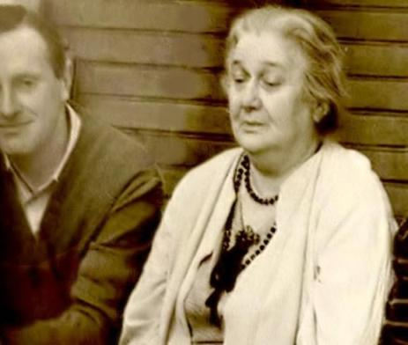
Anna Akhmatova highly appreciated talent of the young poet, became for it one of spiritual mentors. Brodsky who is torn away by official circles, gains popularity in literary circles, the environment of an intellectual underground; but it never belongs to any group, isn't connected with a recusancy.
Brodsky wrote: "In each of us — God" also was proud that actually anew entered the shower word concept into domestic poetry.

Slide 9
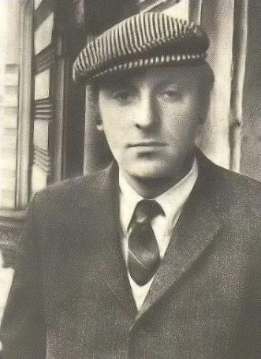
On November 29, 1963 in the Evening Leningrad newspaper the lampoon "The would-be-literary drone" on Brodsky was published.
The organized persecution expanded; it was dangerous to remain in Leningrad to Brodsky; in order to avoid arrest
Friends in December, 1963.
took away the poet to Moscow.
In the evening 13 февраля1964
years on Iosif Street
Brodsky was unexpectedly
it is arrested.

Slide 10
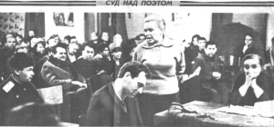
Court. Iosif Brodsky's link
Two court sessions over Brodsky (the judge of the Dzerzhinsk court Savelyeva E. A. ) were summarized by Frida Vigdorova and made the maintenance of the extending
in a samizdat of "The white book".
All witnesses of charge
began the indications
from words: "I with Brodsky
personally I am not familiar …",
having something in common with the formulation of times of persecution of Pasternak: "I didn't read the novel of the Parsnip, but I condemn! . ". For the poet Akhmatova, Marshak, Shostakovich, Sartre interceded. Akhmatova's told concerning process the words: "What biography do to our red! " — were prophetical.

Slide 11
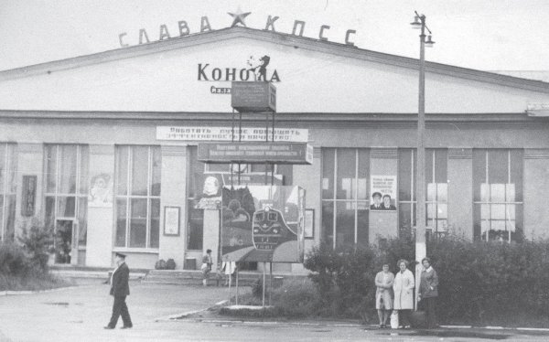
Konosha and Brodsky.

Slide 12
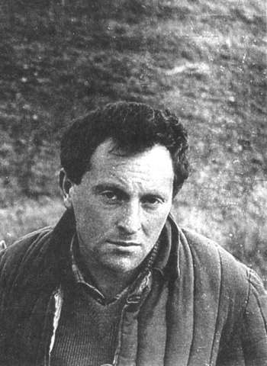
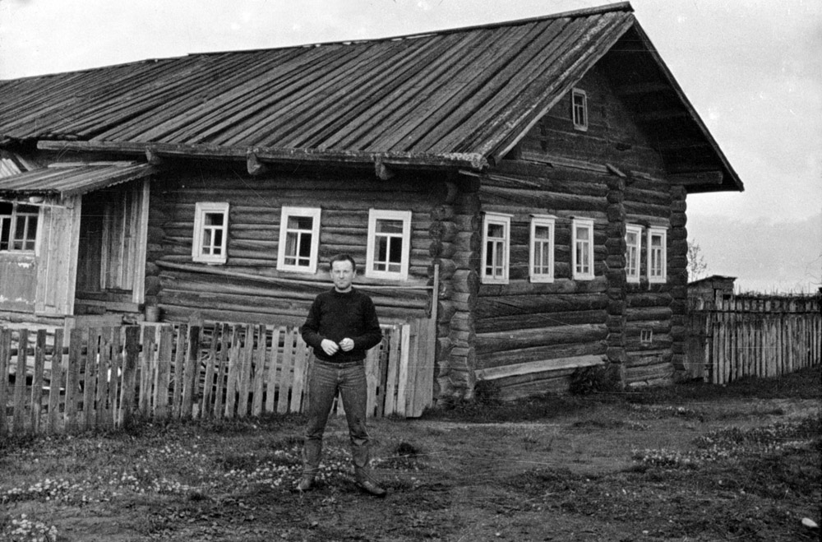
The village Norensky spring of 1964 – autumn of 1965.
Brodsky was sentenced to the five-year exile to the Arkhangelsk region ("with obligatory attraction to physical work"). It stayed in the village Norenskaya since spring 1964 till fall 1965. Thanks to protests of world community, the poet was released ahead of schedule. In exile talent and its spirit ("the main thing not to change... I dispersed too far, and I already never will stop to the death") got stronger and came to new level.

Slide 13
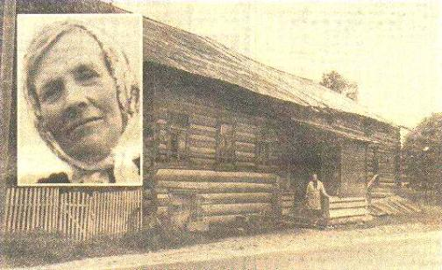
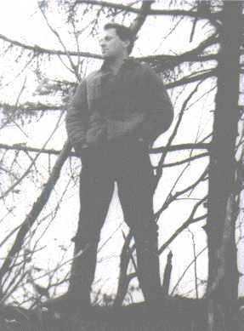
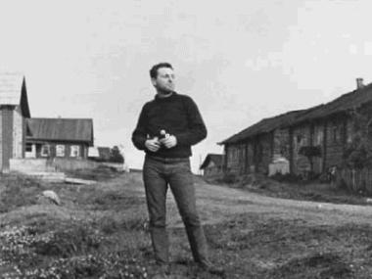
House and its hostess Taisiya Ivanovna Pestereva. Here on a billeting defined the exiled Brodsky.

Slide 14
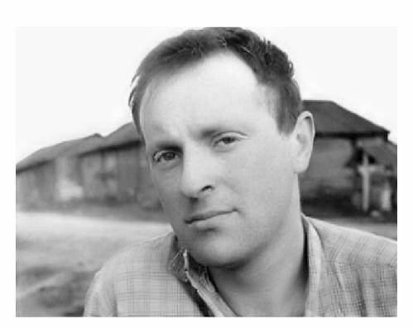
Brodsky about Norenskaya.
"When I got up from the dawn and early in the morning, hours per six, followed a dress in board, understood that in the same hour on great earth of the Russian all that is called there is the same: the people go to work. And I by right felt the belonging to these people. And it was enormous feeling! ".

Slide 15
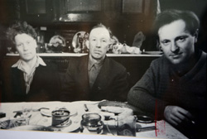
"Tractors at sunrise" - I. Brodsky's poem in the Prizyv newspaper, accepted from the poet A.Zabaluyev.
А. Буров - тракторист - и я, сельскохозяйственный рабочий Бродский, мы сеяли озимые - шесть га. Я созерцал лесистые края и небо с реактивною полоской, и мой сапог касался рычага. Топорщилось зерно под бороной, и двигатель окрестность оглашал. Пилот меж туч закручивал свой почерк. Лицом в поля, к движению спиной, я сеялку собою украшал, припудренный землицею как Моцарт. август - сентябрь 1964
Brodsky lived in the house Afanasy Mikhaylovny and Konstantin Borisovicha Pesterevykh
K.B.Pesterev on a visit at Brodsky.

Slide 16
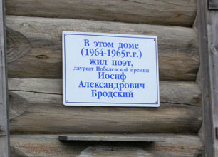
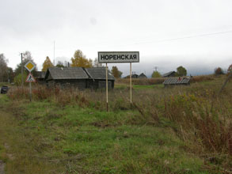
В 1965 г., под давлением мировой общественности, решением
Верховного суда РСФСР срок высылки сокращен до фактически отбытого (1 год, 5 месяцев).

Slide 17
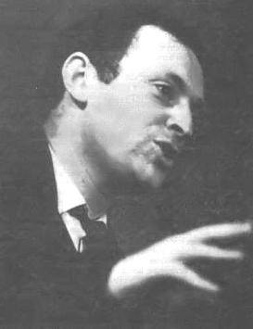
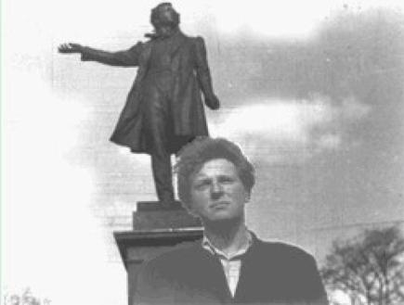
Returned ahead of schedule from exile, Brodsky tried
actively to join in literary process.
He persistently and tensely studied on samples, mastered
new rhythms, extremely productively
I worked creatively, I wrote original verses, I translated,
I read verses and the translations at literary soirees. Opportunities
and creative business trips conducted it from Leningrad to Moscow, Palangu, Yalta, Gurzuf...

Slide 18
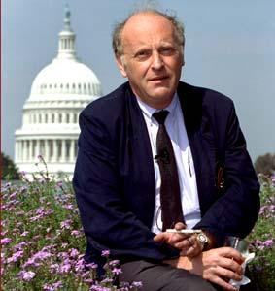
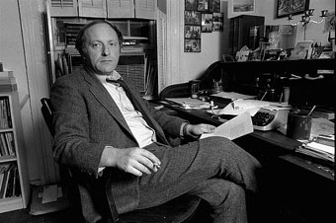
In the USA Brodsky in the full
to measure I realized everything
opportunities creative and
career growth, and also
publishing activity

Slide 19
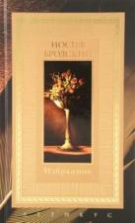
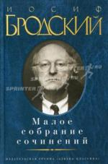
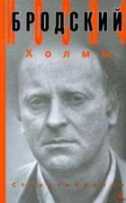
Way to an international recognition
The poet feels the fortieth anniversary as an important milestone; in total "I entered instead of a wild animal a cage... " he confirms stoical, courageous acceptance of all experience of past life, with its losses, blows. In 1980 Iosif Brodsky obtains the American nationality. Since the beginning of the 1980th years it becomes not only a considerable figure of the Russian poetic abroad, but more and more, thanks to English-speaking prose, the world famous writer. Convinced of the great clearing, creative force of poetry, Brodsky fights for that "collections of verses lay at a bed near aspirin and the bible".

Slide 20
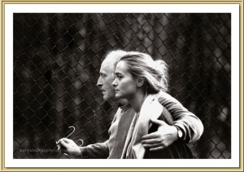

Slide 21
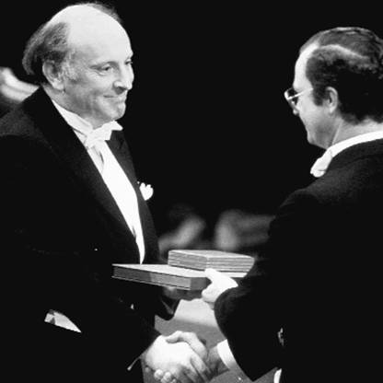
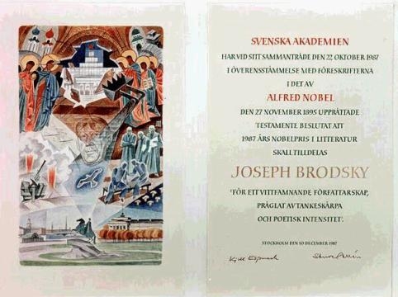
On October 22, 1987 the Swedish academy declared a name of the next Nobel winner in literature. Iosif Brodsky became him. He is the fifth Russian writer after I. Bunin (1933), B. Parsnip (1958), M. Sholokhova (1965) and A.Solzhenitsina (1970), received this high award. Brodsky became one of the youngest Nobel winners in literature.

Slide 22
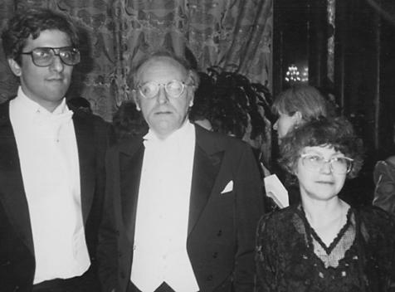
After award of the Nobel Prize to it
its verses and poems began to extend widely and in
Russia. Some its meetings were published even
compositions. From the middle of the 1980th years Brodsky's creativity
becomes a subject of fascinating studying: leave
works about its poetics.
In the same years Iosif Brodsky collects the plentiful
crop of the numerous
awards, but, first of all,
as English-speaking author.
It receives a rank
"Poet winner of the USA" 1991.

Slide 23
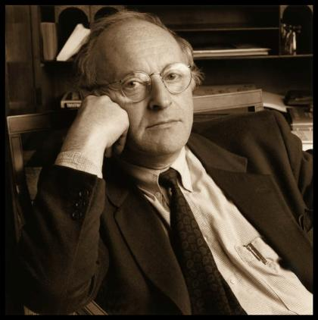
The poet Iosif Brodsky suddenly died in New York on January 28, 1996, without having lived till 56 years. Brodsky's death in spite of the fact that it was known of his worsening state of health, shook people on both sides of the ocean. It is buried in Venice. In the USA it still had daughter who was born in 1992, in Petersburg — the son (I was born in 1967). Creation of the Russian Academy in Rome where for some months there could come the Russian poets was one of the last initiatives of the poet.

Slide 24
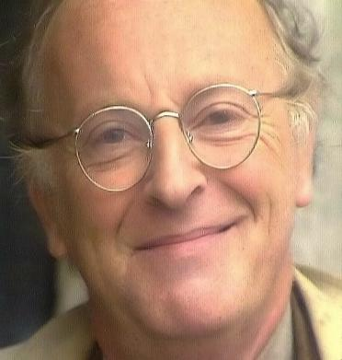
Iosif Brodsky quite often call the last poet of the Silver age, though, probably, it in general the last big Russian poet of the left century. The concept the Silver age belongs not so much at the right time, how many to culture level. Brodsky was the person of the highest culture, in perfection mastered several languages,
perfectly I knew world poetry,
I was familiar with the best poets
the time. Following the
to predecessors, great
to poets of a century Gold, it managed
to create the poetry going from
depth of consciousness, the
figurative language. He loved the
The homeland and the people, I was proud it
force also I admired courage.

Slide 25
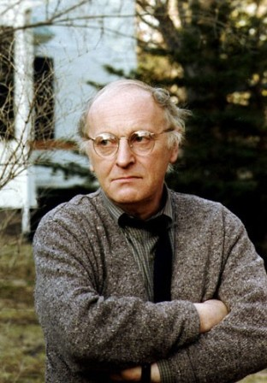
«Я верю, что вернусь,
Ведь писатели всегда
возвращаются — если
не лично, то на
бумаге, и если мой
народ не нуждается
В моей плоти, то,
может быть, моя душа
ему пригодится».

