Slide 1
Altay region
Zakharova Nadya, 9”b”

Slide 2
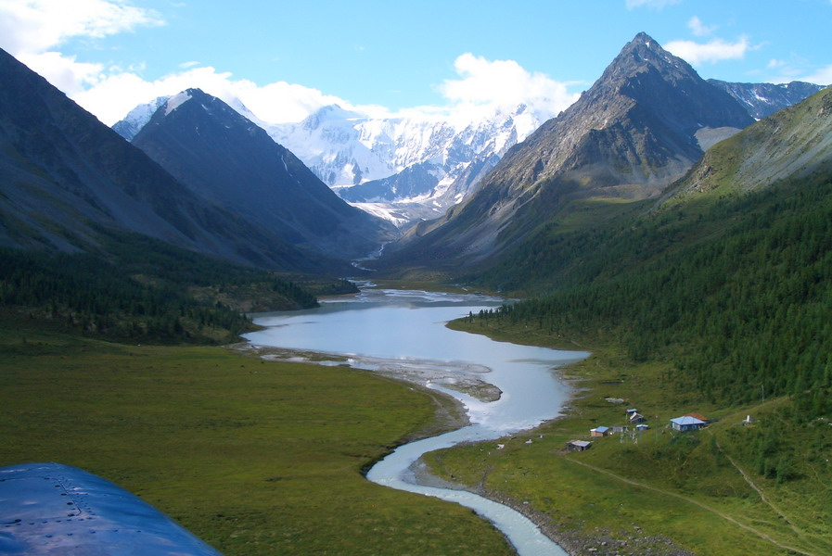
Origin of the name "Altai" is associated with the Turkic-Mongolian word "hit the jackpot", denoting "gold", "gold".

Slide 3
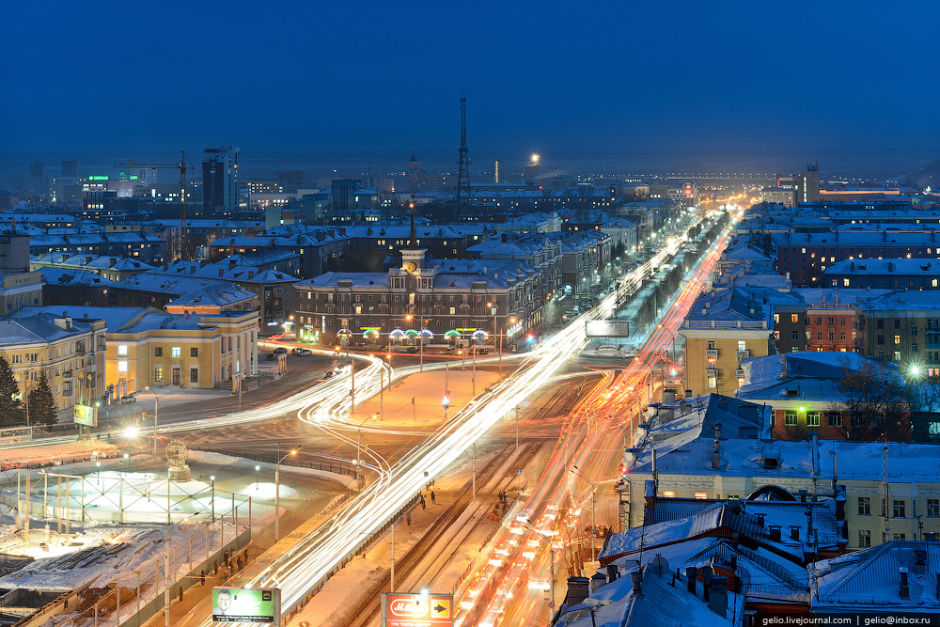
Barnaul.
City in Russia, the administrative center of the Altai Territory
There are several stories about the origin of the name of the city of Barnaul. The most common version among barnaultsy said that the word "Barnaul" is translated from Kazakh language as a good camp.

Slide 4
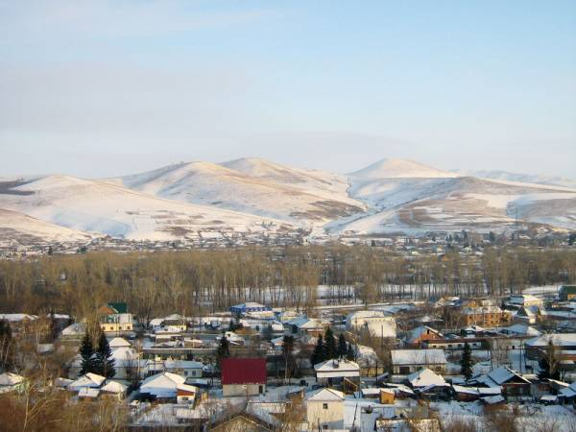
Altai regional center
The village is known informally as "three Altai" (the village of Altai, the Altai region, the Altai Territory). The village was founded in 1808

Slide 5
Thank you!

