Slide 1
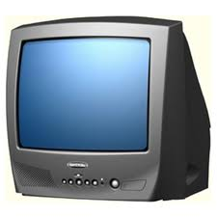
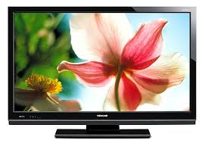
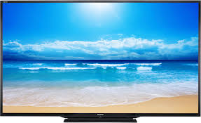
Slightly about TV.

Slide 2
pros
One of the advantages of the device is completely submerged - technology allows you to see the image and hear. The present set of TV channels and a variety of programs that may be of interest almost everyone. There is the possibility to connect the console, flash drive, computer, and so on. Thanks to regular updates, you can check the changes in the world. Also among these programs will always be those who will help you make a choice between the professions or shopping.

Slide 3
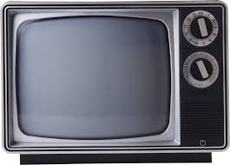
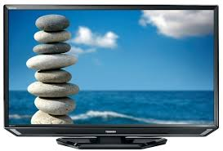
Minuses
This device has no restrictions or filters, it shows everything as useful tips and interesting facts and a lot of advertisements and the imposition of others' interests. Nearly every model has a lot of weight, or a huge, eliminating the possibility of a compact. Not everyone can afford to buy it. TV consumes electricity.

Slide 4
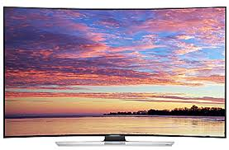
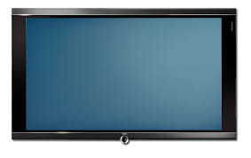
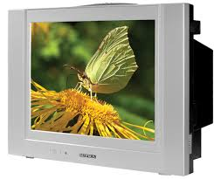
Bottom line
Despite the many drawbacks, television is a promising source of information. With improvement of the device will be less than the number of cons, and possibly increase dignity.

Slide 5
The presentation was made
Кошкаров Филипп
Ушаков Михаил
Баева Нина

