Slide 1
Муниципальное бюджетное образовательное учреждение
«Сергачская средняя общеобразовательная школа №3» г. Сергач, Нижегородская область
Презентация по английскому языку для 8 класса
Тема: « Northern Ireland»
Автор - составитель:
Поняева Наталья Валерьевна
учитель английского языка
МБОУ «Сергачская СОШ №3»,
высшая квалификационная категория
Сергач 2018
Сергач 2016

Slide 2
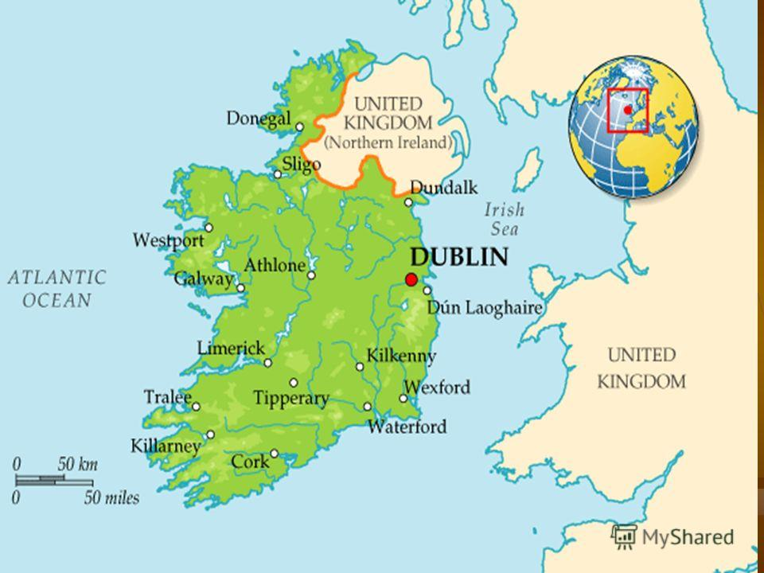
Northern Ireland
Northern Ireland is a part of the United Kingdom and Northern Ireland.
It is situated in the north-east of the island of Ireland. It borders on the Republic of Ireland in the south and west.
Its population is about 3 % of the population of the United Kingdom.

Slide 3
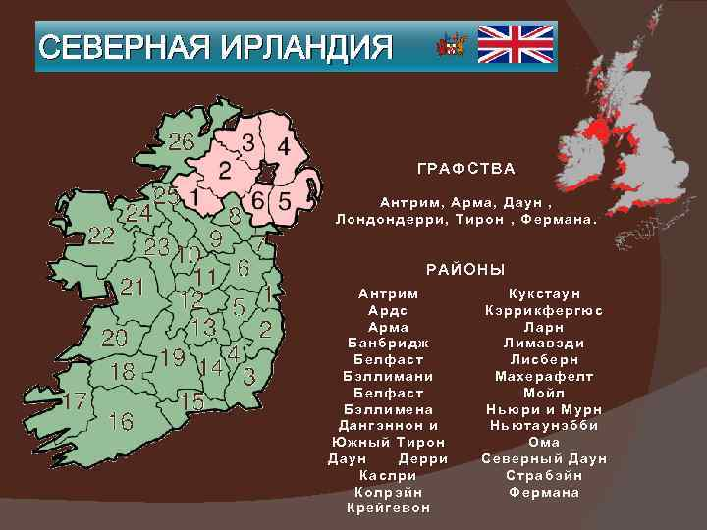
The administrative division
Northern Ireland consists of six of the nine counties of the Irish province of Ulster. It was created as a division of he United Kingdom in May 1921.

Slide 4
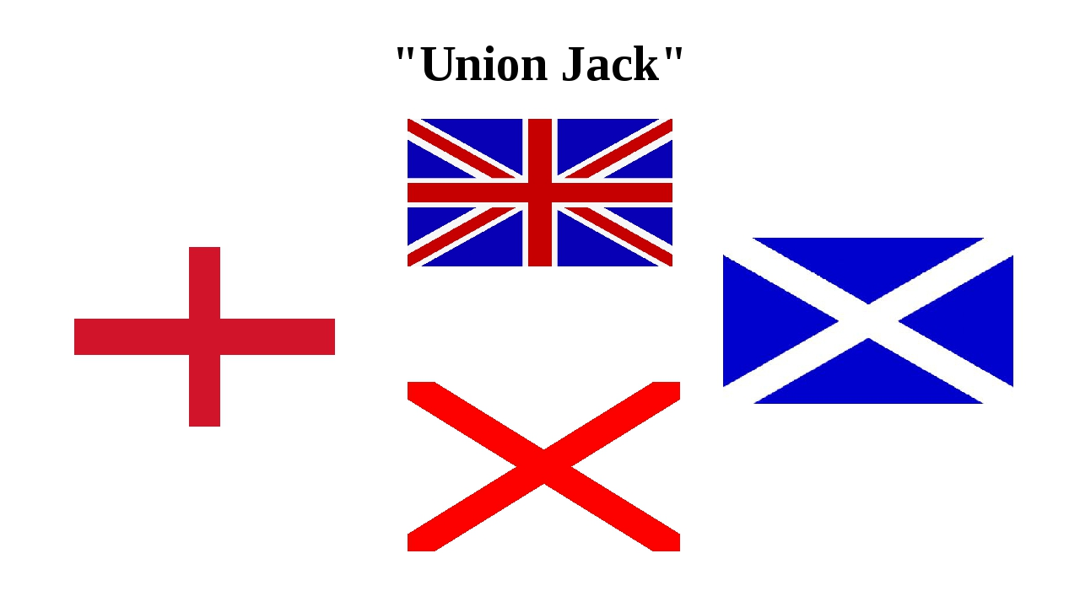
The flags of Ireland
The former flag of Ireland – a red cross against the white background is St. Patrick’s cross, as flag of Church of Ireland. Saint Patrick is the patron saint of Ireland
The Union Flag is the official flag of the country
There is also the Ulster Banner but it has no official status since1972

Slide 5
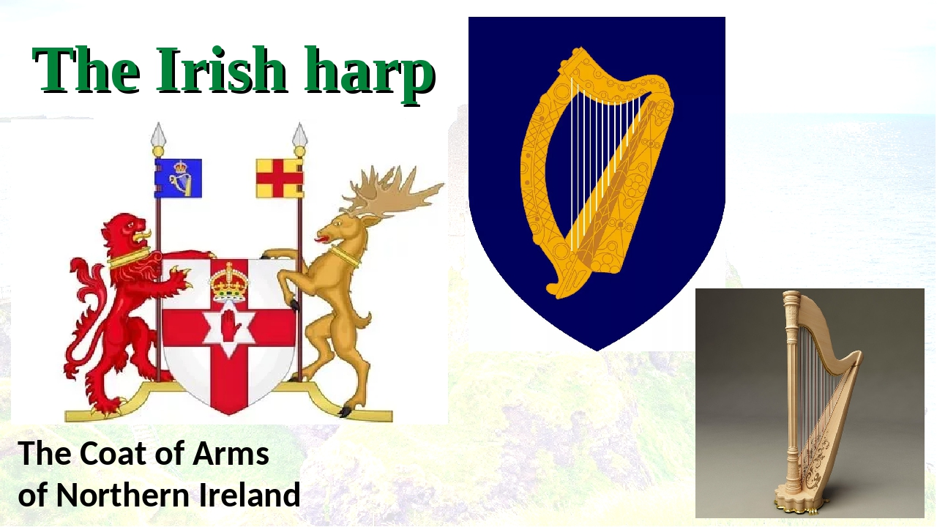
The coat of arms
The coat of arms of the Government of Northern Ireland were granted to the Executive Committee of the Privy Council of Northern Ireland in 1924.

Slide 6
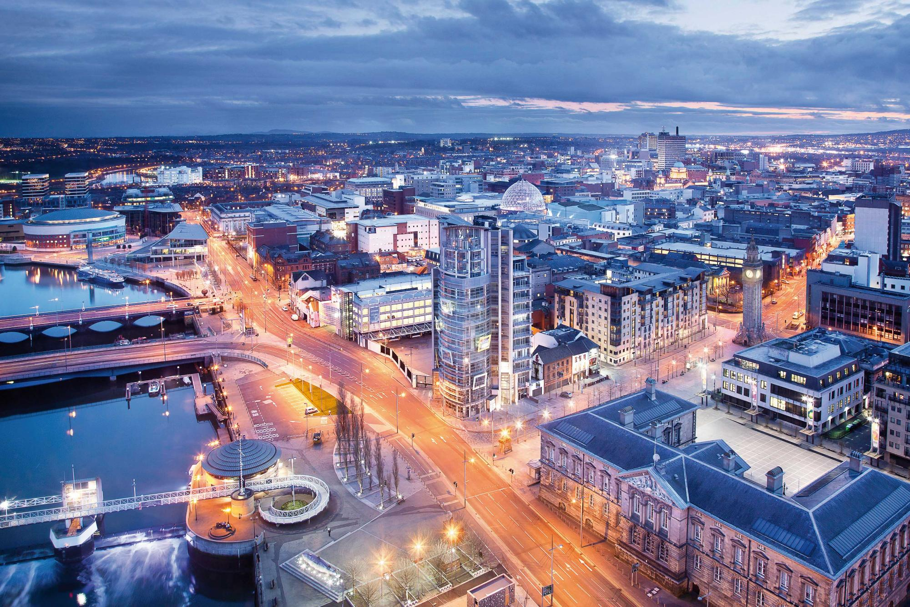
The capital of the country
Belfast is the capital and the largest city of Northern Ireland and the main settlement in the province of Ulster. It is the center for business, art, industry, higher education and law, full of wonderful sights.
It stands on the river Lagan
Its Northern Ireland Assembly consists of 108 members

Slide 7
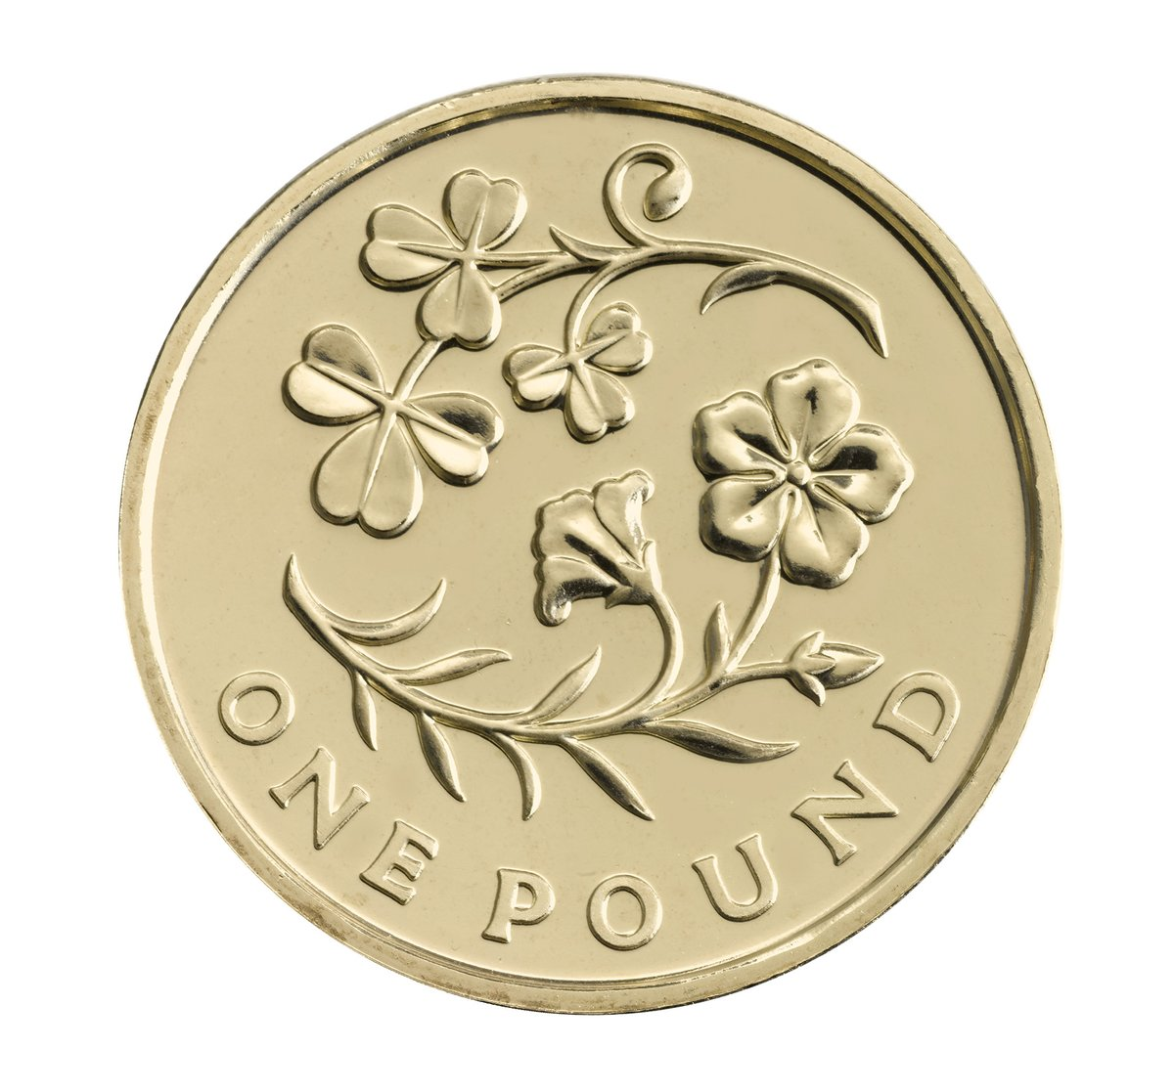
The floral emblems
The first floral emblem of Northern Ireland is the shamrock, derived from the Irish word “seamróg”, meaning 'little clover,' shamrock refers to young sprigs of clover.
The second floral emblem is the flax because the country is famous for its linen
This one pound depicts a flax alongside a shamrock to represent Northern Ireland as part of the floral emblems £1 series

Slide 8
Literature
Источники:
1. Alvin Jackson. Ireland 1798-1998: War, Peace and Beyond. 2nd Ed. Wiley-Blackwell, Oxford, 2010.
2. Генри В. Мортон. Ирландия. Прогулки по священному острову. М.: ЭКСМО, Мидгард, 2009.
3. Карта Ирландии ( Электронный источник) Режим доступа: https://sun1-29.userapi.com/3y3zZn1_h5BmcLq79BYYkq-bT9SV2atvd_TVIw/SkLwplL30Bw.jpg
4. Административное деление Северной Ирландии ( Электронный источник) Режим доступа: https://sun1-23.userapi.com/unWvL9AEPt7-d44tlIoqboIrJhOZzIAhn1YC0A/P_oOiYXbKBc.jpg
5. Ирландские флаги(Электронный источник) Режим доступа: https://ds05.infourok.ru/uploads/ex/09b0/001293c7-373a9952/img5.jpg
6. Ирландский герб (Электронный источник) Режим доступа:https://ds05.infourok.ru/uploads/ex/0c70/000947b7-0508dbfa/3/img4.jpg
7.Белфаст (Электронный источник) Режим доступа: https://wikiway.com/upload/iblock/577/Belfast.jpg
8. Цветочные символы. Режим доступа: https://pbs.twimg.com/media/ETTmqEnWoAAddlf.jpg

