Slide 1
New words:
A trip
A travel
A ship
A journey
Luggage
A cruise
A balloon
A taxi
Is associated
Use
To get to
To cross
путешествие
такси
путешествие
Ассоциироваться с
корабль
Использовать, применять
путешествие
Добираться до…
багаж
пересекать
Круиз
Воздушный шар

Slide 2
If you guess all the words correctly, you will be able to name the topic of our lesson. Are you ready?

Slide 3
T R I P
T R A V E L
T R A I N
V I S I T
C R U I S E
L U G G A G E
B I C Y C L E
S H I P
B A L L O O N
V O Y A G E

Slide 4
Travelling around the world

Slide 5
New words
Sightseeing
Landmark
Copper
Extend
Rickshaw-boy
достопримечательность
Traffic lights
Pedestrian
Island
Slippers
Ориентир
светофор
пешеход
медь
простираться
Остров
тапочки
«Рикша», водитель такси

Slide 6
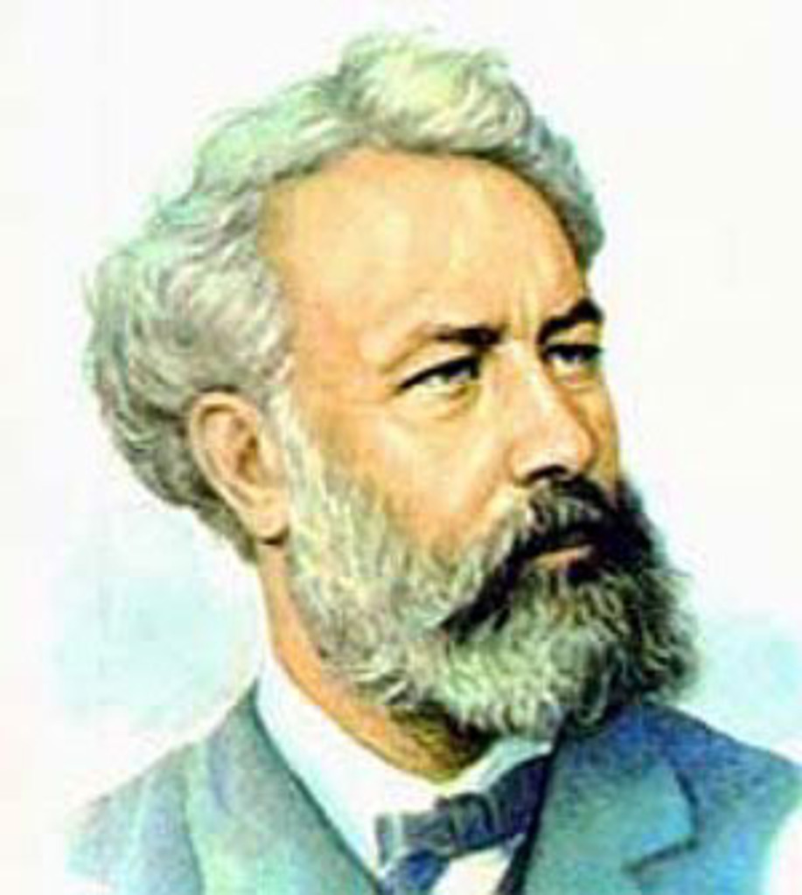
Jules Gabriel Verne
1828 — 1905

Slide 8
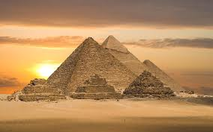
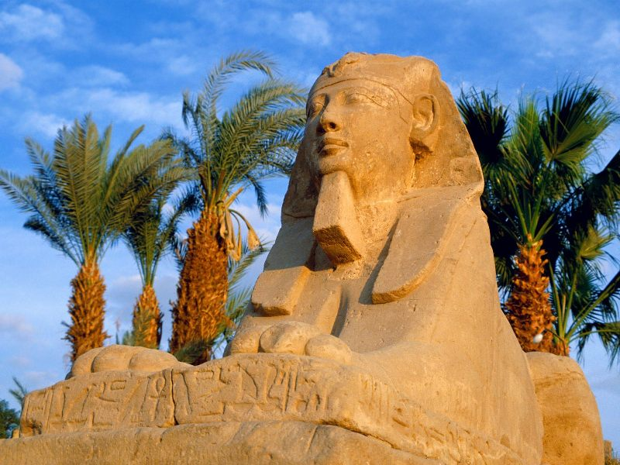
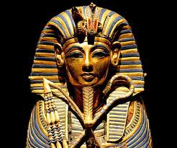
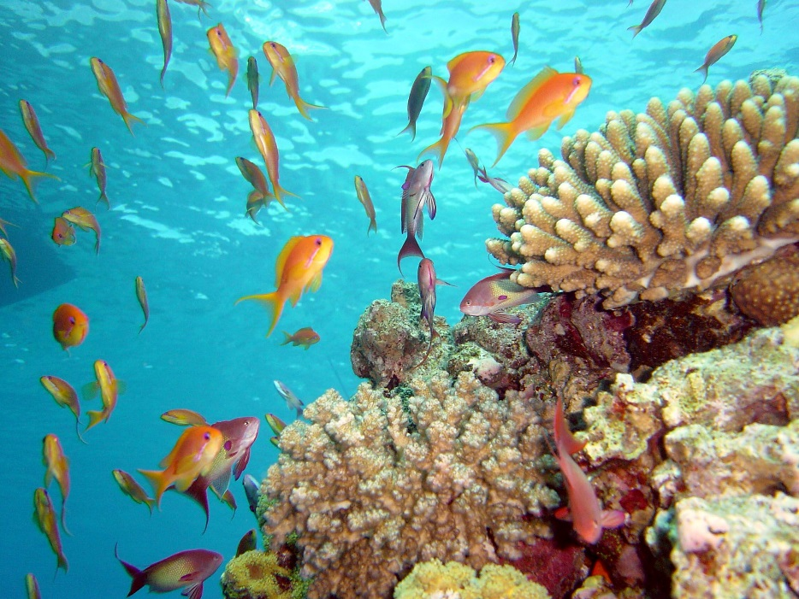
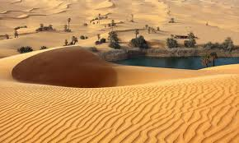
This is Egypt

Slide 9
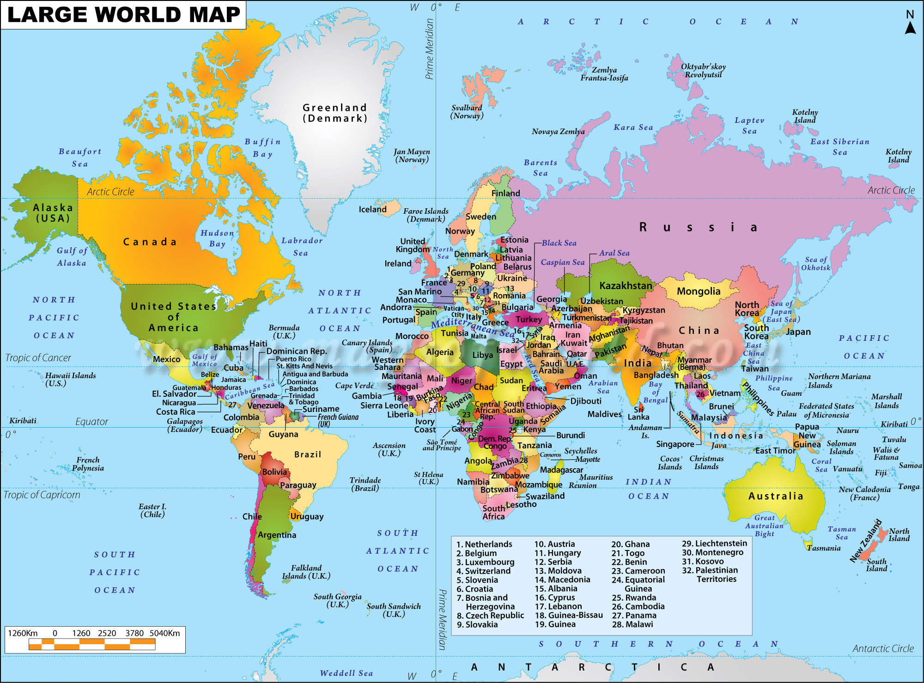

Slide 10
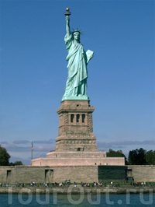
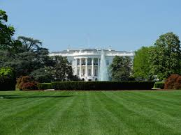
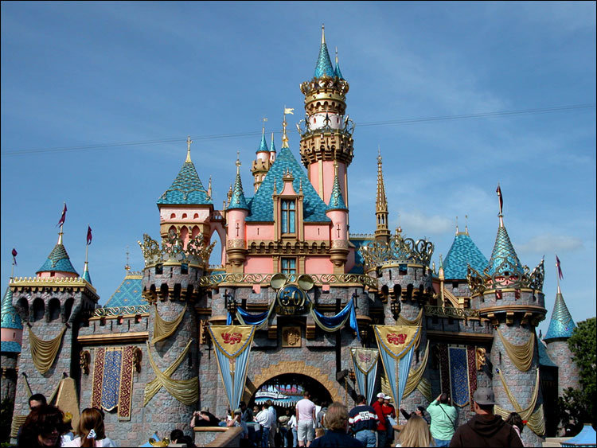
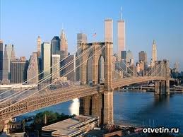
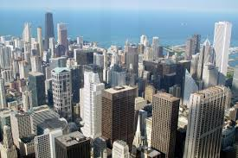
That is the United States of America

Slide 12
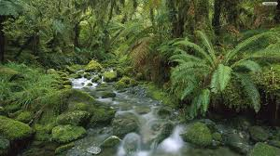
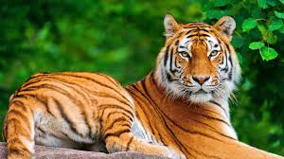
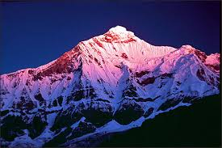
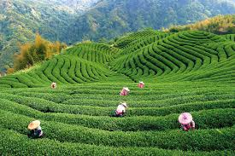
This is India

Slide 14
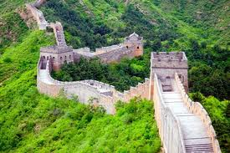
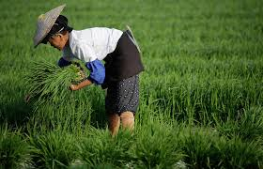
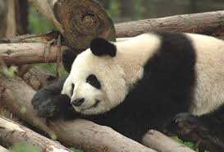
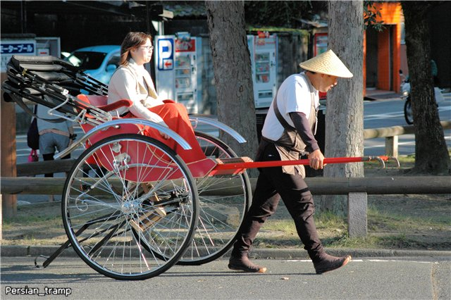
It is China

Slide 16
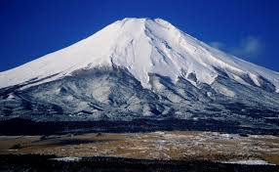
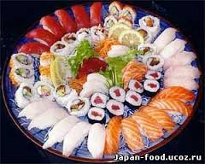
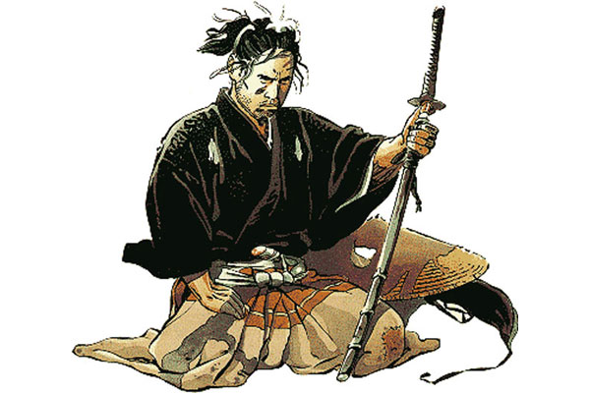
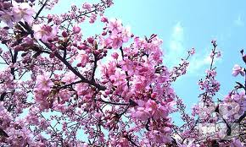
That is Japan

Slide 17
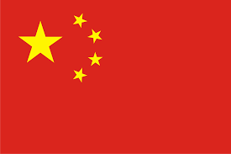
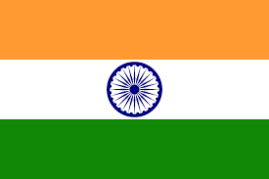

Slide 18
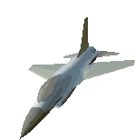
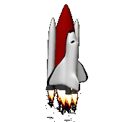
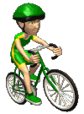
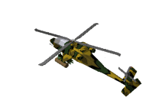
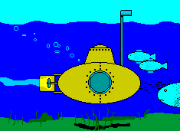
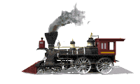
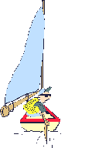
Revise the means of transport
A plane
A car
A bike
A rocket ship
A helicopter
A truck
A submarine
A taxi
A scooter
A bus
An yacht
A train

Slide 20
Now let’s check your answers
1.car
11. A taxi
6. A bike
2.truck
7. yacht
12. A rocket ship
3.train
8. A submarine
4. A bus
9. A plane
5. A scooter
10. A helicopter

Slide 21
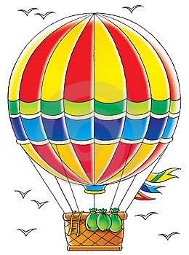
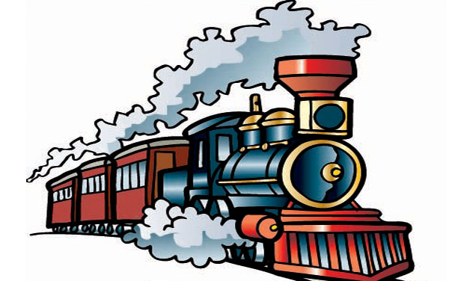
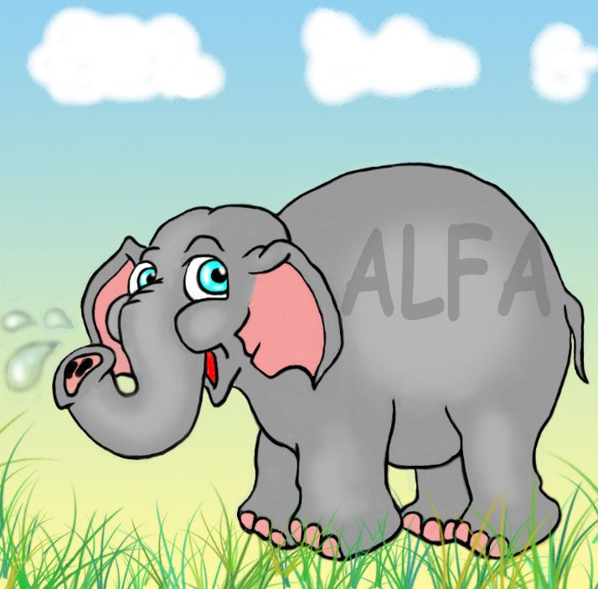
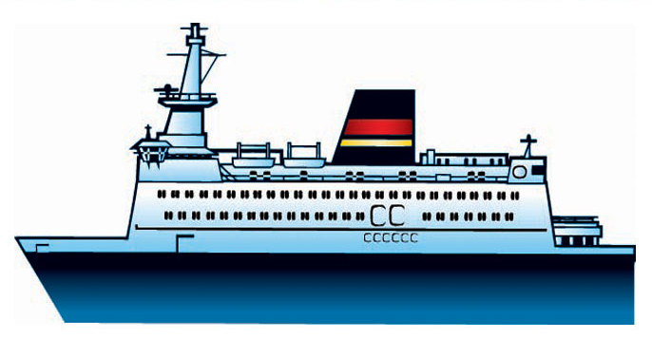
Means of transport
Philease Fogg used … to get to…

Slide 22
Look at the example and make your own sentences.
An elephant is slower than the train.
The plane is the fastest.
The plane is the most comfortable.
The balloon is as boring as an elephant.

Slide 23
Hometask
What means of transport will your choose if you have to travel around the world? Try to argument your choice!!! 2-3 means of transport will be better to desribe…

