Slide 1
United Kingdom
QUIZ

Slide 2
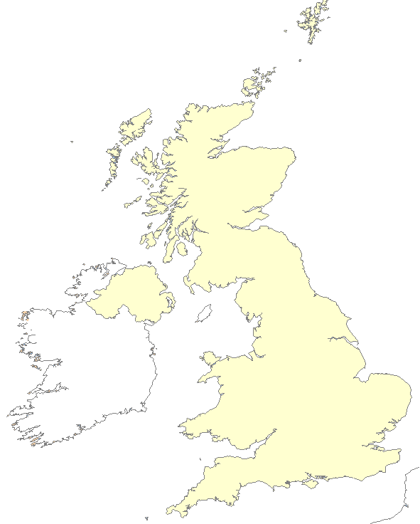
What’s this?
Great Britain
The United Kingdom

Slide 3
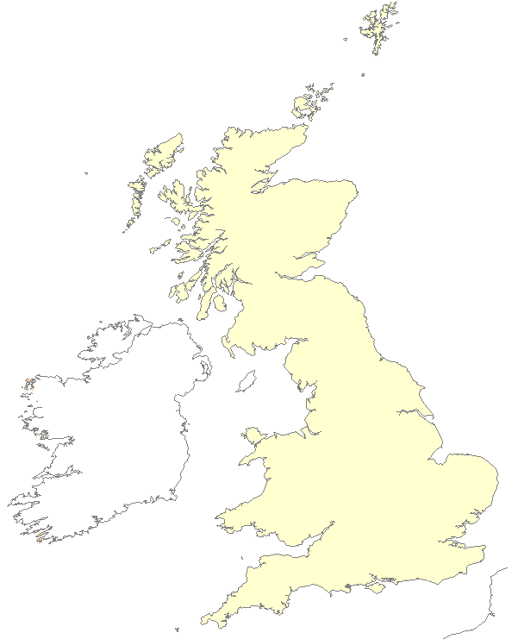
What’s this?
Great Britain
The United Kingdom

Slide 4
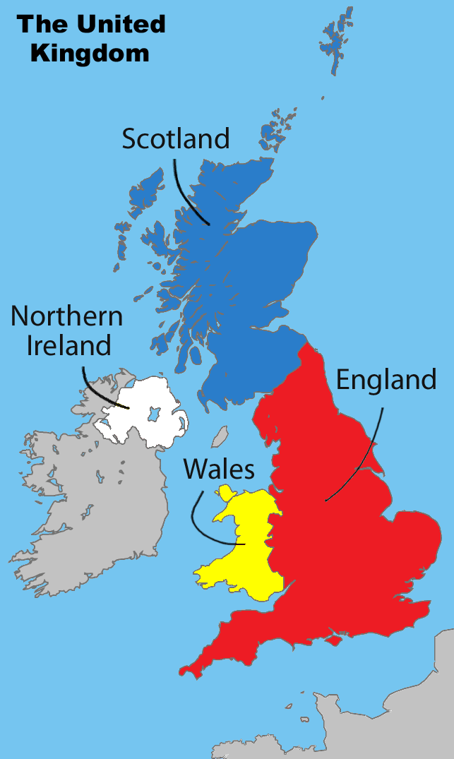
The United Kingdom consists of
four
countries
three countries

Slide 5
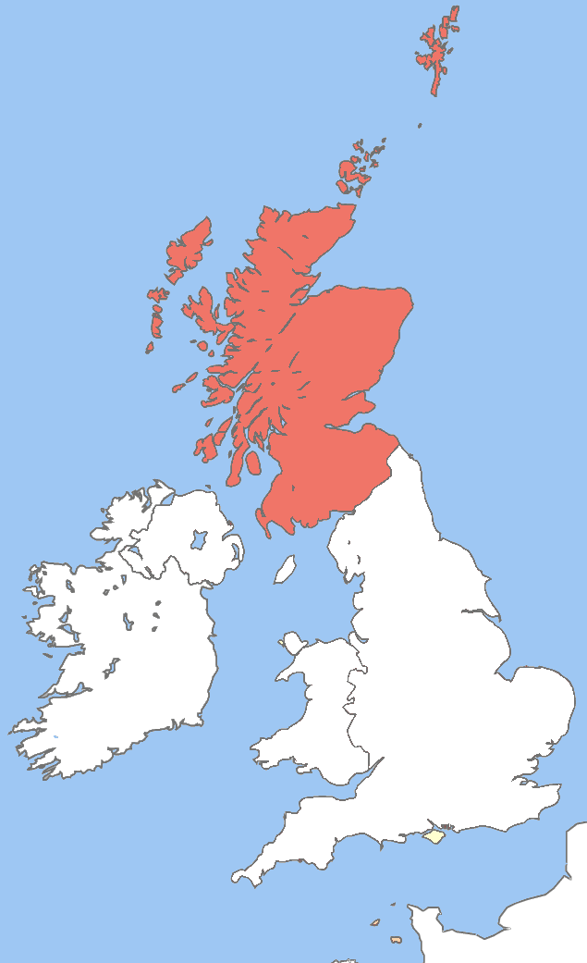
What’s this?
England
Wales
Northern Ireland
Scotland

Slide 6
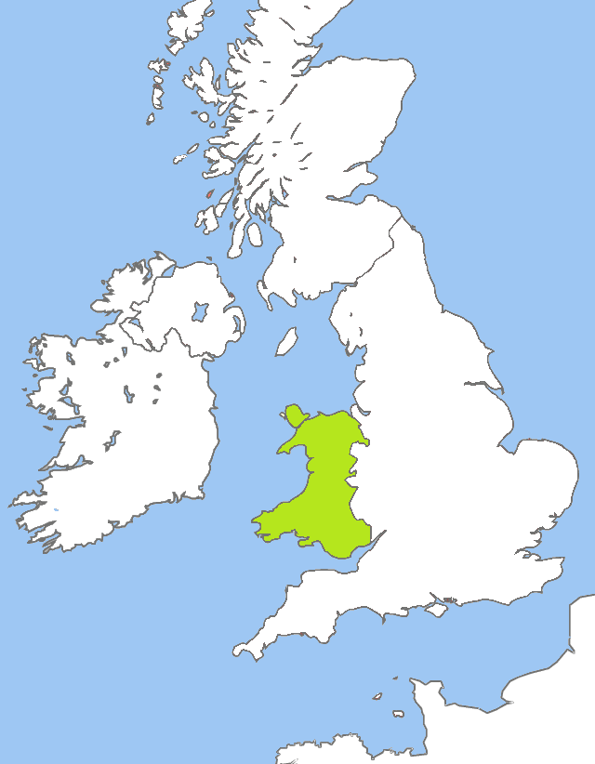
What’s this?
England
Wales
Northern Ireland
Scotland

Slide 7
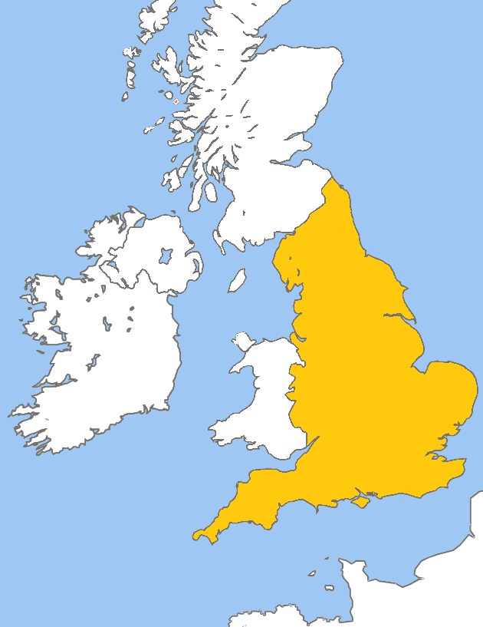
What’s this?
England
Wales
Northern Ireland
Scotland

Slide 8
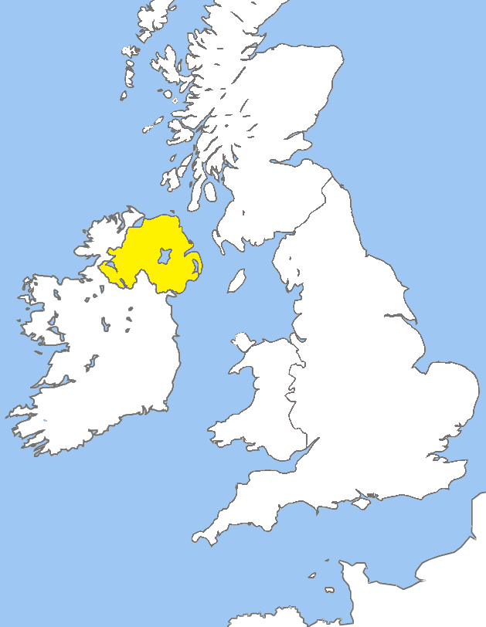
What’s this?
England
Wales
Northern Ireland
Scotland

Slide 9
Belfast is the capital of…
England
Scotland
Wales
Northern Ireland

Slide 10
London is the capital of…
England
Scotland
Wales
Northern Ireland

Slide 11
Edinburgh is the capital of…
England
Scotland
Wales
Northern Ireland

Slide 12
Cardiff is the capital of…
England
Scotland
Wales
Northern Ireland

Slide 13
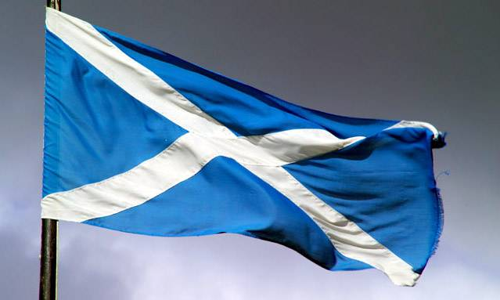
This is the flag of…
England
Scotland
Northern Ireland
Wales
CORRECT!

Slide 14
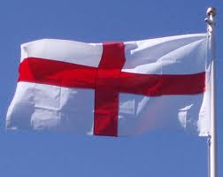
This is the flag of…
England
Scotland
Northern Ireland
Wales
CORRECT!

Slide 15
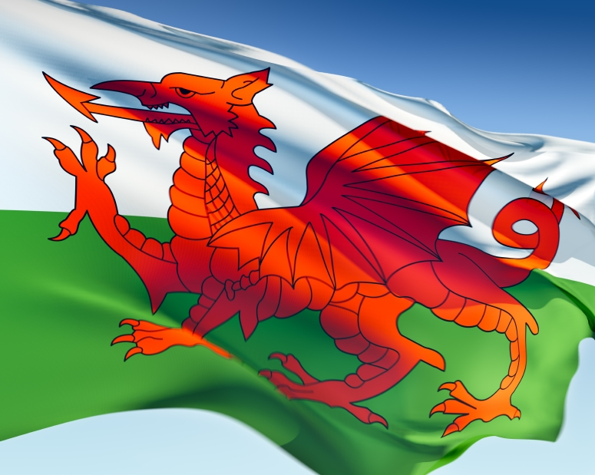
This is the flag of…
England
Scotland
Northern Ireland
Wales
CORRECT!

Slide 16
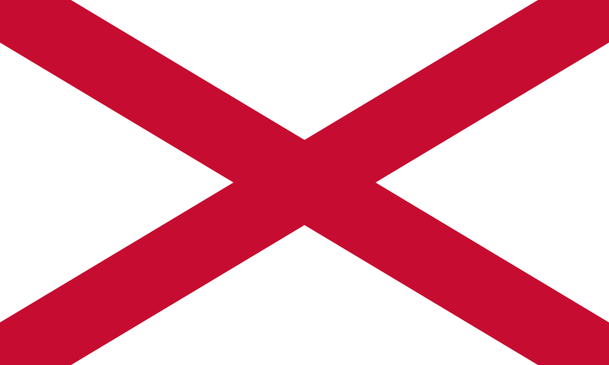
This is the flag of…
England
Scotland
Northern Ireland
Wales
CORRECT!

Slide 17
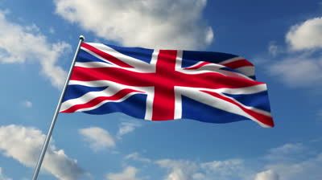
The flag of the UK is called…
Union John
United Jack
Union Jack
Play again

