Slide 1
SHE’S GOT BLUE EYES…

Slide 2
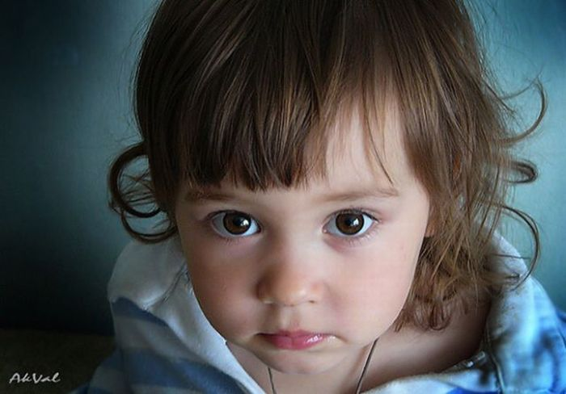
Посмотри на картинку, прочти предложение и выбери правильное слово.
She’s got big brown eyes and dark hair.
She’s got big brown/blue eyes and fair/dark hair.

Slide 3
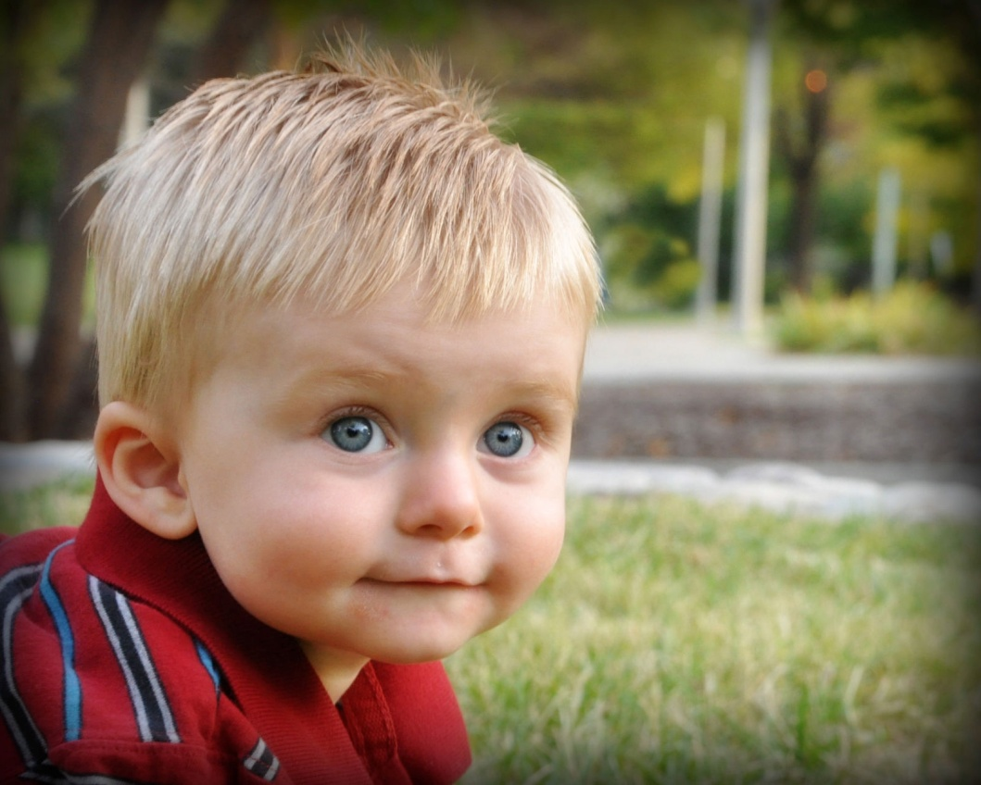
He’s got big green/blue eyes and fair/dark hair.
He’s got big blue eyes and fair hair.

Slide 4
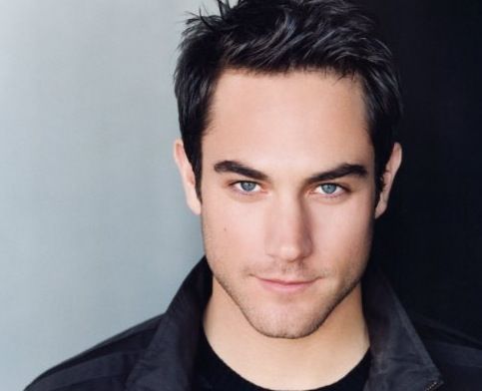
He’s got grey eyes and dark hair.
He’s got brown/grey eyes and fair/dark hair.

Slide 5
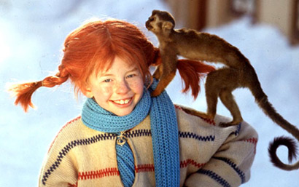
She’s got red/dark hair.
She’s got red hair.

Slide 6
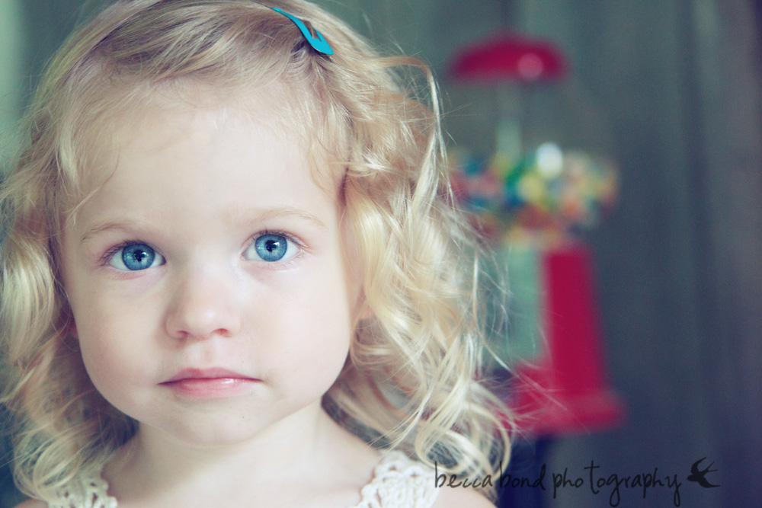
Посмотри на картинку и назови цвет глаз и волос.
She’s got blue eyes and fair hair.
She’s got …. eyes and …. hair.

Slide 7
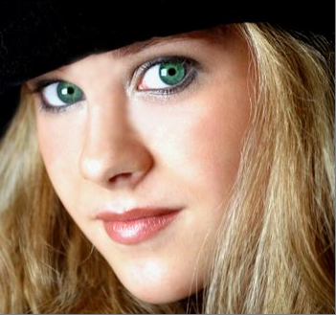
She’s got …. eyes and …. hair.
She’s got green eyes and fair
hair.

Slide 8
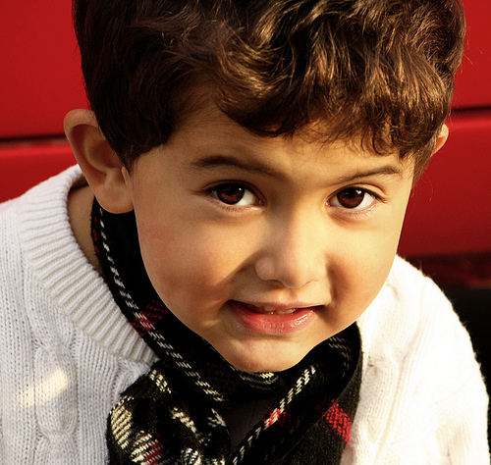
He’s got dark hair and brown eyes .
He’s got …. hair and ….. eyes.

Slide 9
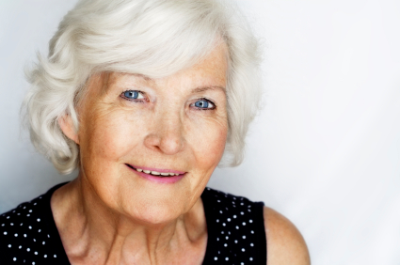
Посмотри на картинку и заверши предложение.
She’s got white hair and blue eyes.
She’s got ….

Slide 10
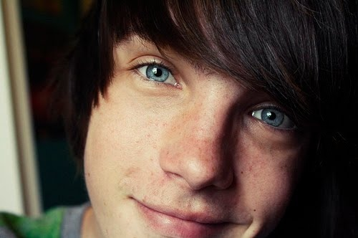
He’s got dark hair and blue eyes.
He’s got ….

Slide 11
А теперь расскажи о себе и о своих близких.
I’ve got …. hair and …. eyes.
My mum has got …. hair and …. eyes.
My dad has got ….. hair and …. eyes.
My sister/brother has got….
My grandma has got ….
My grandpa has got ….
My friend has got ….

Slide 12
GOOD JOB!
THE END

