Slide 1
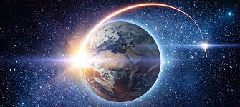
Cosmonautics Day
April,12

Slide 2
How are you today? What’s the weather like today? What date is it today?

Slide 3
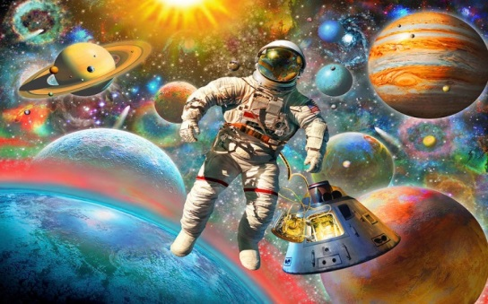
Today is the 12Th of April. And do you know what holiday is it today?
Today is Space day!
And today is 60 Years since the first flight into space was made. So according to this date and pictures what’s the aim of today’s lesson? For our unusual lesson you need special words. Let’s fill in the spider gram.

Slide 4
PHONETICS.PLANETS.
Today we will explore the planets.For this, we need to PRONOUNCE THEIR NAMES correctly. Listen to me and repeat after me all together.
https://youtu.be/ZHAqT4hXnMw
Netflix Jr.

Slide 5
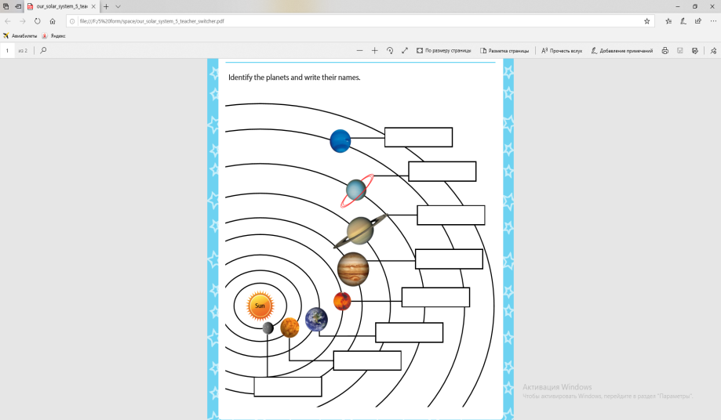
Work in pairs https://youtu.be/ASQkz4XaphU (solar system ). Find all the planets. Then watch the video and identify the planets.

Slide 6
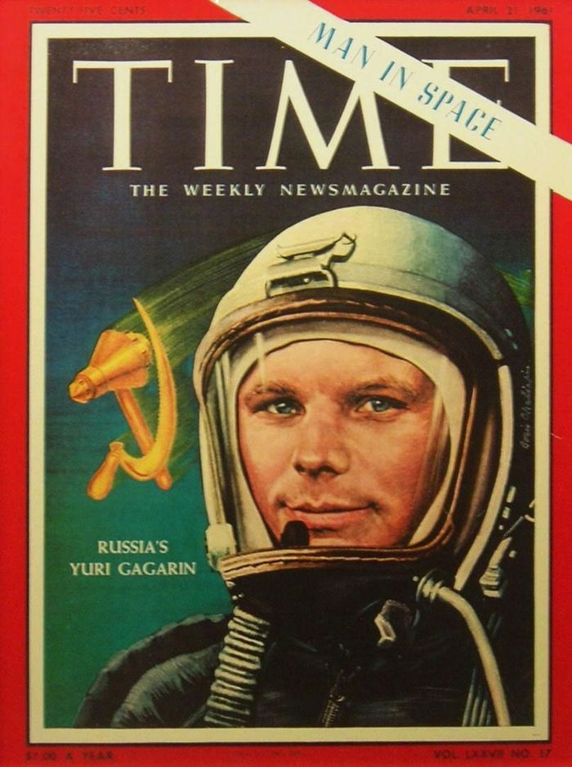
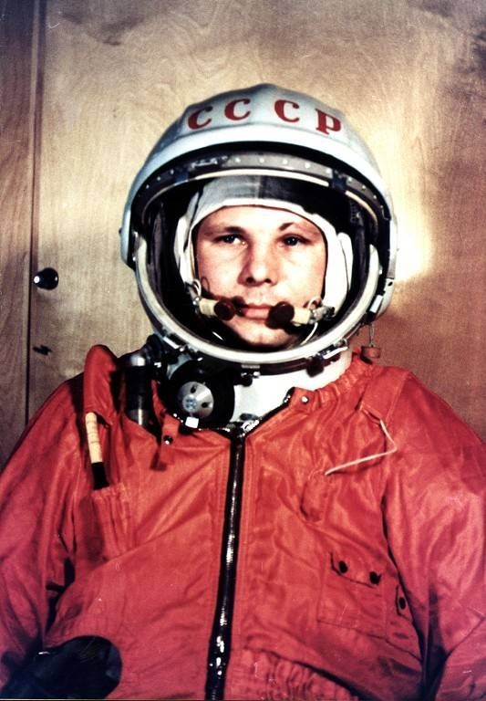
YURI GAGARIN

Slide 7
Who is an astronaut?
An astronaut or cosmonaut is a person who goes into outer space. The Soviet Union and countries that it was friends with used the word cosmonaut. Western countries including the United States said astronaut. Astronauts are also called "taikonauts" in China or "spationaute" in France. Soviet Union –Советский Союз

Slide 8
Read the text and answer the questions.
Yuri Gagarin is the first cosmonaut in the world. He was born on March 9,1934. His name is known to everybody. His life and work were a great example to all young people. In 1951 he finished a vocational school in Lyubertsy. When he was a school boy his favorite subjects were Physics and Math. Yuri Gagarin began to fly when he was a student of a technical secondary school. In 1955 he entered a flying school. On April 12,1961 Yuri Gagarin flew into space for the first time in history. He spent 108 minutes in space. When he came back in his spaceship “Vostok” he was made a Hero of the Soviet Union and was awarded the Gold Star medal. Yuri Gagarin visited many countries. Millions of people greeted him as a great patriot of our country. Yuri Gagarin was a commander of the cosmonaut group. People will always remember him as the world’s first cosmonaut.

Slide 9
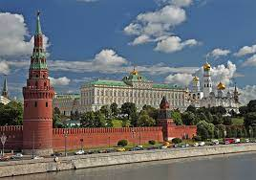
Answer the questions
Who is the first cosmonaut?
When did Yuri Gagarin fly into space?
How many minutes did he spend there?
What medal was he awarded?
And I want to show you some interesting facts:
Yuri Gagarin on BBC TV, July 11 1961
https://youtu.be/KSvAe7_GjJM

Slide 10
Let’s have a rest
Listen to music. https://youtu.be/8g8DfmfsVv4
Close your eyes.
Hands up
Hands down
Open your eyes

Slide 11
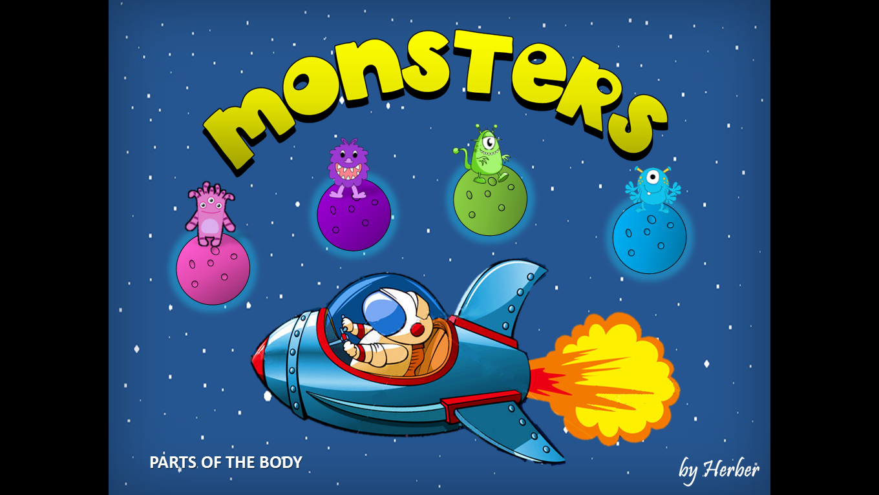
Let’s play
Describing monsters (aliens)

Slide 12
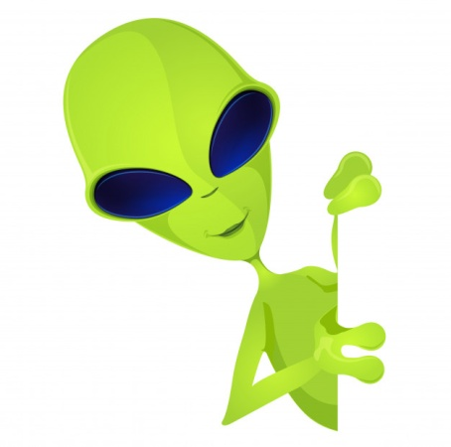
Conclusion
So what new words have we learnt?
Can you speak about space and planets?
Do you remember some fact about Yuri Gagarin?
Was it easy or hard?
Your marks are…
Your HT is to learn new words by heart
Thank you

Slide 13
Resources
Our solar system-teacher-switcher_vk #teacher_switcher #ts_idea #teacher_switcher
https://youtu.be/8g8DfmfsVv4
www.learnenglishkids
https://youtu.be/ASQkz4XaphU
Cambridge English Dictionary
https://youtu.be/KSvAe7_GjJM
Multiurok.ru
English PROPS | Ideas Games Materials

