Slide 1
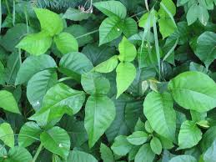
Plants and their using
Group blue

Slide 2
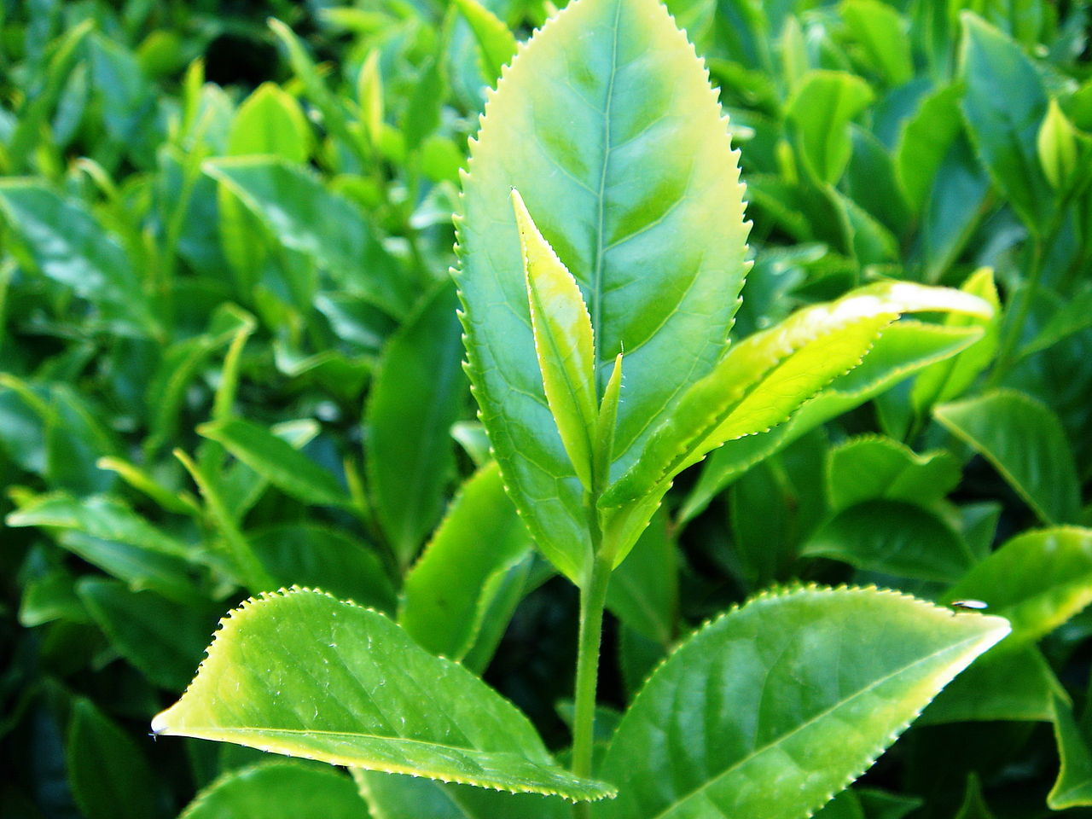
We are going to talk about:
Pine
Rowan tree
Fireweed
Urtica dioica
Ledum
Juniper communis
Sorrel
Birch

Slide 3
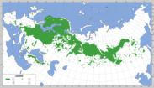
Pine
Bread (bark)
Snacks
Bacteria
Building
Europe, Asia
45m high ca.
Lives the hole year
Mai-June

Slide 4
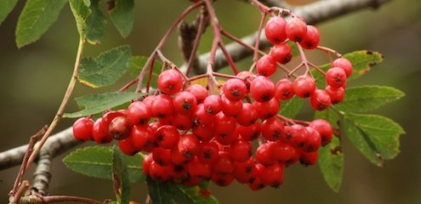
Rowan tree
Water cleaning
Sauna
Berries
Juice
Early spring
September

Slide 5
Fireweed
Use for tea
Different taste of the leaves
Spread seed in autumn
Springs in the spring
Great taste like asparges
First week of skoting
0,6-1,25m high

Slide 6
Urtica dioica
Eating in the spring
Clothes
Ropes
Tired jump in
Used for Tea
Medicine
Jam
June-September harvest season
Spread seed in August- October
Eurasian continental plate
Over 50cm high

Slide 7
Ledum
Tea
Sauna
Poisonous
Medicine
North Europa and Siberia
Lives the hole year
50-150 cm high
It lives in the mire
In the beginning of the spring

Slide 8
Juniper communis
Washing
Protect you for spirits
10-12m high
Lives almost everywhere
Important for the animals
Food
Medicine
Good taste
Perfumery
Berries
August-September good to eat
Blom in April-June

Slide 9
Sorrel
Saur
30-90cm high
Red, dark red or green blooms
Eurasian Continental palte
Food
Weed
June-July

Slide 10
Birch
Juice
Sauna
Funiture
Treewoods
Use to make dfferent things instead of plastic
Leaves falls down autumn
The seeds fall down in August
Europa and North America
Bud burst from may-june

Slide 11
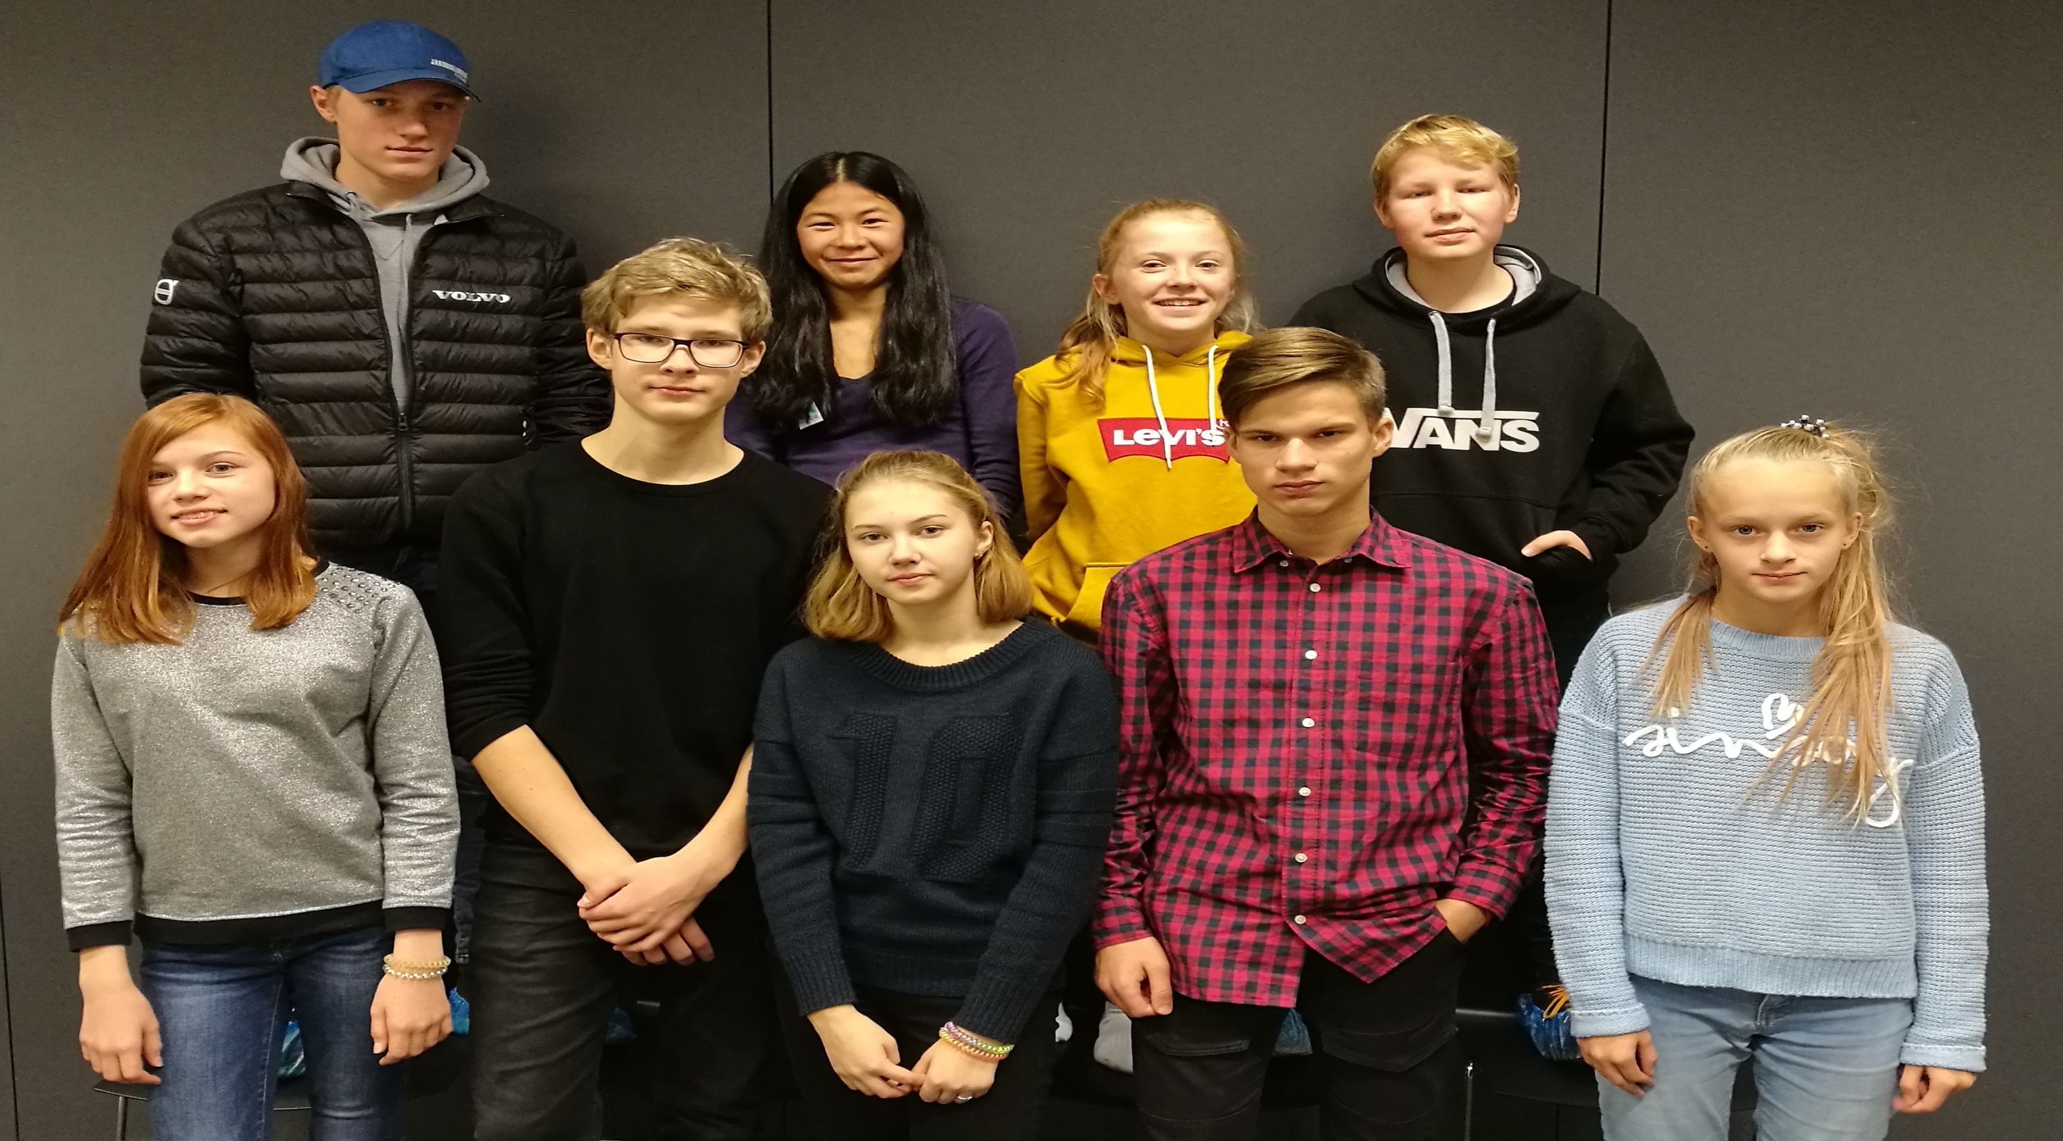
Group Blue
Thanks
For your attention

