Slide 1
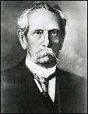
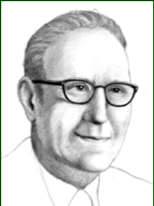
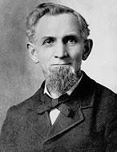
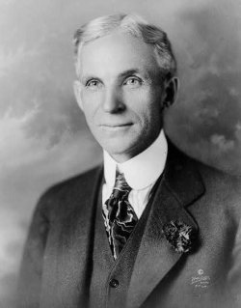
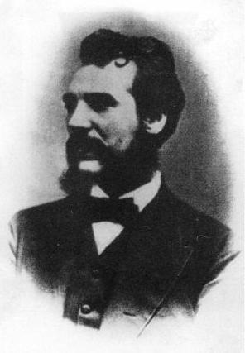
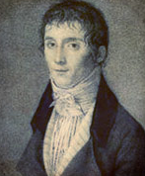
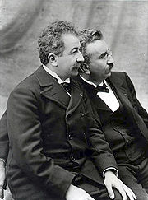
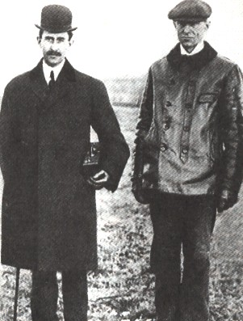
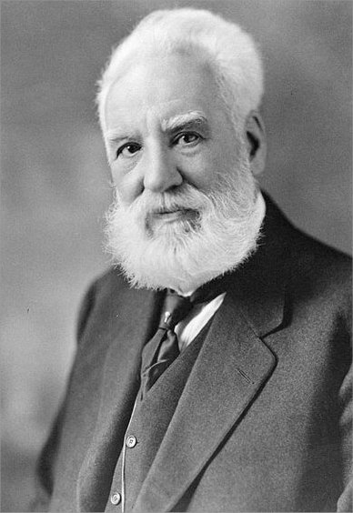
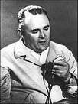
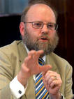
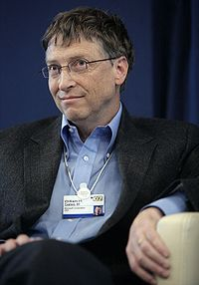
INVENTIONS AND INVENTORS.

Slide 2
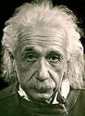
"To raise new questions, new possibilities, to regard old questions from a new angle, requires creative imagination and marks real advance".
"Imagination is more important than knowledge".
Albert Einstein

Slide 3
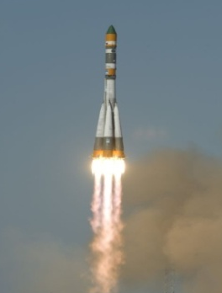
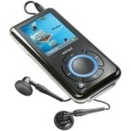
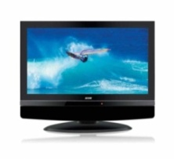
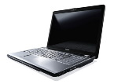
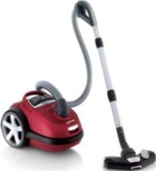
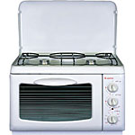
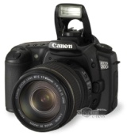
To invent is to see anew.
An invention is a new composition, device, or process. Some inventions are based on pre-existing models or ideas and others are radical breakthroughs. Inventions can extend the boundaries of human knowledge or experience.

Slide 4
INVENTIONS:
1. Nicephore Niepce from France pioneered photography in 1829.
2. In 1876 Alexander Graham Bell, an American engineer, invented telephone.
3. Karl Benz produced the world’s first petrol-driven car in Germany in 1878.
4. In 1895 the Lumiere brothers patented their cinematography and opened the world’s first cinema in Paris.
5. The first Russia’s automobile was designed by P.A.Frez and E.A.Yakovlev. By May 1896 the car had been built.
6. Wilbur and Orville Wright built the first airplane in 1903.
7. The first ballpoint pen was produced in 1940 though it had been invented by L. Biro, a Hungarian artist and journalist, in 1905.
8. In 1908 James M. Spangler from the USA built the first vacuum cleaner.
9. In 1908 US automobile manufacturer Henry Ford created the world’s first car assembly line.
10. John Logie Baird from Scotland invented television in 1926.
11. In 1928 Richard Drew perfected the Scotch tape, which had been invented by Jim Kirst from the USA in 1923.
12. In 1945 the Nobel Prize was given to Alexander Fleming for penicillin that had been discovered in 1928.
13. Sergey Korolyev designed the first artificial satellite in 1957.
14. Akio Morita developed the first personal stereo – Sony Walkman in 1957.
15. In 1981 Bill Gates created Microsoft-DOS (Disk Operating System).
16. Scottish scientist Ian Wilmat developed the idea of cloning in 1997.

Slide 5
Some inventors:

Slide 6
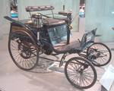
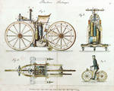
Karl Friedrich Benz (1844 – 1929)
Karl Friedrich Benz was a German engine designer and automobile engineer, generally regarded as the inventor of the petrol-powered automobile and pioneering founder of the automobile manufacturer, Mercedes-Benz.

Slide 7
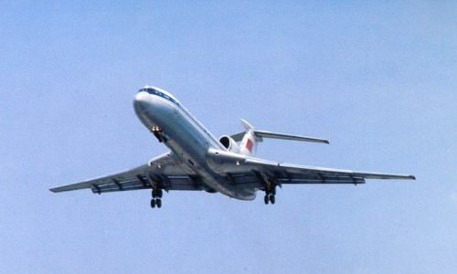
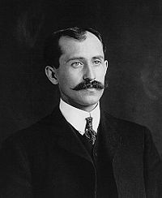
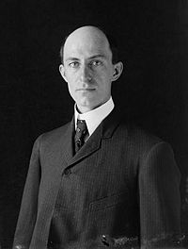
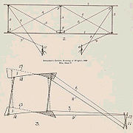
The Wright brothers: Orville (1871 – 1948) Wilbur (1867 – 1912)
The Wright brothers were two Americans who are generally credited with inventing and building the world's first successful airplane and making the first controlled, powered and sustained heavier-than-air human flight, on December 17, 1903. In two years afterward, the brothers developed their flying machine into the first practical fixed-wing aircraft. The Wright brothers were the first to invent aircraft controls that made fixed-wing flight possible.

Slide 8
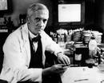
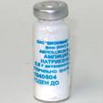
Alexander Fleming (1881 – 1955)
Sir Alexander Fleming was a Scottish biologist and pharmacologist. His best-known achievements are the discovery of the enzyme lysozyme in 1923 and the antibiotic substance penicillin from the fungus Penicillium notatum in 1928, for which he shared the Nobel Prize in Physiology or Medicine in 1945 with Howard Walter Florey and Ernst Boris Chain.

Slide 9
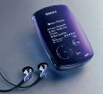
Akio Morita (1921 — 1999)
Akio Morita was a Japanese entrepreneur, cofounder of Sony Corp. In 1949, the company developed magnetic recording tape and in 1950, sold the first tape recorder in Japan. In 1957, it produced a pocket-sized radio.

Slide 10
I prepared presentation schoolgirl of the 11th class "A" schools № 6 city Yuzhno-Sakhalinsk Aleksandrova Elena.

