Slide 1
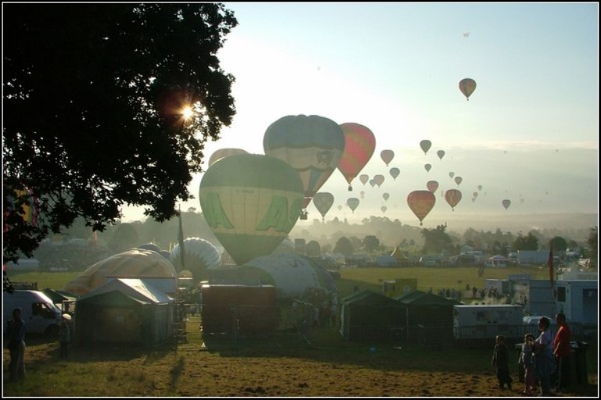
Aviation in the UK

Slide 2
General Aviation
General aviation in the United Kingdom has been defined as a civil aircraft operation other than a commercial air transport flight operating to a schedule. Although the International Civil Aviation Organization (ICAO) excludes any form of remunerated aviation from its definition, some commercial operations are often included within the scope of general aviation (GA) in the UK. The sector operates business jets, rotorcraft, piston and jet-engined fixed-wing aircraft, gliders of all descriptions, and lighter than air craft.
The ICAO Flag

Slide 3
Statistics
Of the 21,000 civil aircraft registered in the UK,[1] 96 per cent are engaged in GA operations, and annually the GA fleet accounts for between 1.25 and 1.35 million hours flown. The single most common class of aircraft is the fixed-wing light aircraft associated with traditional GA, but the main area of growth over the last 20 years has been in the use of more affordable aircraft, such as microlights, amateur built aeroplanes, and smaller helicopters. There are 28,000 Private Pilot Licence holders, and 10,000 certified glider pilots. Some of the 19,000 pilots who hold professional licences are also engaged in GA activities. Although GA operates from more than 1,800 aerodromes and landing sites, ranging in size from large regional airports to farm strips, over 80 per cent of GA activity is conducted at 134 of the larger aerodromes. The GA industry, which is around 7 per cent the size of its CAT cousin, employs 12,000 people, and contributes £1.4 billion to the UK economy.
Traditional general aviation fixed-wing light aircraft, the most numerous class of aircraft in the sector

Slide 4
First steps
The first aerodrome in the UK was established by the Aero Club at Muswell Manor on the Isle of Sheppey, and in May 1909 it was the venue of the first flight conducted in the country by a British pilot, John Moore-Brabazon. In 1910 the Aero Club was granted the Royal prefix, took responsibility for controlling all private flying in the UK, and started issuing the first British pilot licences. The introduction of the de Havilland DH.60 Moth in 1925 revolutionised light aviation, and the Royal Aero Club, recognising the "vital necessity of promoting civil flying", formed the Light Aeroplane Club scheme. Between 1925 and 1939 around 60 flying clubs were started, and more than 5,000 pilots were trained.
Amy Johnson and her de Havilland
DH.60 Moth 'Jason'

Slide 5
Activities
Commercial operations
Commercial operations are remunerated activities which fall within the ICAO definition of CAT. Some are, however, closely aligned to, and considered part of, the GA sector.[3][4][20] Public transport operations are non-scheduled, on-demand services flying between points specified by the customer, providing a more flexible service than airline travel. Air taxi operations offer charter services for third parties, and business or corporate aviation uses company-owned aircraft to transport employees and clients.
Flying schools
Flying schools are commercial businesses engaged in the training of pilots, both for recreational purposes and for those intending to fly professionally. They make widespread use of fixed-wing light aircraft associated with traditional GA, not only for flying lessons but also as club aircraft rented out to qualified pilots for recreational flights.
Private flying
Private flying can be for both recreational purposes and personal transport, using aircraft that are owned individually, collectively as part of a syndicate, or rented from a flying club. A survey of pilots conducted between 2001 and 2002 indicated that the most common purposes of recreational flights were local flights near the base aerodrome, visits to other aerodromes, and day trips away.
Sports
Gliders at the 2004 Standard Class Nationals race
Competitive gliding in the UK takes place between May and September. Regionals are local competitions, organised and run by one of the bigger gliding clubs in the region, and represent the entry level to glider racing. Races are handicapped according to glider performance, and normally take place over nine days. Success in the regionals allows pilots to progress to the nationals

Slide 6
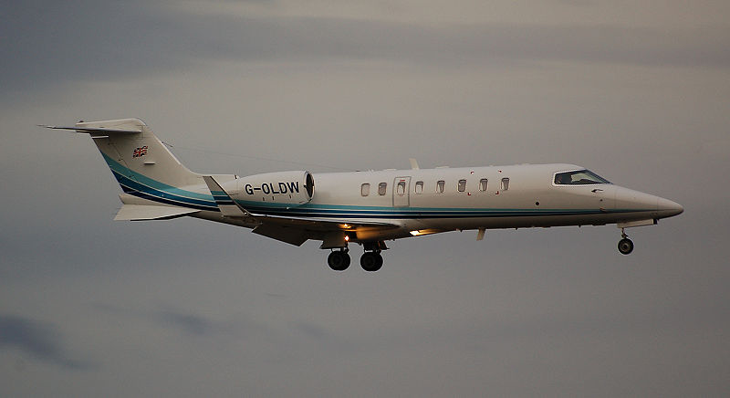
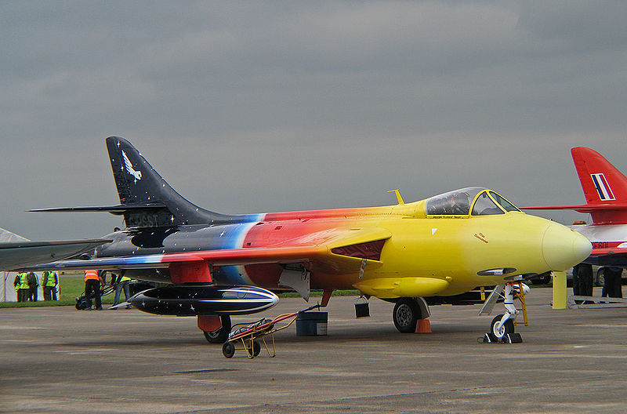
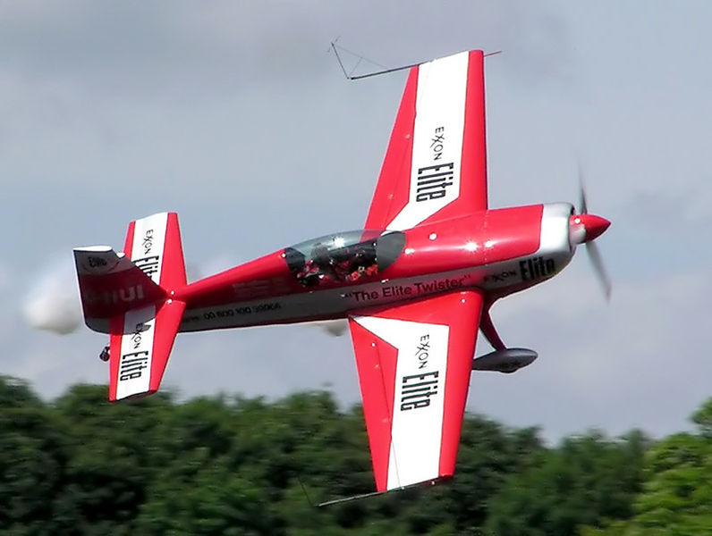
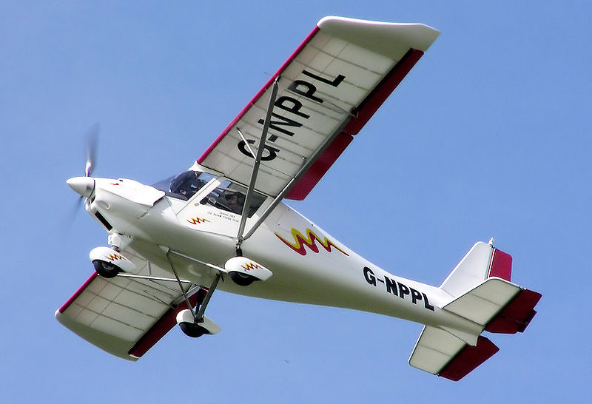
Business aviation
"Miss Demeanour" - privately owned
Extra 300 Unlimited class aerobatic aircraft
Ikarus C42 fixed-wing microlight

Slide 7
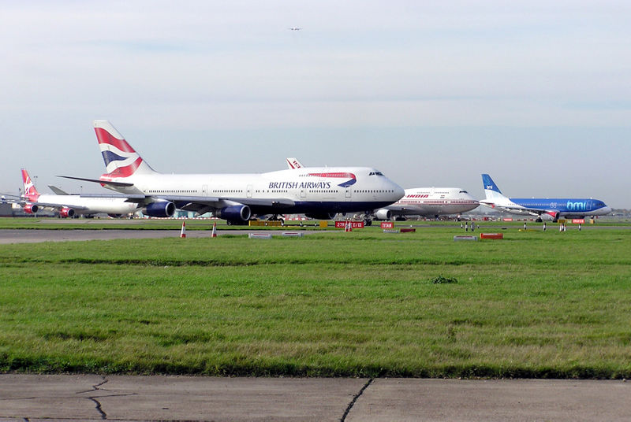
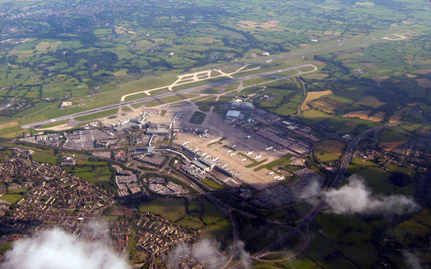
Airports in the UK
London serves as the largest aviation hub in the world by passenger traffic, with five international airports, handling over 133 million passengers in 2011,more than any other city. London's second busiest airport, Gatwick, is the world's busiest single runway airport.The aircraft movement of London's combined gateways is second only to New York City in runway operations (number of takeoffs and landings).
The United Kingdom is home to many of Europe's largest and busiest airports as well as one of the busiest international airports in the world, London Heathrow Airport, which handles over 67 million international passengers annually.
Queue of aircraft for take-off at London Heathrow Airport which handled 69million passengers in 2011
Manchester Airport, the third busiest airport in the UK and busiest of the non-London airports.

Slide 8
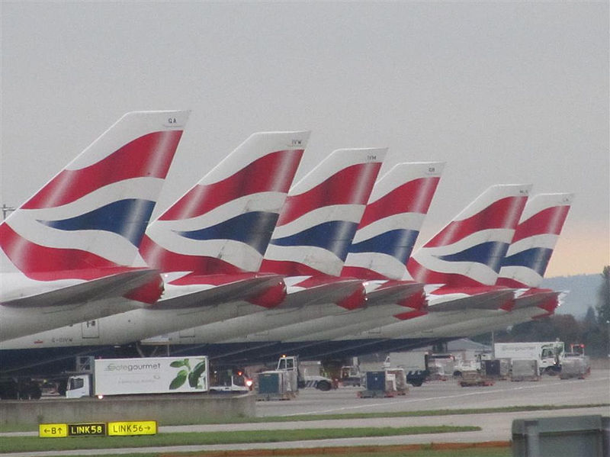
The End

