Slide 1
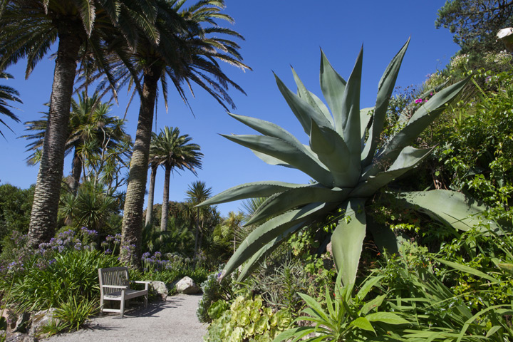
Tresco Abbey Gardens
Scilly Isles

Slide 2
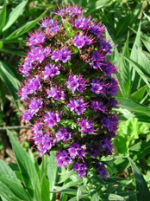
Welcome to the Abbey Garden
Open 10am - 4pm every day.
The adult entry ticket is £12.00 but all children under the age of 16 can visit the garden free of charge.
The sub-tropical Abbey Garden is a glorious exception - a perennial Kew without the glass - shrugging off salt spray and Atlantic gales to host thousands of exotic plants.

Slide 3
The history of Tresco Abbey Garden
In 1834 Augustus Smith left Hertfordshire and took up residence on the Isles of Scilly as Lord Proprietor and leaseholder of all the islands. He chose to live on Tresco and selected a site adjacent to St Nicholas Priory - which had fallen into disrepair in the sixteenth century - to build his home.
On a rocky outcrop above these ruins Augustus Smith built his house, which he named Tresco Abbey. In addition to constructing the house, he started almost immediately creating a garden based around the St Nicholas priory. In order to protect his early plantings from the winter gales, he built a series of walls around the garden.

Slide 4
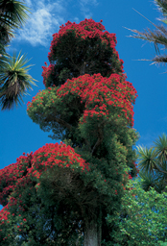
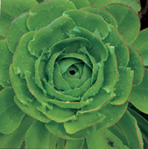
Plants
Garden-flame tree
Summer breezes and salty winter gales alike push through the foliage of Protea , Leucadendron , Aloe, Banksia , Callistemon , Dryandra and Cape heaths.
Plant life from all corners of the globe thrives in this maritime position, thirty miles out in the Atlantic Ocean. The top terrace with its sea views and open, sunny-aspect, is home to many plants from the dry regions of Australia and South Africa.
Garden-Aeonium

Slide 5
Tresco's Historic Monuments
Tresco is famed for its natural beauty, its mild climate and its exotic gardens, but this idyllic island has also been in the frontline of Britain’s defences since the 16th century. Due to the threat from the Spanish and the French, two Tudor forts (the Old Blockhouse and King Charles’ Castle) were built to defend the harbours at Old Grimsby and New Grimsby, where enemies would try to land their troops.
In the mid-17th century Tresco had a prominent role in the Civil War and saw fighting and bloodshed and Cromwell’s Castle was built in the early 1650s to strengthen the defences of New Grimsby harbour. From the 18th century onwards government military expenditure in Scilly was devoted to the major fortifications on St Mary’s, but during World War I a seaplane base was established at New Grimsby and part of its site is now occupied by accommodation for visitors.

Slide 6
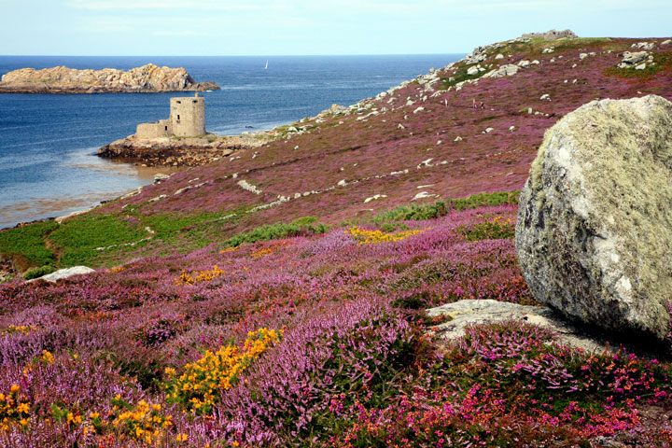
Tresco Castles

Slide 7
Things to do
Boat trips - Bryher Boat Services visit other islands daily as well as trips to see birds and seals. Private charters and fishing trips are also available.
Cycling - Bike hire is available on Tresco and St Mary's.
Diving - Explore Scilly under the sea, swim with seals or simply snorkel off one of the many sandy beaches surrounding the island with Isles of Scilly Diving School
Fishing - Trips can be arranged through Bryher Boat Services (see above) or you can fish from the shore, the deep clear waters are perfect for Pollock, Mackerel, and Mullet to name but a few. Or when tides permit simply grab a net and go shrimping!
Sailing/Windsurfing/Canoeing

Slide 8
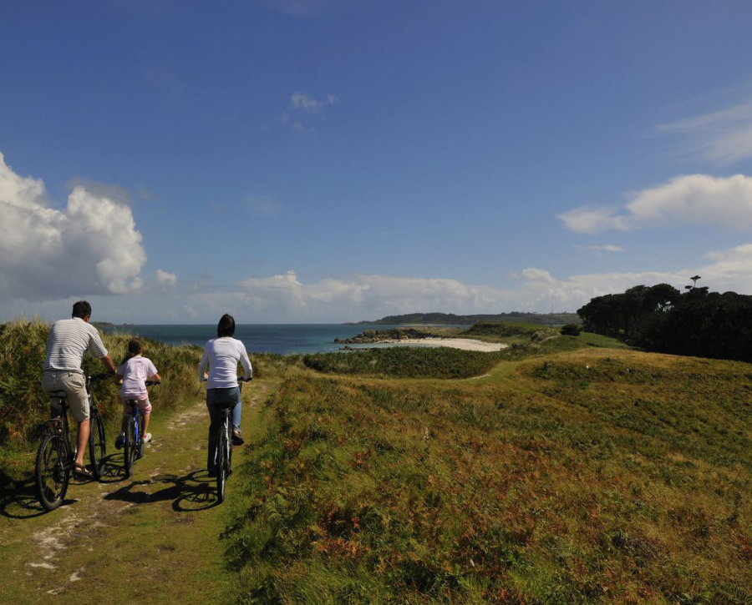
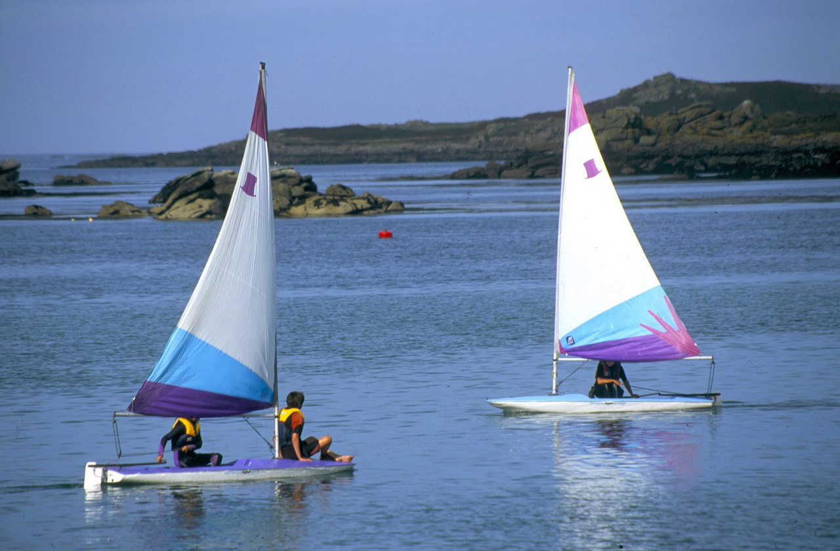
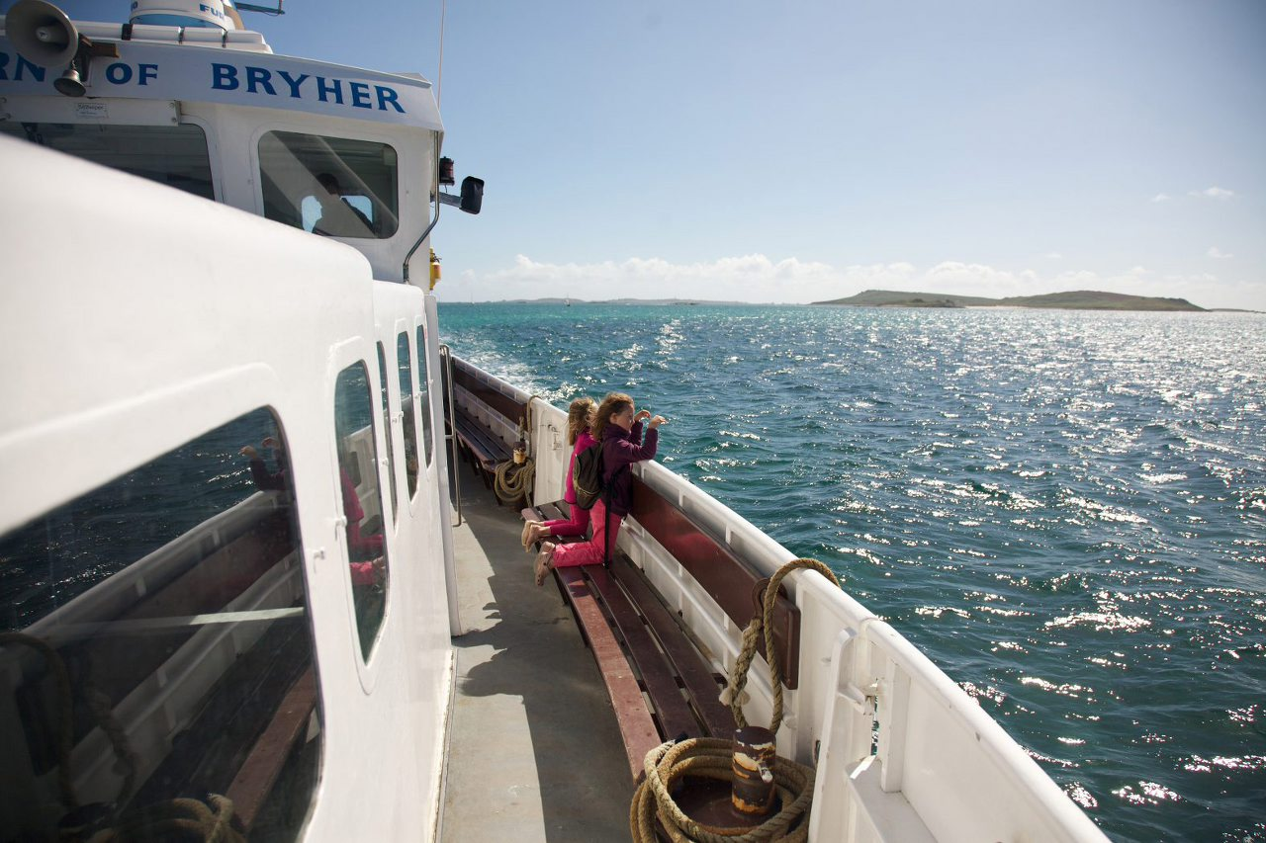

Slide 9
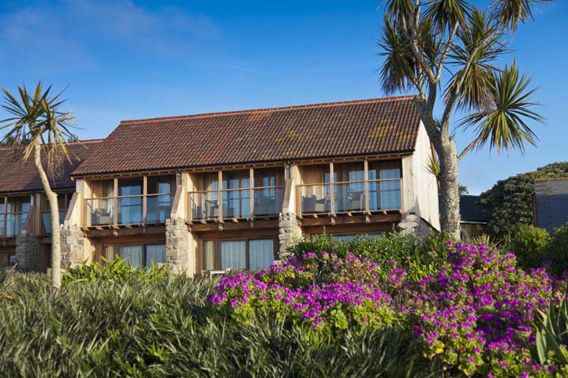
Accommodation
Tresco has a wide range of accommodation, from fully-serviced rooms to self-catering cottages available by the night, by the week or even by the year, with our long-standing 30 year timeshare opportunities.
By the night - The Sea Garden Cottages at the Island Hotel and The New Inn.
By the week - Tresco's rental holiday cottages provide a range of high-quality self-catering options. In addition, there are also the stylish, contemporary beachfront houses of the Flying Boat Club.
By the year - Timeshare cottages.
The Sea Garden Cottages

Slide 10
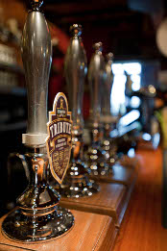
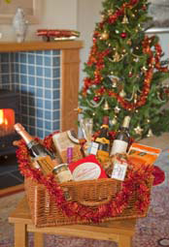
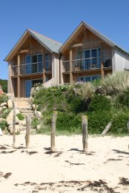
Christmas and New Year on Tresco
The New Inn - The convivial atmosphere at the New Inn makes for a warm and welcoming place to spend Christmas and New Year on Tresco.
As well as rooms at the welcoming New Inn, there is a range of self-catering accommodation available, from traditional cottages to the beachfront houses at the Flying Boat Club. All of these come with their very own Christmas tree, a seasonal hamper, including champagne, wine and assorted local goodies.
Tresco Cottages - Enjoy a very special island Christmas and New Year on Tresco. Stay with your family in one of our luxurious cottages, which can accommodate up to 10 people.

Slide 11
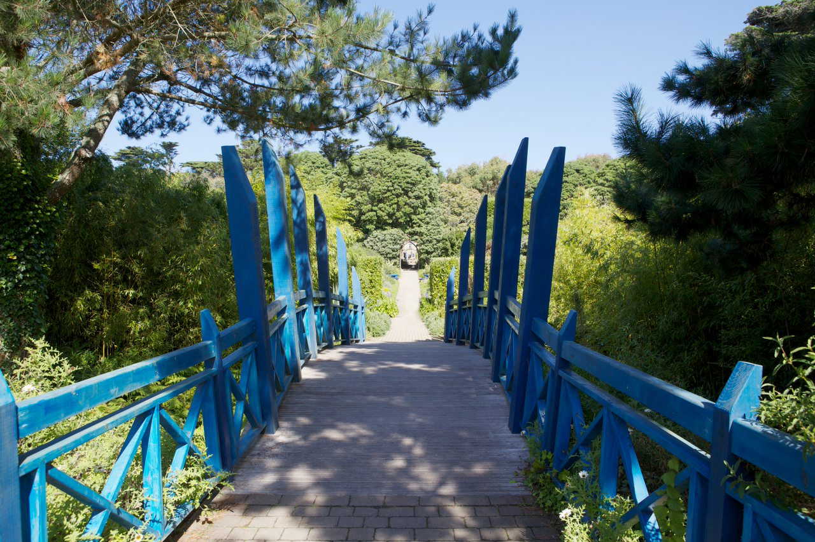
THE END

