Slide 1
Landmark of Russia
Motherland.
Volgograd city.

Slide 2
Motherland
Sculpture /Motherland is calling/
Sculptor Eugene Vuchetich and engineer
Nikolai Nikitin

Slide 3
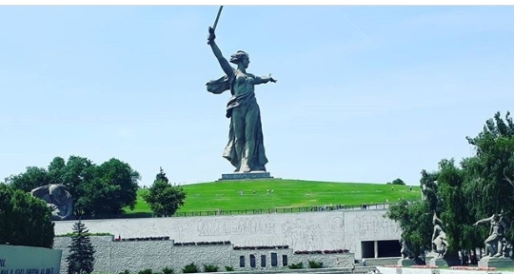
Motherland
The central monument was created for the heroes of the Battle of Stalingrad on the Mamaev Kurgan in Volgograd

Slide 4
Motherland
One of the highest statues in the world. The highest statue of Russia and Europe.
The construction of the monument began in May 1959 and was completed on October 15 ,1967.
The work is a figure of a woman stepping forward with a raised sword, calling her sons to battle with the enemy.

Slide 5
Thank you very much

