Slide 1
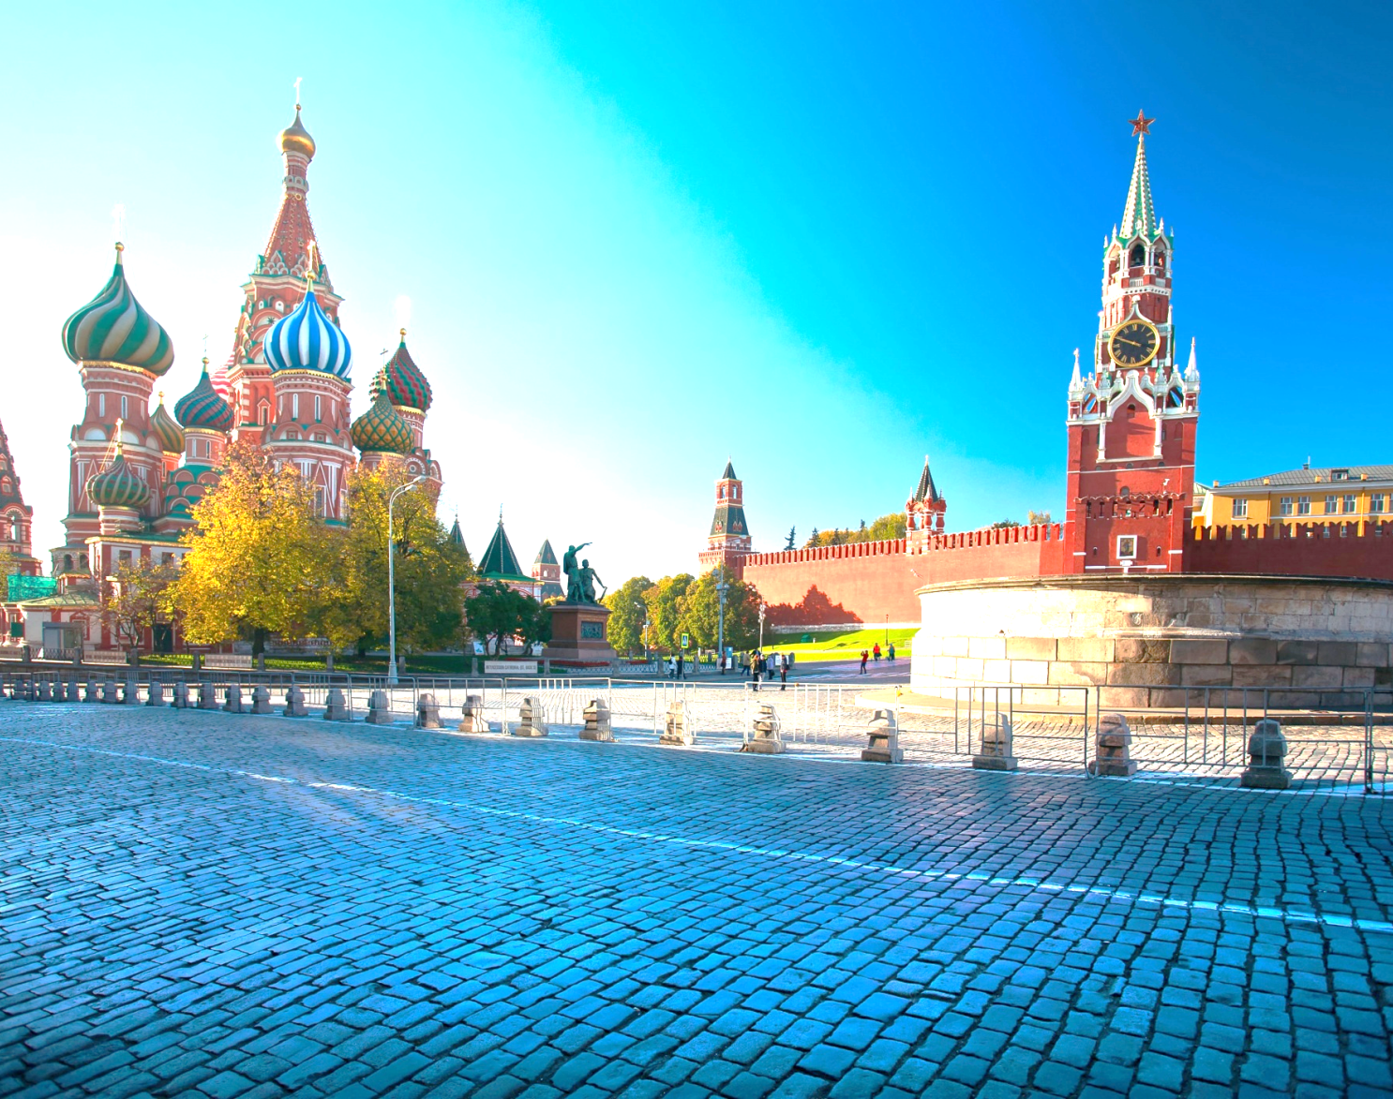
Red Square
Red Square is the main and most famous square in Moscow and Russia, the arena of many important events of Russian history and the history of the Soviet state, the place of mass demonstrations of the working people of the capital and parades of the Armed Forces of Russia.
Even in ancient times, an area appeared near the eastern wall of the Kremlin, where busy trade was noisy. In the Middle Ages, fires often blazed here, so the square also had another name - “Fire”. From the middle of the 17th century they began to call it “Red”, which in Old Russian meant “beautiful”.

