Slide 1
Icons of Volgograd
Sergeev Stas
7th form pupil
Teacher: Kobyzeva N.B.
2016

Slide 2
Mamaev Kurgan
The complex’s centre part is an extraordinarily 72 m-high statue of Mother Russia handing a sword

Slide 3
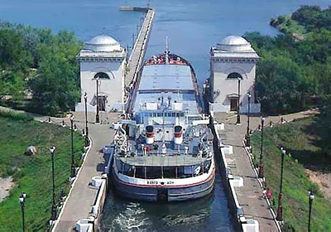
Volga-Don Canal
Was built in 1952. The Volga-Don Canal is the big gateway to the White and the Black Seas via the Volga and Don Rivers.

Slide 4
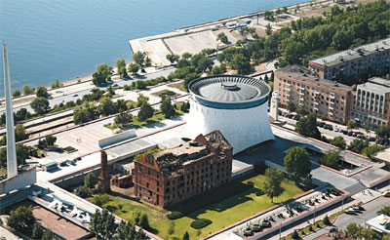
Battle of Stalingrad
This museum, part of the Battle of Stalingrad museum complex, has dozens of exhibits on the Battle of Stalingrad and the soldiers who fought.

Slide 5
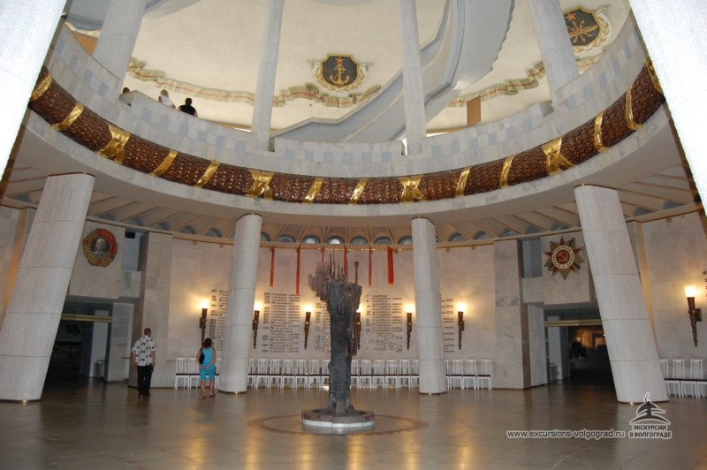
360-degree Battle of Stalingrad Panorama

Slide 6
Resorces
http://poiskvolgograd.ru/wp-content/uploads/2015/11/muzei-5.jpg
http://www.excursions-volgograd.ru/pc/excursionimage_pic/dsc_0125.JPG?1401022839
http://www.rus-shipping.ru/upload/stats/rtf/120_untitled-315.jpg
http://www.lonelyplanet.com/russia/volga-region/volgograd/sights

