Slide 1
Electric Circuit

Slide 2
Say after me and translate:
circuit
conductor
function
difference
open
short
trouble
no
to reduce
to supply
to connect
to compare
to pass through
to result in
to result from

Slide 3
No current through circuit results from an open.
A trouble in a circuit results in no current in it.
Current passes through
the circuit.

Slide 4
Complete next sentences:
- An electric circuit consists of…
- A voltage source…
- A conductor…
- A resistor…
- A short and an open…

Slide 5
Answer the questions:
What other elements does a circuit consists of?
What is the function of a voltage source?
What is the function of a conductor?
What is the function of a resistor?
When is there no current in a circuit?
What does an open and a short result in?
What does no current in a circuit result from?

Slide 6
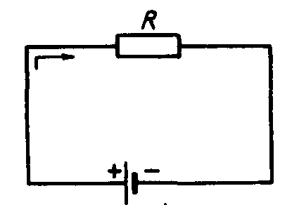
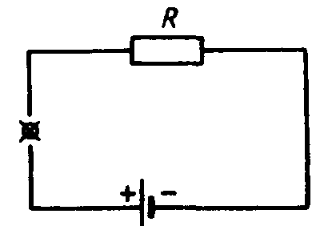
Describe the circuits

