Slide 1
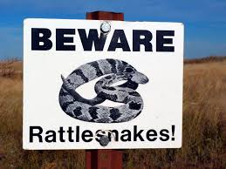
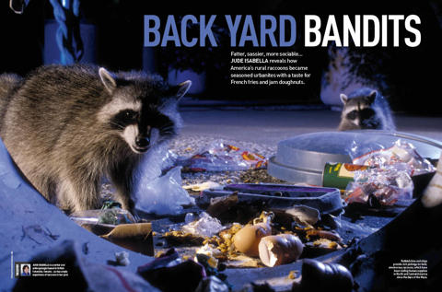
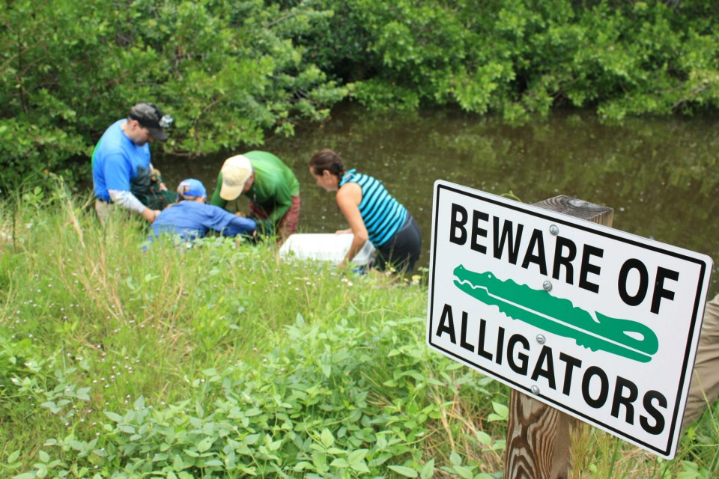
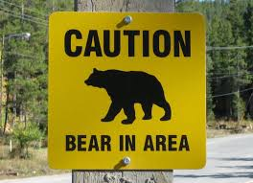
Beware! The USA’s Dangerous Wild Animals

Slide 2
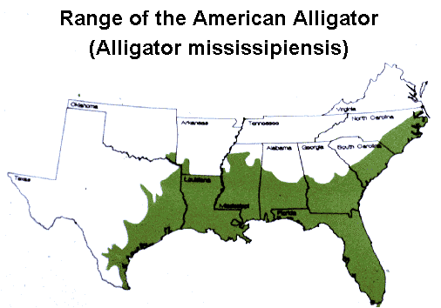
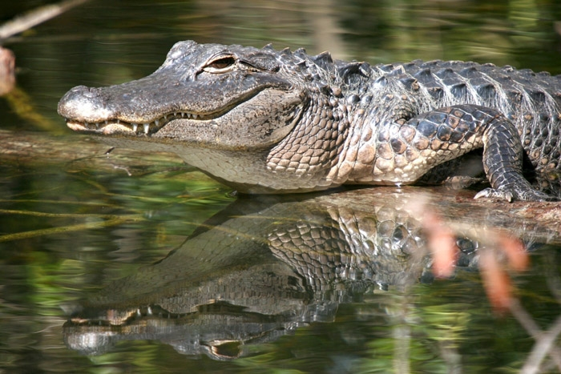
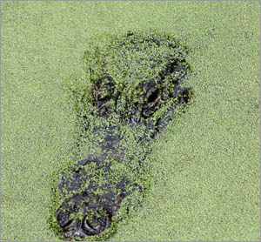
Never try to feed alligators or walk too close to the edge of the water!

Slide 3
Alligators are usually 3 to 5 metres long. They have about 80 constantly replacing teeth.

Slide 4
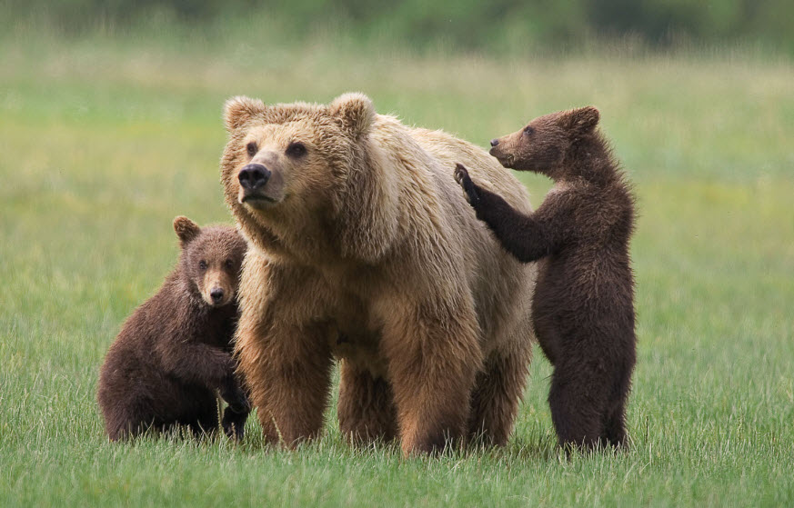
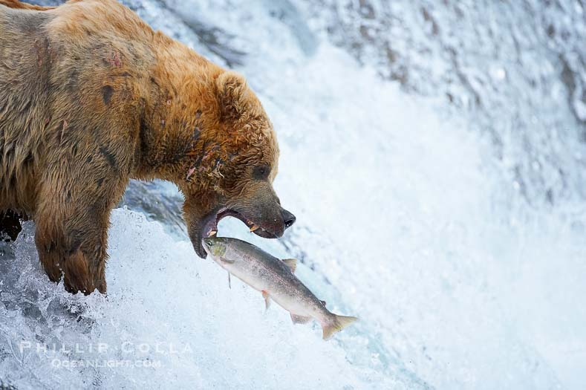
Grizzly bears can be unpredictable and ferocious. Don’t run if you attacked!

Slide 5
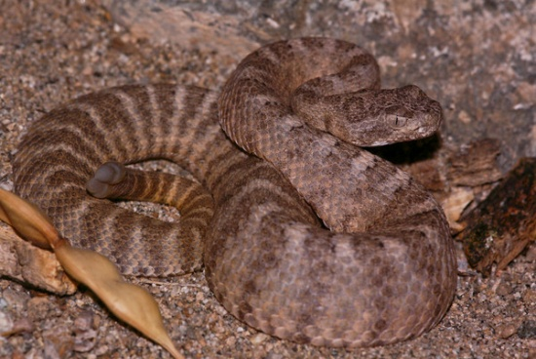
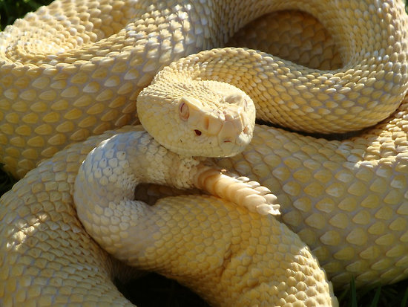
If you know there are rattlesnakes around, wear strong leather boots!

Slide 6
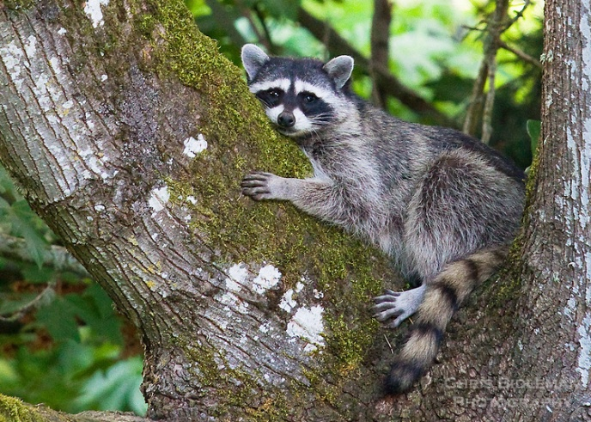
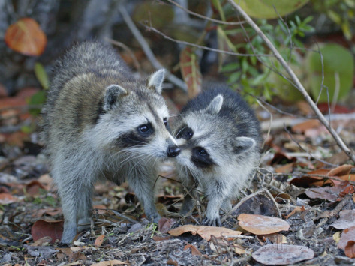
Raccoons carry many diseases. If you are ever scratched by one, wash the scratch well and see a doctor immediately!

Slide 7
Do some research about dangerous wild animals in your country.

