Slide 1
Western Democracies.
Are they democratic ?

Slide 2
Discuss the questions :
What kinds of political systems do you know ?
How do they work in different countries ?
Do people take an active part in politics ?
Do you want to take part in politics ? Why?

Slide 3
What is the United Kingdom of Great Britain and Northern Ireland ?

Slide 4
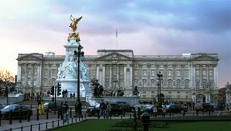
British Monarchy
Buckingham Palace is the monarch's principal residence.

Slide 5
Who is the head of the UK ?

Slide 6
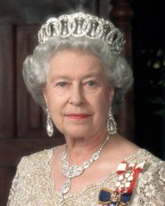
Her Majesty Queen Elizabeth II
Born :April 21, 1926 London, United Kingdom
Reign: February 6, 1952 - Present
Coronation:June 2, 1953
Heir Apparent : Charles, Prince of Wales
Spouse : Prince Philip, Duke of Edinburgh
Royal House : Windsor

Slide 7
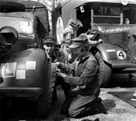
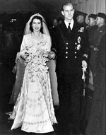
Early Life
Princess Elizabeth changing the wheel of a lorry during the war.
The Duke and Duchess of Edinburgh on their wedding day.

Slide 8
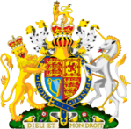
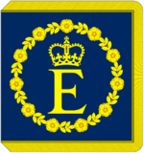
Queen’s emblems
The Queen's personal flag, used when she is representing the Commonwealth
The Queen's
Coat of Arms
in the United Kingdom

Slide 9
Who makes laws in the UK ?

Slide 10
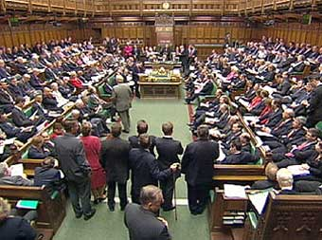
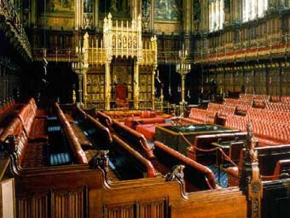
British Parliament
The House of Commons:
about 650 elected MPs
The House of Lords :
over 1,100 non-elected members

Slide 11
What institution represents the executive power in the UK ?

Slide 12
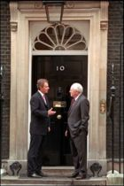
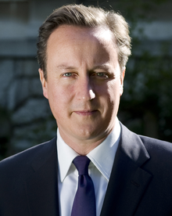
The Government
Prime Minister of the United Kingdom
In office since : 11 May 2010
Deputy :Nick Clegg
Preceded by : Gordon Brown
Born : October,9, 1966
London,England
Political party : Conservative
Spouse :Samantha Sheffield
David Cameron

Slide 13
The USA
Is it a monarchy or a republic ?
Who heads the country ?

Slide 14
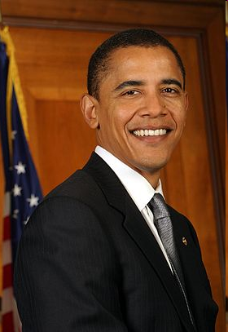
The United States of America
The President
In office since : 2009
Preceded by :George W. Bush
Born: August 4, 1961
Political party :
the Democratic party
Spouse: Michelle Obama
(m. 1992)
Children: Malia Ann (b.1998)
Sasha (b.2001)
Barack Obama

Slide 15
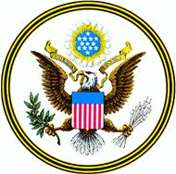
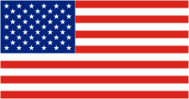
The National Emblem
The Stars and the Stripes
and Old Glory.
The Bald Eagle.
“E Pluribus Unum”-
“One out of many”.
An eagle , holding a bangle of rods
(the symbol of administer) and
an olive twig (the emblem of love)
Red - courage,
White - liberty,
Blue - loyalty

Slide 16
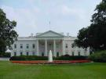
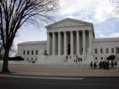
Branches of Power
the Capitol-
the USA Congress-
the legislative branch
the White House-
the USA President-
the executive branch
the Supreme court-
the Supreme Court –
the judicial branch

Slide 17
What are the main political parties in the USA ?
What are their emblems?

Slide 18
Political Parties
the Republican party resides at present in White House
The Democratic party

Slide 19
The national motto of the USA is
In God We Trust.

Slide 20
What country do you live in ?
Are you a patriot ?

Slide 21
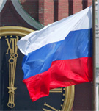
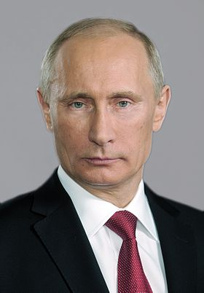
The Russian Federation
The President
In office since : May 7, 2012
Preceded by : Vladimir Putin
Born : October,7,1952
Spouse : Lyudmila
Children : 2 daughters
Mariya Yekaterina
Vladimir Putin

Slide 22
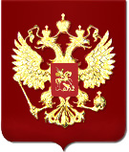
National emblems of Russia
Two-headed eagle- the most ancient symbol of Russia
Three-coloured banner with three horizontal stripes:
White –the earth,
Blue –the sky,
Red - liberty

Slide 23
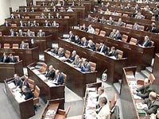
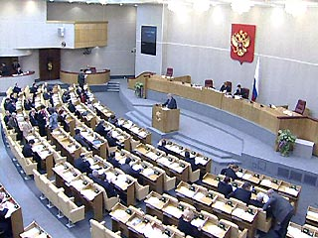
Legislative power
The Federation Council:
2 representatives from each federal subject
The State Duma :
450 deputies

Slide 24
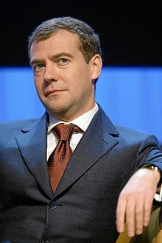
The Government
The Federal Government - the executive power
The Supreme Court – the judicial power
Dmitry Medvedev
The Prime Minister
Born : September, 14, 1965
In office since : May,8,2012

Slide 25
Conclusion
People of different countries live in different political systems
All nations have their historical traditions
Every country has its own state symbols
Every citizen must be a patriot of his country and respect it

